Slide 1
Suggested Solution to Exercise 4: Modelling Requirements for an Information System at a Zoo
Erik Perjons
DSV, Stockholm University

Slide 2
Domain Description
Zoo International is a company with eight zoos in different European cities. Zoo International has specified an introduction process that all zoos should follow. In order to support the introduction process, Zoo International aims to introduce an information system (IS) supporting the process.
As a first step, requirements on the IS have been gathered from different stakeholders. Three of the requirements are as follows:
When an animal arrive at a zoo (which is part of Zoo International) the animal needs to be registered in the IS by one of the zoo adminstrators. The following information must then be registered in the information system by the administator: date of registration, name of the animal, spieces, gender, year of birth
For each animal arriving at the zoo, one of the zoo veterinarian needs to document information in the IS about the medical status of the animal after carrying out a medical investigation
For each animal arriving at the zoo, one of the animal keepers needs to document the result of the meeting between the arrived animal and its ”cage colleagues”

Slide 3
Your Task
Describe the functional requirements of the information system using UML Use Case Diagram, and make Use Case Descriptions for all the use cases

Slide 4
Register animal
Administrator
Document medical status
Veterinarian
Document result from meeting with ”cage colleagues”
Animal keeper

Slide 5
Register animal
Administrator
Document medical status
Veterinarian
Document result from meeting with ”cage colleagues”
Animal keeper

Slide 6
Register animal
Administrator
Use case: Registrer animal
Actor: Administrator
Goal: Animal must be registered at the zoo
Main scenario: 1) Administrator asks for register arrived animal
2) System presents registration form 3) Administrator registers the animal with required info
(date of registration, name of the animal, spieces, gender, year of birth)
4) Systemet confirms registration

Slide 7
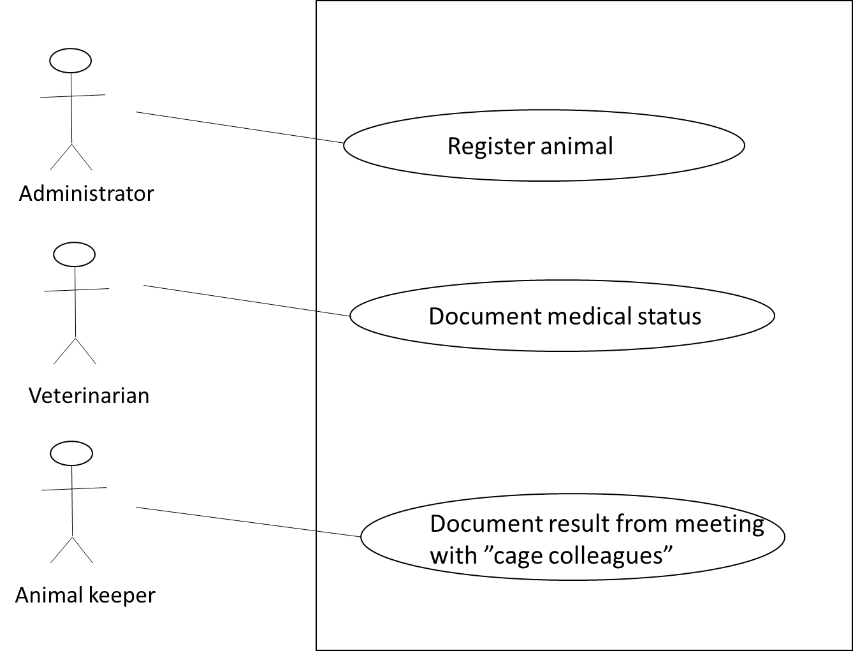
Use case: Registrer animal
Actor: Administrator
Goal: Animal must be registered at the zoo
Main scenario: 1) Administrator asks for register arrived animal
2) System presents registration form 3) Administrator registers the animal wihj required info
(date of registration, name of the animal, spieces, gender, year of birth)
4) Systemet confirms registration
Use case: Document medical status
Actor: Veterinarian
Goal: Medical status of animal must be documented
Main scenario: 1) Veterinarian asks for document the medical status of an animal
2) System presents medical status form 3) Veterinarian documents medical staus and date for medical investigation 4) Systemet confirms documentation
Use case: Document result from meeting with ”cage colleagues”
Actor: Animal keeper
Goal: Result from animal’s meeting with ”cage colleagues” must be documented
Main scenario: 1) Animal keeper asks for document animal meeting with ”cage colleagues”
2) System presents form for document meeting 3) Animal keeper documents result from meeting and date for meeting 4) Systemet confirms documentation

