Slide 1
Software Engineering - a brief introduction
Erik Perjons

Slide 2
Questions to answer
What is software engineering?

Slide 3
Software Engineering

Slide 4
Software Engineering
”Software Engineering is the branch of computer science that seeks principles to guide the development of large complex software systems” (Brookshear, 2008)
Examples of sub-disciplines/sub-branches:
Requirement engineering
Software/System design and development
Software/System testing
Software/System maintenance
...

Slide 5
System development
System (software) development - is the creation/construction of system/software, and it is usually described as a set of phases/activities
Requirement
Requirement engineering – define the requirement of the system (this phase/activity is sometimes called analysis)
Design – define the overall architecture and structure of the system
Implementation – code the functions and build the database system
Test and deploy – test that the implemented system fulfill the requirements, and introduce the system in the organisation and integrate it with processes and other systems
Design
Implementation
Test & Deploy

Slide 6
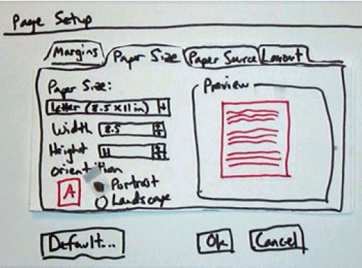
Prototype
There is no agreement on what a prototype is, but it can be seen as an early form of the final system, focusing on certain aspects of it.
The prototype enables the designers to better understand design challenges before developing the final system, and the prototype is also often constructed to obtain early user-feedback

Slide 7
Stakeholders
Stakeholders in software engineering are people or roles that have an interest in a software system, such as users, business analysts, software developers, IT support, managers, executives, owner, etc
Stakeholders need to be involved in the system development, especially in the requirement engineering phase, so that the “right” system is developed

Slide 8
Software Life Cycle
The software life cycle describes the major phases of a software system from development to withdrawal of the system
Since the maintenance (i.e., correcting and updating the software) can be very costly, this phase has to be considered during development: is the system developed so that the correcting and updating of the systemare easy to do?
Software development
Use
Maintenance
Withdrawal

Slide 9
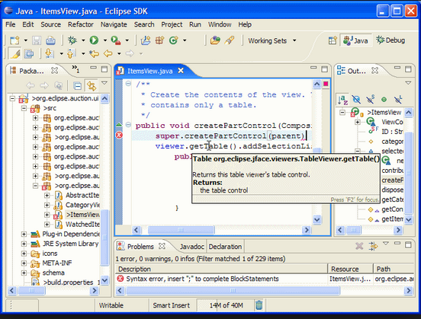
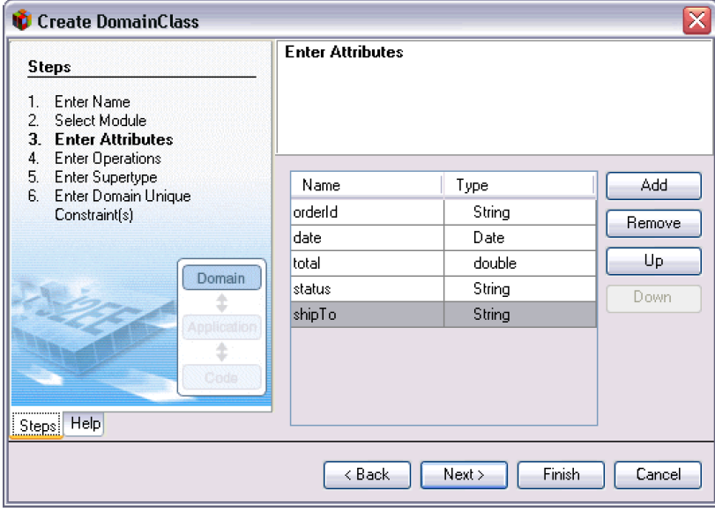
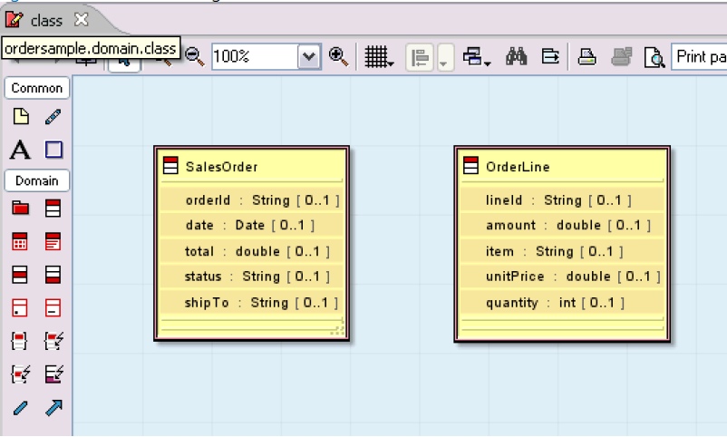
Tool Support for Software Engineering
Integrated development environment (IDE) – is an environment that ”combine tools for developing software (that is, editors, compilers, debugging) into a single, integrated package, some of which provide visual programming features...” (Brookshear, 2008)
An interesting example of an IDE is the Eclipse platform that is an open source environment which provide a number of plug in for different purposes

Slide 10
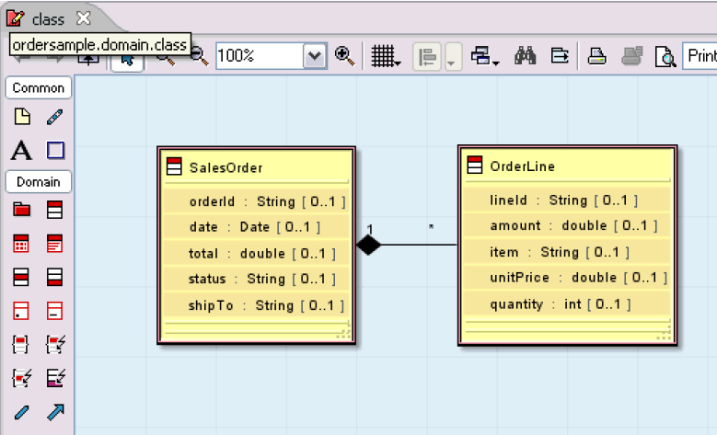
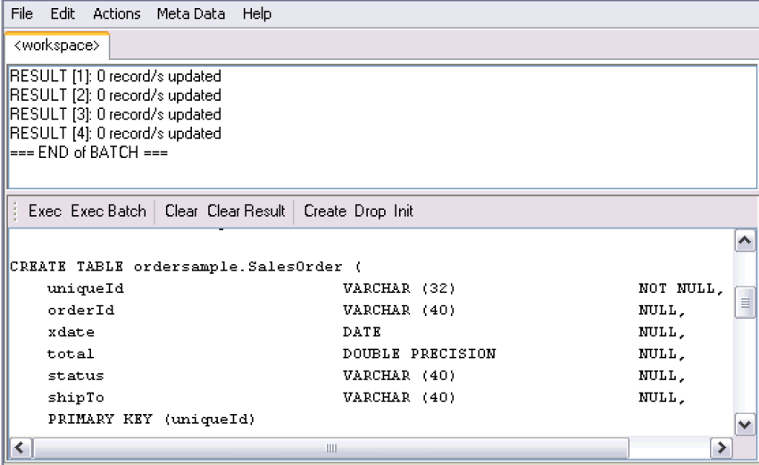
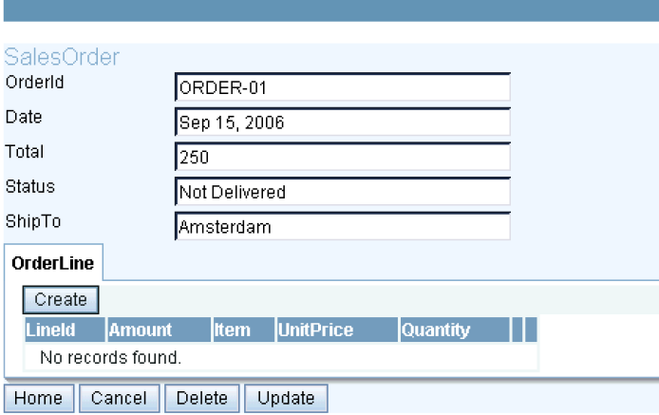
Tool Support for Software Engineering
Modelling tool – is a tool that support graphical modelling of system, including software system, for example UML modelling (like Visio, ArgoUML)
Model-driven development tool (MDD tool) – is a tool that support generation of code and user interface from graphcal models (like Rational Software Architect)
Case tool – "Computer-aided software engineering” – is a tool that support analysis, design och implementation of software – but is sometimes seen as predecessor to IDEs and MDD tools

Slide 11
Questions to answer
What is software engineering?

Slide 12
Erik Perjons – Lärare
Jonas Collin – Mediepedagog
Notes:
Denna sida behövs pga upphovsrätten

