Slide 1
More about Processes Modelling with UML Activity Diagram
SUPCOM
Erik Perjons

Slide 2
Completed example
Initial node
action
AND split
Receive order
flow
Get ordered products
OR split
Update
customer info
Calculate sum for products
condition
[sum> 1000]
activity
[sum<= 1000]
OR join
Calculate delivery cost
AND join
Calculate total sum
Deliver products
activity final

Slide 3
More about UML Activity Diagram

Slide 4
Action vs. Activity
An activity diagram can include both activities and actions
Action is a named element which represents a single atomic step within an activity, that is, an action cannot be further decomposed
Activity represents a behavior that is composed of activities and/or actions
Get ordered products
Calculate sum for products

Slide 5
Action vs. Activity
An activity diagram can include both activities and actions
Action is a named element which represents a single atomic step within an activity, that is, an action cannot be further decomposed
Activity represents a behavior that is composed of activities and/or actions
Get ordered products
Calculate sum for products

Slide 6
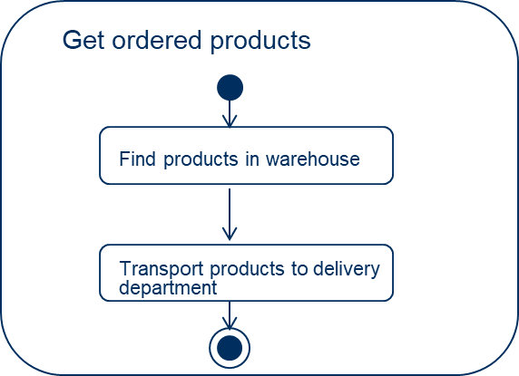
Action vs. Activity
An activity diagram can include both activities and actions
Action is a named element which represents a single atomic step within activity, that is, an action cannot be further decomposed
Activity represents a behavior that is composed of activities and actions
Get ordered products
Calculate sum for products

Slide 7
Action vs. Activity
Activity represents a behavior that is composed of individual elements that are actions and/or activities
activity
activity
Get ordered products
Calculate sum for products

Slide 8
Token
The modelling element "token" is shorthand for control and data values that flow through an activity
A token could represent many things: an specific order, a case, a patient which can flow through an activity

Slide 9
Token
Token is consumed and produced in each actions/activity in the diagrams.
Guideline: Use tokens to see if the activity diagram is modelled correctly

Slide 10
Token
Receive order
Get ordered products
Update
customer info
Calculate sum for products
[sum> 1000]
[sum<= 1000]
Calculate delivery cost
Calculate total sum
Deliver products
Notes:
.

Slide 11
Token
Token in the initial node
Receive order
Get ordered products
Update
customer info
Calculate sum for products
[sum> 1000]
[sum<= 1000]
Calculate delivery cost
Calculate total sum
Deliver products

Slide 12
Token
Receive order
Get ordered products
Update
customer info
Calculate sum for products
[sum> 1000]
[sum<= 1000]
Calculate delivery cost
Calculate total sum
Deliver products

Slide 13
Token
Receive order
Get ordered products
Update
customer info
Calculate sum for products
[sum> 1000]
[sum<= 1000]
Calculate delivery cost
Calculate total sum
Deliver products

Slide 14
Token
Receive order
Get ordered products
Update
customer info
Calculate sum for products
[sum> 1000]
[sum<= 1000]
Calculate delivery cost
Calculate total sum
Deliver products

Slide 15
Token
Receive order
Get ordered products
Update
customer info
Calculate sum for products
[sum> 1000]
[sum<= 1000]
Calculate delivery cost
Calculate total sum
Deliver products

Slide 16
Token
Receive order
Get ordered products
Update
customer info
Calculate sum for products
[sum> 1000]
[sum<= 1000]
Calculate delivery cost
Calculate total sum
Deliver products

Slide 17
Token
Receive order
Get ordered products
Update
customer info
Calculate sum for products
[sum> 1000]
[sum<= 1000]
Calculate delivery cost
Calculate total sum
Deliver products
Notes:
Här har vi nu kompletterat aktivitetsdiagrammet från den första bilden med det vi har lärt oss hittills notationsmässigt, samt ett konkret textgivet exempel.
Vi börjar i startnoden och följer flödena genom aktionsnoderna.
Vi kommer till en förgreningsnod som ger parallella sekvenser av flöden.
Vi kommer till en beslutsnod, med dess villkorade utgående flöden, som så småningom återförs i en samgåendenod.
De parallella sekvenserna av flöden från förgreningen går också de så småningom samman, i föreningsnoden.
Slutligen når vi noden för aktivitetsslut.

Slide 18
Token
Receive order
Get ordered products
Update
customer info
Calculate sum for products
[sum> 1000]
[sum<= 1000]
Calculate delivery cost
Calculate total sum
Deliver products
Token in the activity final

Slide 19
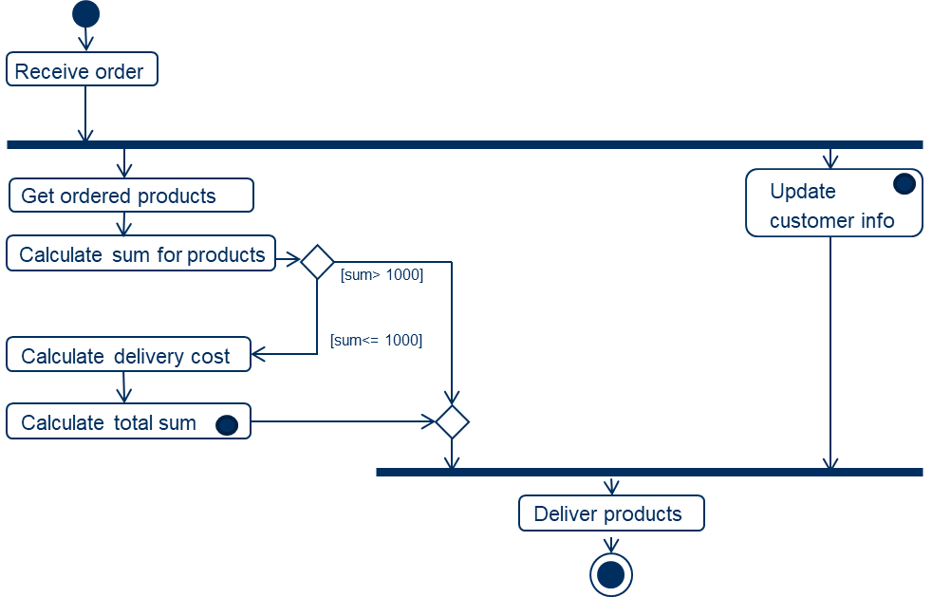
Process instance revisited
A token could make the concept of process instance more understandable
The token can be used for describing the performance of a certain process instance

Slide 20
Process instance revisited
Another way to describe a process instance could be by showing the order of actions and activties carried out by the instance, and which date and time they were carried out, as well as other data related to the process instance, see figure right
date: 2020-08-21; timeInterwall: 10:22:22 – 10:24:16; orderNo: 44669392; name: Anna Anderssson, kundNo: 22354; productID: 33939, 6666
Receive order
Update customer info
date: 2020-08-21; timeInterwall: 10:48:11 – 11:01:36
Calculate sum for products
date: 2020-08-21; timeInterwall: 11:09:22 – 12:07:21,
Sum: 5 000
Calculate delivery cost
Not carried out
Calculate total sum
Not carried out
Deliver products
date: 2020-08-21; timeInterwall: 14:28:56 – 15:01:23

Slide 21
Swimlanes/Lanes/Partitions
Order handling department
Delivery department
Sales & Marketing department
Receive order
Get ordered products
Update
customer info
Calculate sum for products
[sum> 1000]
[sum<= 1000]
Calculate delivery cost
Calculate total sum
Deliver products

Slide 22
Swimlanes/Lanes/Partitions
Order handling department
Delivery department
Sales & Marketing department
Receive order
Swimlanes/
Lanes/ Partitions
Get ordered products
Update
customer info
Calculate sum for products
[sum> 1000]
[sum<= 1000]
Pool
Calculate delivery cost
Calculate total sum
Note, the terms Swimlane. Lane and Pool are not used in UML Activity Diagram but in other modelling languages. UML use the term Partition
Deliver products

Slide 23
Swimlanes/Lanes Partitions
Order handling department
Delivery department
Sales & Marketing department
Performer
Receive order
Get ordered products
Update
customer info
Calculate sum for products
[sum> 1000]
[sum<= 1000]
Calculate delivery cost
Calculate total sum
Deliver products

Slide 24
Swimlanes/Lanes Partitions
Order handling department
Delivery department
Sales & Marketing department
Responsible
Receive order
Get ordered products
Update
customer info
Calculate sum for products
[sum> 1000]
[sum<= 1000]
Calculate delivery cost
Calculate total sum
Deliver products
Notes:
Här har vi nu kompletterat aktivitetsdiagrammet från den första bilden med det vi har lärt oss hittills notationsmässigt, samt ett konkret textgivet exempel.
Vi börjar i startnoden och följer flödena genom aktionsnoderna.
Vi kommer till en förgreningsnod som ger parallella sekvenser av flöden.
Vi kommer till en beslutsnod, med dess villkorade utgående flöden, som så småningom återförs i en samgåendenod.
De parallella sekvenserna av flöden från förgreningen går också de så småningom samman, i föreningsnoden.
Slutligen når vi noden för aktivitetsslut.

