Slide 1
Conceptual and Requirement Modelling using Unified Modelling Language (UML)
- with solutions
Erik Perjons
DSV, Stockholm University
perjons@dsv.su.se

Slide 2
Enterprise and System Models

Slide 3
Real World and Models
Business process model
of business activities
(in UML Activity diagram)
Domain model of business concepts
(in UML Class
diagram)
Human interaction with software systam
(in UML Use cases)
Interaction between software
objekts
(in UML Sequence
diagram)
System model of software objects (in UML Class
diagram)
The real world
Graphical models/diagram

Slide 4
Real World and Models
Business process model
of business activities
(in UML Activity diagram)
Domain model of business concepts
(in UML Class
diagram)
Human interaction with software systam
(in UML Use cases)
Interaction between software
objekts
(in UML Sequence
diagram)
System model of software objects (in UML Class
diagram)
The real world
Graphical models/diagram

Slide 5
Real World and Models
Business process model
of business activities
(in UML Activity diagram)
Domain model of business concepts
(in UML Class
diagram)
Human interaction with software systam
(in UML Use cases)
Interaction between software
objekts
(in UML Sequence
diagram)
System model of software objects (in UML Class
diagram)
The real world
Graphical models/diagram

Slide 6
Real World and Models
Business process model
of business activities
(in UML Activity diagram)
Domain model of business concepts
(in UML Class
diagram)
Human interaction with software systam
(in UML Use cases)
Interaction between software
objekts
(in UML Sequence
diagram)
System model of software objects (in UML Class
diagram)
The real world
Graphical models/diagram

Slide 7
Real World and Models
Business process model
of business activities
(in UML Activity diagram)
Domain model of business concepts
(in UML Class
diagram)
Human interaction with software systam
(in UML Use cases)
Interaction between software
objekts
(in UML Sequence
diagram)
System model of software objects (in UML Class
diagram)
The real world
Graphical models/diagram

Slide 8
Real World and Models
Business process model
of business activities
(in UML Activity diagram)
Domain model of business concepts
(in UML Class
diagram)
Human interaction with software systam
(in UML Use cases)
Interaction between software
objekts
(in UML Sequence
diagram)
System model of software objects (in UML Class
diagram)
The real world
Graphical models/diagram

Slide 9
Real World and Models
Business process model
of business activities
(in UML Activity diagram)
Domain model of business concepts
(in UML Class
diagram)
Human interaction with software systam
(in UML Use cases)
Interaction between software
objekts
(in UML Sequence
diagram)
System model of software objects (in UML Class
diagram)
The real world
Graphical models/diagram

Slide 10
Real World and Models
Business process model
of business activities
(in UML Activity diagram)
Domain model of business concepts
(in UML Class
diagram)
Human interaction with software systam
(in UML Use cases)
Interaction between software
objekts
(in UML Sequence
diagram)
System model of software objects (in UML Class
diagram)
The real world
Graphical models/diagram

Slide 11
Real World and Models
Business process model
of business activities
(in UML Activity diagram)
Domain model of business concepts
(in UML Class
diagram)
Human interaction with software systam
(in UML Use cases)
Interaction between software
objekts
(in UML Sequence
diagram)
System model of software objects (in UML Class
diagram)
The real world
Graphical models/diagram

Slide 12
Enterprise and System Models
Enterprise models/ Business models
System models

Slide 13
Why enterprise models?
Enterprise models are useful for:
analyzing business processes and business concepts
designing more efficient business processes
designing a common conceptual base for the organization
providing requirements on software system solutions

Slide 14
Why system models?
System models are useful tools for:
analysing software systems
designing software systems that are align with the business processes
designing software systems using a model driven approach

Slide 15
Static and Dynamic Models
Static/Structural models
represent static aspects of the real world/system
more precisely: which objects exists and their relationships
answer the question: “What things exist?
Dynamic/Behavioural models
represent dynamic aspects of the real world/system
more precisely: how does objects and their relationships change
answer the questions: “How does the things change”

Slide 16
Modelling Language
Static/Structural model
Abstract Syntax – define the language’s central concept, usually in form of a metamodel
Concrete Syntax – describe which symbols the language consists of and how they look like, called the notation
using
represented by
Dynamic/Behavoural model
consists of
using

Slide 17
Unified Modelling Language (UML) is a general-purpose modelling language/technique which is designed to provide a standard way to visualize the design of a software system - but the language can also be used for enterprise modelling Maintained by Object Management Group (OMG)
UML

Slide 18
UML diagrams
UML 2.0 has 13 diagram types, which each provide a certain focus/perspective on a model. According to UML there is one model of a system, and the different diagrams provide different perspectives of
that model
Structure diagram (6)
Class diagram
Diagrams (13)
Activity diagram
Behaviour diagram (7)
Use Case
Sequence diagram
State machine diag.

Slide 19
UML Class Diagram

Slide 20
Real World and Models
Business process model
of business activities
(in UML Activity diagram)
Domain model of business concepts
(in UML Class
diagram)
Human interaction with software systam
(in UML Use cases)
Interaction between software
objekts
(in UML Sequence
diagram)
System model of software objects (in UML Class
diagram)
The real world
Graphical models/diagram

Slide 21
Class
A class is shown as a rectangle with three compartments:
name of the class (use a noun in singular, first letter capital)
attribute(s) (use a noun in singular for each atttribute, first letter lower case)
operation(s) (use a verb, first letter lower case)
Student
Name
studentNo
name
mobileNo
Attribute
registerForCourse()
Operation

Slide 22
Class
The class can be shown in three different variants
We will use the variant in the middle showing the name of the class and the attributes
Student
Student
Student
studentNo
name
mobileNo
studentNo
name
mobileNo
registerForCourse()

Slide 23
Class
A class groups a set of things with common properties or characteristics
Student
studentNo
name
mobileNo

Slide 24
Class
A class groups a set of things with common properties or characteristics
An attribute is a descriptive property or characteristic of the class
Student
studentNo
name
mobileNo

Slide 25
Class
A class groups a set of things with common properties or characteristics
An attribute is a descriptive property or characteristic of the class
Student
studentNo
name
mobileNo

Slide 26
Association
Association is shown as a line between classes
In order to support interpretation of the association, it should be given a name – preferably in form of a verb or verb phrase – and it should also be visualized in which direction the name should be read
Name of the association
Student
Course
registered at
studentNo
name
mobileNo
courseNo
courseName
Association

Slide 27
Association
Association has two directions – one from Student to Course and one from Course to Student
Student
Course
registered at
studentNo
name
mobileNo
courseNo
courseName

Slide 28
Association
Only the name of the association in one direction is usually shown, but there is possible to use names in both direction
Student
Course
registered at
studentNo
name
mobileNo
courseNo
courseName
has registered

Slide 29
Association
Association shows the roles the objects of the classes can plays towards each other
There is a role in each direction of the association:
Student plays the role of being registered at course(s)
Course plays the role of having registered student(s)
Student
Course
registered at
studentNo
name
mobileNo
courseNo
courseName

Slide 30
Association
It is possible to specify that an association only has one direction by introducing a navigation arrow
Student
Course
registered at
studentNo
name
mobileNo
courseNo
courseName
Association in form of a Navigation arrow

Slide 31
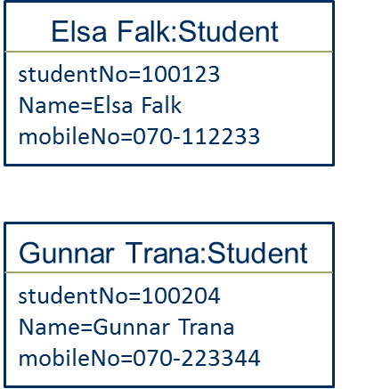
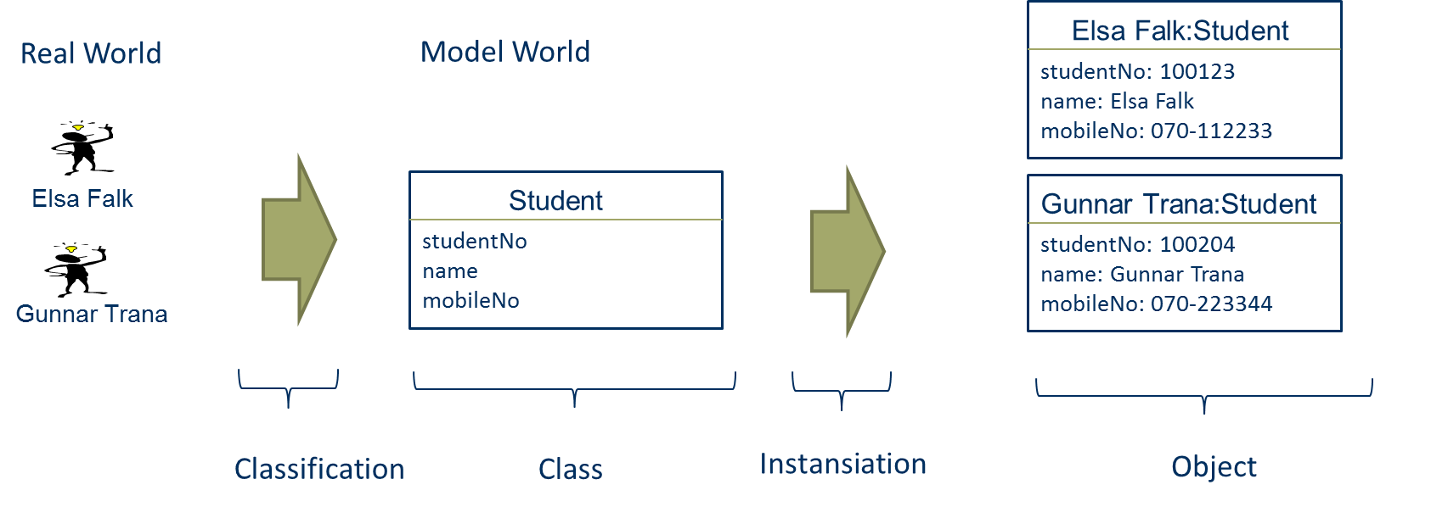
Modelling Class and Objects
Instantiation

Slide 32
Class and Association Structure
A class and association structure can be seen an information structure, constraining what objects and links are possible to create/instantiate
Student
Course
studentNo
name
mobileNo
registers for
CourseNo
CourseName
Class
Association
Class

Slide 33
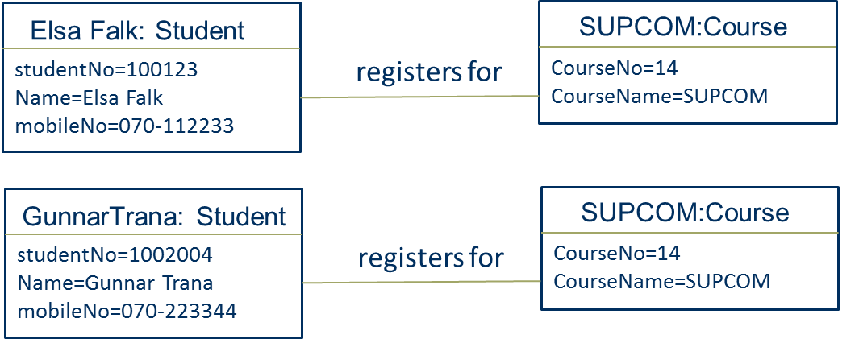
Creating Object and Link structures
Class and association structures
Object and link structures
registers for

Slide 34
Object and Link structures
Object and link structures are usually not modelled, but could be:
Elsa Falk: Student
SUPCOM:Course
studentNo=100123
Name=Elsa Falk
mobileNo=070-112233
registers for
CourseNo=14
CourseName=SUPCOM
Object
Link
Object

Slide 35
Multiplicity
Multiplicity describes how many objects (minimum and maximum) of a class that can be linked to objects of an other class – in both directions of the association
Minimum can be 0 (”cero”) eller 1 (”one”)
Maximum can be 1 (”one”) or * (”many”)
Customer
Order
1..1
0..*
customerNo
name
emailAddress
placed
orderNo
totalSum

Slide 36
Multiplicity
Multiplicity describes how many objects (minimum and maximum) of a class that can be linked to objects of an other class – in both directions of the association
Minimum can be 0 (”cero”) eller 1 (”one”)
Maximum can be 1 (”one”) or * (”many”)
Multiplicity with min and max value
Customer
Order
1..1
0..*
customerNo
name
emailAddress
placed
orderNo
totalSum

Slide 37
Multiplicitet
Association
Customer
placed
Order
customerNo
name
eMailAddress
0..*
orderNo
totalSum
Class
1..1
:Customer
:Order
customerNo=223344
name=Anna Lönn
eMailAddress=lonn@hotmail
orderNo=9945361
totalSum=5124SEK
:Customer
:Order
Object
customerNo=112233
name:=Zlatan”
eMailAddress=z@hotmail
orderNo=9945362
totalSum=402SEK
Link
Notes:
Vi förtydligar multiplicitet hos associationer ytterligare. Högst upp i bilden syns det bekanta klassdiagrammet, men nu med enbart klassnamnen utritade.
Under klassdiagrammet för vi nu in ett objektdiagram för detta klassdiagram, motsvarande någon viss punkt i tiden. I objektdiagrammet finns tre studenter, tre registreringar och tre kurser. Studenterna är Anna, Nils och Tove. Registreringarna benämns 9, 2 och 6, respektive. De tre kurserna är oop, oos och jök.
Om vi tittar från vänster i bilden ser vi att studenten Anna har en association till registreringen 9.
Studenten Nils har en association till registreringen 2,
och dessutom en till registreringen 6.
Tittar vi nu från höger i bilden ser vi att kursen oop har en association till registreringen 6.
Kursen oos har en association till registreringen 9,
och dessutom en till registreringen 2.
Om vi nu granskar bilden, kan vi då säga att klassdiagrammets associationer med multiplicitet, och de faktiska associationerna mellan objekten i objektdiagrammet inte motsäger varandra? Ja, det kan vi.
Om vi börjar med studenterna ser vi att Anna har en registrering, Nils har två registreringar, och Tove saknar registreringar. Detta stämmer ju helt överens med klassdiagrammet, som säger att en student kan ha mellan noll och obegränsat antal registreringar.
Nu tittar vi på kurserna. Vi ser att oop har en registrering, oos har två registreringar, och att jök saknar registreringar. Även detta stämmer med klassdiagrammet; en kurs kan ha mellan noll och obegränsat antal registreringar.
Så till registreringarna. Enligt klassdiagrammet ska varje registrering ha en, och endast en, student. Dessutom ska varje registrering ha en, och endast en, kurs. Detta stämmer. Registreringen 9 associeras till studenten Anna och till kursen oos. Registreringen 2 associeras till studenten Nils och till kursen oos. Slutligen associeras registreringen 6 till studenten Nils och kursen oop.

Slide 38
Multiplicity
Multiplicy in the direction from Customer to Order: An object of a class Customer can minimum be linked to 0 and maximum to many
Multiplicy in the direction from Order to Customer: An object of a class Customer can minimum be linked to 1 and maximum to 1, that is, exactly one
Customer
placed
Order
customerNo
name
emailAddress
orderNo
totalSum
1..1
0..*

Slide 39
Multiplicity
A guideline to use for helping you deciding multiplicity:
Use the phase: ”One object of Customer is linked to minimum {zero or one} and maximum {one or many} object(s) of Order”, and (in the other direction): ”One object of Order is linked to minimum {zero or one} and maximum {one or many} object(s) of Customer”
Customer
Order
placed
customerNo
name
emailAddress
orderNo
totalSum
1..1
0..*

Slide 40
Multiplicity Exercise
Your task: Find the violation of multiplicity rules and correct the multiplicity
Owner
nationalIdNo
1..*
Car
licenceNo
1..1
:Owner
nationalIdNo =“771134”
:Car
licenceNo=UML123
:Owner
nationalIdNo=“871211”
:Car
licenceNo=OMG234
:Owner
nationalIdNo=891223”
:Car
licenceNo=MDA345
Notes:
Vi förtydligar multiplicitet hos associationer ytterligare. Högst upp i bilden syns det bekanta klassdiagrammet, men nu med enbart klassnamnen utritade.
Under klassdiagrammet för vi nu in ett objektdiagram för detta klassdiagram, motsvarande någon viss punkt i tiden. I objektdiagrammet finns tre studenter, tre registreringar och tre kurser. Studenterna är Anna, Nils och Tove. Registreringarna benämns 9, 2 och 6, respektive. De tre kurserna är oop, oos och jök.
Om vi tittar från vänster i bilden ser vi att studenten Anna har en association till registreringen 9.
Studenten Nils har en association till registreringen 2,
och dessutom en till registreringen 6.
Tittar vi nu från höger i bilden ser vi att kursen oop har en association till registreringen 6.
Kursen oos har en association till registreringen 9,
och dessutom en till registreringen 2.
Om vi nu granskar bilden, kan vi då säga att klassdiagrammets associationer med multiplicitet, och de faktiska associationerna mellan objekten i objektdiagrammet inte motsäger varandra? Ja, det kan vi.
Om vi börjar med studenterna ser vi att Anna har en registrering, Nils har två registreringar, och Tove saknar registreringar. Detta stämmer ju helt överens med klassdiagrammet, som säger att en student kan ha mellan noll och obegränsat antal registreringar.
Nu tittar vi på kurserna. Vi ser att oop har en registrering, oos har två registreringar, och att jök saknar registreringar. Även detta stämmer med klassdiagrammet; en kurs kan ha mellan noll och obegränsat antal registreringar.
Så till registreringarna. Enligt klassdiagrammet ska varje registrering ha en, och endast en, student. Dessutom ska varje registrering ha en, och endast en, kurs. Detta stämmer. Registreringen 9 associeras till studenten Anna och till kursen oos. Registreringen 2 associeras till studenten Nils och till kursen oos. Slutligen associeras registreringen 6 till studenten Nils och kursen oop.

Slide 41
Multiplicity Exercise
Your task: Find the violation of multiplicity rules and correct the multiplicity
Owner
nationalIdNo
1..*
Car
licenceNo
1..1
:Owner
nationalIdNo =“771134”
:Car
licenceNo=UML123
:Owner
nationalIdNo=“871211”
:Car
licenceNo=OMG234
:Owner
nationalIdNo=891223”
:Car
licenceNo=MDA345
Notes:
Vi förtydligar multiplicitet hos associationer ytterligare. Högst upp i bilden syns det bekanta klassdiagrammet, men nu med enbart klassnamnen utritade.
Under klassdiagrammet för vi nu in ett objektdiagram för detta klassdiagram, motsvarande någon viss punkt i tiden. I objektdiagrammet finns tre studenter, tre registreringar och tre kurser. Studenterna är Anna, Nils och Tove. Registreringarna benämns 9, 2 och 6, respektive. De tre kurserna är oop, oos och jök.
Om vi tittar från vänster i bilden ser vi att studenten Anna har en association till registreringen 9.
Studenten Nils har en association till registreringen 2,
och dessutom en till registreringen 6.
Tittar vi nu från höger i bilden ser vi att kursen oop har en association till registreringen 6.
Kursen oos har en association till registreringen 9,
och dessutom en till registreringen 2.
Om vi nu granskar bilden, kan vi då säga att klassdiagrammets associationer med multiplicitet, och de faktiska associationerna mellan objekten i objektdiagrammet inte motsäger varandra? Ja, det kan vi.
Om vi börjar med studenterna ser vi att Anna har en registrering, Nils har två registreringar, och Tove saknar registreringar. Detta stämmer ju helt överens med klassdiagrammet, som säger att en student kan ha mellan noll och obegränsat antal registreringar.
Nu tittar vi på kurserna. Vi ser att oop har en registrering, oos har två registreringar, och att jök saknar registreringar. Även detta stämmer med klassdiagrammet; en kurs kan ha mellan noll och obegränsat antal registreringar.
Så till registreringarna. Enligt klassdiagrammet ska varje registrering ha en, och endast en, student. Dessutom ska varje registrering ha en, och endast en, kurs. Detta stämmer. Registreringen 9 associeras till studenten Anna och till kursen oos. Registreringen 2 associeras till studenten Nils och till kursen oos. Slutligen associeras registreringen 6 till studenten Nils och kursen oop.

Slide 42
Multiplicity Exercise
Your task: Find the violation of multiplicity rules and correct the multiplicity
Owner
nationalIdNo
0..*
Car
licenceNo
0..*
:Owner
nationalIdNo =“771134”
:Car
licenceNo=UML123
:Owner
nationalIdNo=“871211”
:Car
licenceNo=OMG234
:Owner
nationalIdNo=891223”
:Car
licenceNo=MDA345
Notes:
Vi förtydligar multiplicitet hos associationer ytterligare. Högst upp i bilden syns det bekanta klassdiagrammet, men nu med enbart klassnamnen utritade.
Under klassdiagrammet för vi nu in ett objektdiagram för detta klassdiagram, motsvarande någon viss punkt i tiden. I objektdiagrammet finns tre studenter, tre registreringar och tre kurser. Studenterna är Anna, Nils och Tove. Registreringarna benämns 9, 2 och 6, respektive. De tre kurserna är oop, oos och jök.
Om vi tittar från vänster i bilden ser vi att studenten Anna har en association till registreringen 9.
Studenten Nils har en association till registreringen 2,
och dessutom en till registreringen 6.
Tittar vi nu från höger i bilden ser vi att kursen oop har en association till registreringen 6.
Kursen oos har en association till registreringen 9,
och dessutom en till registreringen 2.
Om vi nu granskar bilden, kan vi då säga att klassdiagrammets associationer med multiplicitet, och de faktiska associationerna mellan objekten i objektdiagrammet inte motsäger varandra? Ja, det kan vi.
Om vi börjar med studenterna ser vi att Anna har en registrering, Nils har två registreringar, och Tove saknar registreringar. Detta stämmer ju helt överens med klassdiagrammet, som säger att en student kan ha mellan noll och obegränsat antal registreringar.
Nu tittar vi på kurserna. Vi ser att oop har en registrering, oos har två registreringar, och att jök saknar registreringar. Även detta stämmer med klassdiagrammet; en kurs kan ha mellan noll och obegränsat antal registreringar.
Så till registreringarna. Enligt klassdiagrammet ska varje registrering ha en, och endast en, student. Dessutom ska varje registrering ha en, och endast en, kurs. Detta stämmer. Registreringen 9 associeras till studenten Anna och till kursen oos. Registreringen 2 associeras till studenten Nils och till kursen oos. Slutligen associeras registreringen 6 till studenten Nils och kursen oop.

Slide 43
Multiplicity
Commonly, multiplicity described business rules in the organization (for example, a order must be placed by exactly one customer)

Slide 44
Modelling Generalization in UML
Student
Student
studentNumber
name
address
studentNumber
Person
name
address
Teacher
name
address
teacherID
Teacher
teacherID

Slide 45
Modelling Generalization in UML
Student
studentNumber
Person
name
address
ComputerTeacher
Teacher
teacherID
MathTeacher

Slide 46
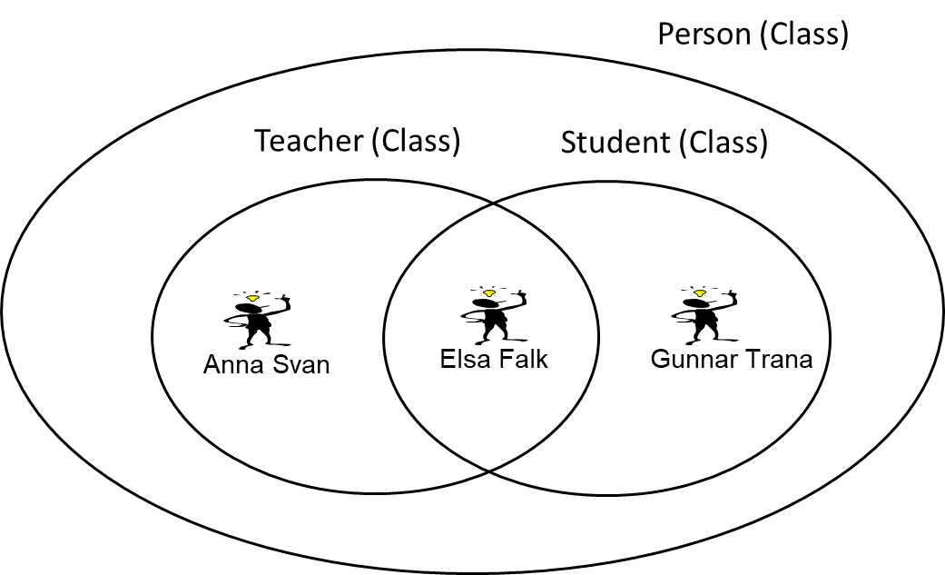
Modelling generalization in UML
Student
Subclass
Person
Superclass
Teacher
Subclass
Real World
The Model World

Slide 47
Generalization
Generalizering are grouping of classes, where classes totally include others
The opposite to generalization is specialization
Person is a generalization of Woman and Student
Woman and Student are specializations of Person

Slide 48
Domain description
This is a domain description of small university library in Sweden
For each borrower, the library needs to have information of national ID Number (called personal number in Sweden), name, address and library card number
For each employed librarian, the library needs to have national ID Number (called personal number in Sweden), name, address, library card number and employee number
A borrower can borrow books. For each loan, the library needs to know which book copy the loan concerns, date of the loan, the date when the copy needs be returned. For each loan, a librarian needs to confirm the loan
For each book title the library needs to have information about: author, title, publisher, ISBN, and what category it belongs to. Regarding copies of books, the library needs to have information of the date of purchase of the copy and which copy number the book has (this number is provided by the library directly after purchase). This copy number is used to identify individual copies of a book, because popular books have several copies

Slide 49
BookTitle
title
author
publisher
isbn
category
Person
1..1
name
address
nationalIDNumber
libraryCardNo
is item of
1..*
Borrower
Librarian
BookCopy
employeeNo
copyNo
purchaseDate
1..1
1..1
0..*
confirmed_by
1..1
BookLoan
made by
0..*
loanDate
plannedReturnDate
returned (Y/N)
0..*
concerns

Slide 50
Requirement Engineering and Use Cases

Slide 51
Requirement
Requirement is a desirable property/feature/attribute/quality/capacity of a system

Slide 52
Requirement Engineering
Requirement Engineering is the process of gathering, defining, organizing, prioritizing, documenting, quality assuring and maintaining requirements

Slide 53
Requirement
Requirements can be categorized into:
Functional requirements
Non-functional requirements

Slide 54
Functional Requirement
Functional requirements – are functions that a system should perform.
A functional requirement - is something that a system should do based on an active action from a user

Slide 55
Functional Requirement
Examples of functional requirements:
The sytem should be able to register an order
The sytem should be able to register an new customer
The system should be able to find a customer when searching after a registered customer in the system by using customer id or customer name

Slide 56
Non-functional Requirement
Non-functional requirements – are requirements of how a system should perform the functions of the system
Non-functional requirement are related to qualities of the system, such as performance, reliability, usability, security, platform constraints

Slide 57
Non-functional Requirement
Examples of non-functional requirements:
The system must be able to handle 100 orders in parallel
The system must be able to integrate with systems in a Microsoft platform

Slide 58
Requirement Specification
Requirement specification is a document specifying the requirements of a system.
The core of the requirement specification is, therefore, to specify the functional and non-functional requirements

Slide 59
Requirement Specification
Usually the requirement specification also describe the context of the requirements, such as which business problems should be addressed by the system and/or the business processes that should be supported by the system

Slide 60
Why Requirement Engineering?
The major reason for failure in system development is shortcoming in requirement engineering, such as:
no requirements have been gathered at all
not all users (or other stakeholders) have been involved in the requirement gathering
the requirements are vaguely stated
users do not know what they want before they use the system in actual business process instances

Slide 61
Why Requirement Engineering?
The requirements are central in the development of a system and are often the things that drive the development process

Slide 62
Why Requirement Engineering?
However, the traditional way of handling requirements – using the waterfall principle - has been heavily critizised

Slide 63
Waterfall Principle
Waterfall principle is based on the idea that all requirements should be defined before the overall design of the system is started.
Requirement
Design
Implementation
Test & Deploy

Slide 64
Waterfall Principle Evaluated
Drawback of Waterfall principle:
many systems developed using the waterfall principle are not successful, mainly due to limited customer feedback during the project
problem to handle changed requirments during development
often results in extensive production of documents that are not used (i.e. easily become bureaucratic)

Slide 65
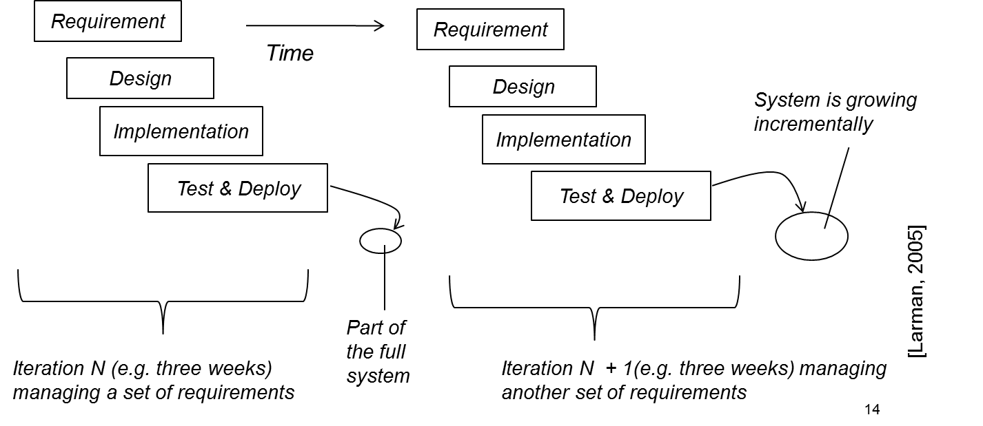
Iteration Principle
Iteration principle is based on the idea that a system should be developed in a set of mini project. Each miniproject, called an iteration, involve a limited set of requirements, which are designed, implemented and deployed to receive early user feedback

Slide 66
Agile Methods
Agile methods are a group of iterative system development methods that share a set of values and principles that should govern the system development – presented in the Agile Manifesto
Agiles methods also provide a set of practices to use for supporting the values and principles, for example pair programming and time boxing
Most well-known agile methods are: eXtreme Programming (XP), Scrum, Crystal, Lean Software Development

Slide 67
Requirement Specification and Models
The requirement specification can consist of only text or both text and models:
Functional requirements can be listed in form of text or as a combination of diagram and text (e.g. UML Use Case Diagram and Use Case Description)
The context of the requitements can be be described in form of text and/or models, e.g. business process models

Slide 68
UML Use Case

Slide 69
UML Use Case Diagram
Registrer
for course
Register
for exam

Slide 70
UML Use Case Diagram
Actor
Use Case
Registrer
for course
Register
for exam
Association

Slide 71
Use Case Description
Use case description describe the interaction between a user and the system
The look of the use case description is not specified in UML
Use case: Registrer for course
Actor: Student
Goal: Student shall be registered for the course
Main scenario: 1) Student wants to see available courses
2) System presents the cources 3) Student chooses a course
4) Systemet confirms registration of the chosen course

Slide 72
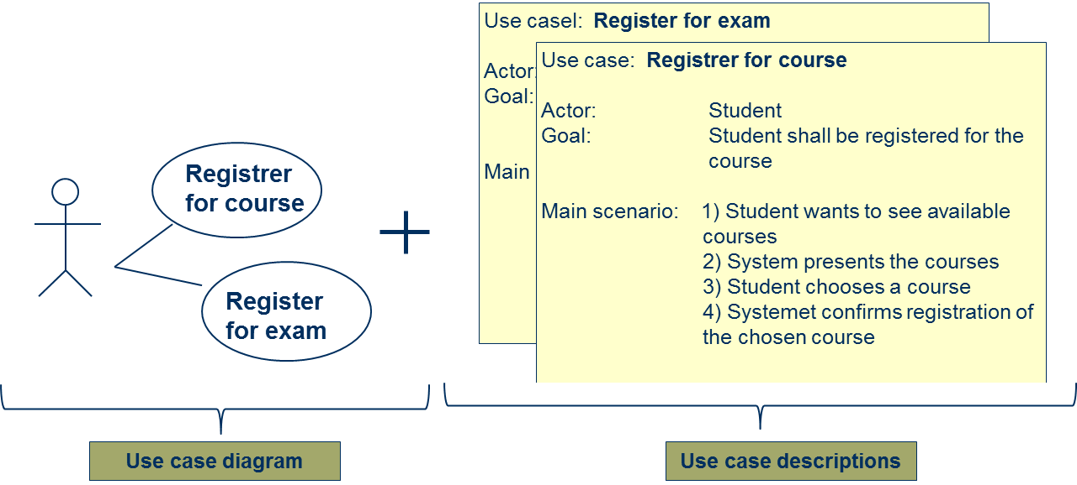
Use Case Model
Use case model – consists of Use case diagram and Use case descriptions

Slide 73
Guidelines for the Use Case Model
Guideline: Create one Use case description for each use case in the Use case diagram
Guideline: Use the same name of the use case in the descrption as in the use case diagram

Slide 74
More about Use Case Description
Guideline: The main scenario shall be divided into a set of steps, which each need to:
start with who is carrying out the step (the actor or the system)
be simple and precise statements of what are communicated between the actor and the system
Use case: Registrer for course
Actor: Student
Goal: Student shall be registered for the course
Main scenario: 1) Student wants to see available courses
2) System presents the cources 3) Student chooses a course
4) Systemet confirms registration of the chosen course

Slide 75
Domain Description
Zoo International is a company with eight zoos in different European cities. Zoo International has specified an introduction process that all zoos should follow. In order to support the introduction process, Zoo International aims to introduce an information system (IS) supporting the process.
As a first step, requirements on the IS have been gathered from different stakeholders. Three of the requirements are as follows:
When an animal arrive at a zoo (which is part of Zoo International) the animal needs to be registered in the IS by one of the zoo adminstrators. The following information must then be registered in the information system by the administator: date of registration, name of the animal, spieces, gender, year of birth
For each animal arriving at the zoo, one of the zoo veterinarian needs to document information in the IS about the medical status of the animal after carrying out a medical investigation
For each animal arriving at the zoo, one of the animal keepers needs to document the result of the meeting between the arrived animal and its ”cage colleagues”

Slide 76
Register animal
Administrator
Document medical status
Veterinarian
Document result from meeting with ”cage colleagues”
Animal keeper

Slide 77
Register animal
Administrator
Document medical status
Veterinarian
Document result from meeting with ”cage colleagues”
Animal keeper

Slide 78
Register animal
Administrator
Use case: Registrer animal
Actor: Administrator
Goal: Animal must be registered at the zoo
Main scenario: 1) Administrator asks for register arrived animal
2) System presents registration form 3) Administrator registers the animal with required info
(date of registration, name of the animal, spieces, gender, year of birth)
4) Systemet confirms registration

Slide 79
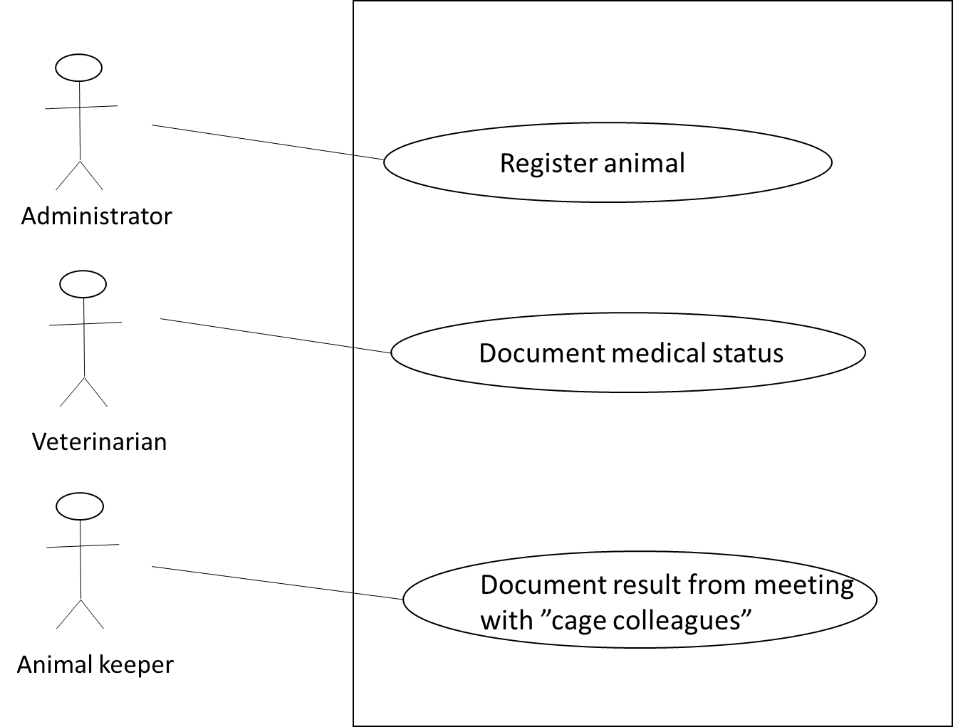
Use case: Registrer animal
Actor: Administrator
Goal: Animal must be registered at the zoo
Main scenario: 1) Administrator asks for register arrived animal
2) System presents registration form 3) Administrator registers the animal wihj required info
(date of registration, name of the animal, spieces, gender, year of birth)
4) Systemet confirms registration
Use case: Document medical status
Actor: Veterinarian
Goal: Medical status of animal must be documented
Main scenario: 1) Veterinarian asks for document the medical status of an animal
2) System presents medical status form 3) Veterinarian documents medical staus and date for medical investigation 4) Systemet confirms documentation
Use case: Document result from meeting with ”cage colleagues”
Actor: Animal keeper
Goal: Result from animal’s meeting with ”cage colleagues” must be documented
Main scenario: 1) Animal keeper asks for document animal meeting with ”cage colleagues”
2) System presents form for document meeting 3) Animal keeper documents result from meeting and date for meeting 4) Systemet confirms documentation

Slide 80
Other types of UML diagram

Slide 81
Real World and Models
Business process model
of business activities
(in UML Activity diagram)
Domain model of business concepts
(in UML Class
diagram)
Human interaction with software systam
(in UML Use cases)
Interaction between software
objekts
(in UML Sequence
diagram)
System model of software objects (in UML Class
diagram)
The real world
Graphical models/diagram

Slide 82
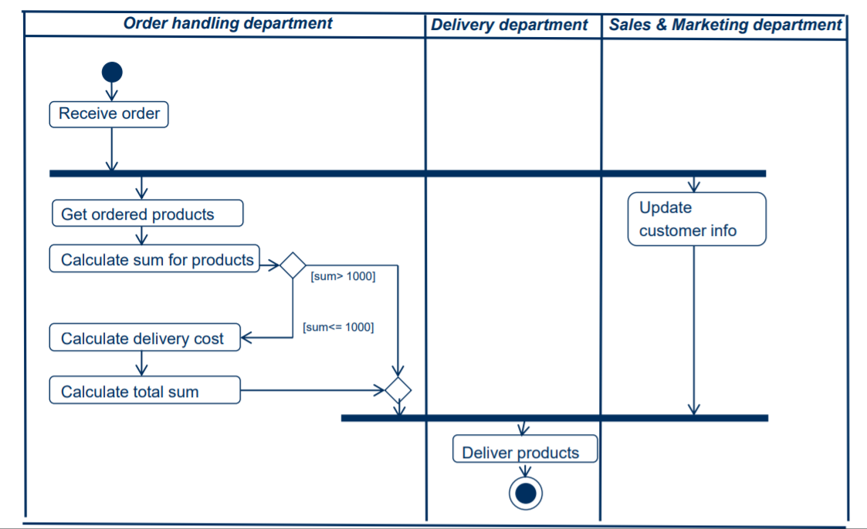
Activity diagram

Slide 83
Real World and Models
Business process model
of business activities
(in UML Activity diagram)
Domain model of business concepts
(in UML Class
diagram)
Human interaction with software systam
(in UML Use cases)
Interaction between software
objekts
(in UML Sequence
diagram)
System model of software objects (in UML Class
diagram)
The real world
Graphical models/diagram

Slide 84
Sequence diagram

Slide 85
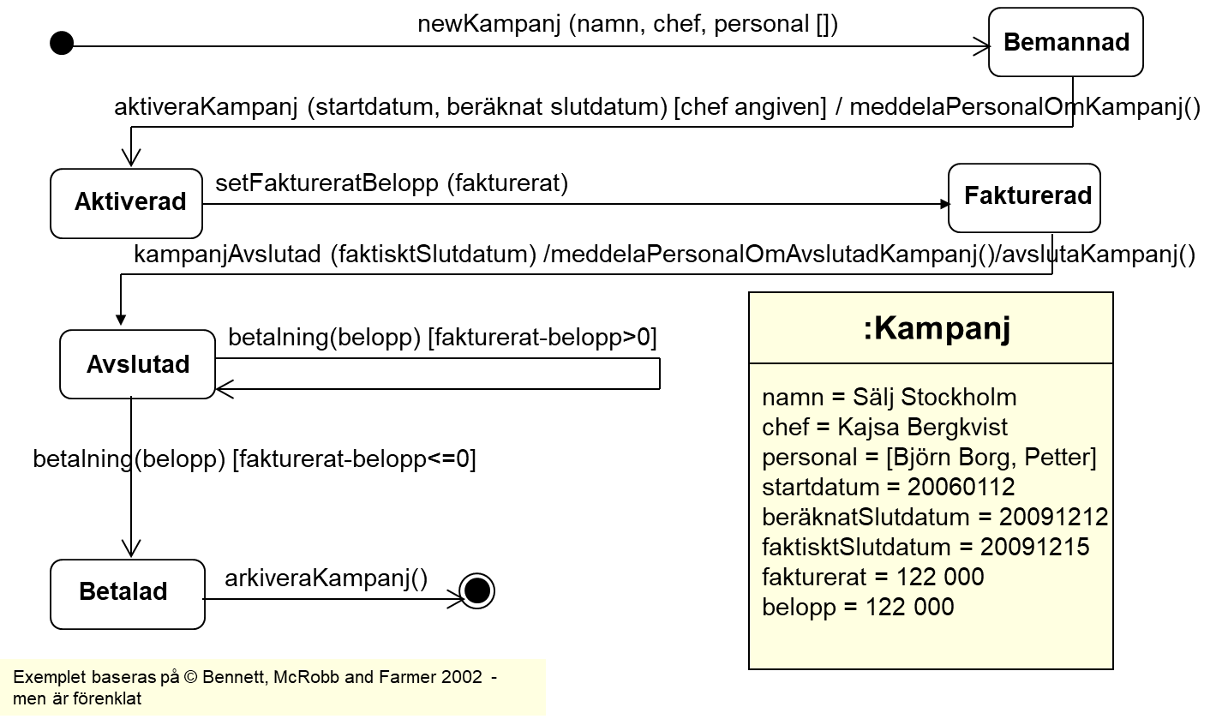
State machine diagram

Slide 86
Information standard in healthcare

Slide 87
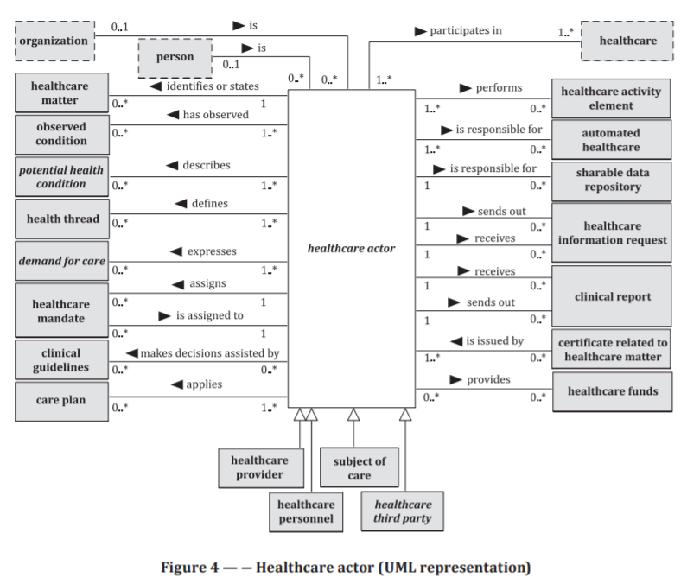
Healthcare standard
CONTSYS

Slide 88
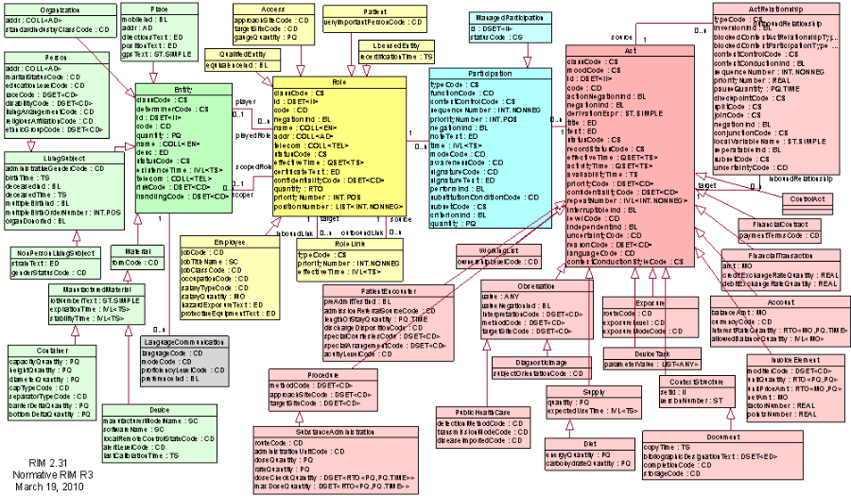
Healthcare standard
HL7 RIM

Slide 89
OMG’s Model Driven Architecture

Slide 90
Real World and Models
Business process model
of business activities
(in UML Activity diagram)
Domain model of business concepts
(in UML Class
diagram)
Human interaction with software systam
(in UML Use cases)
Interaction between software
objekts
(in UML Sequence
diagram)
System model of software objects (in UML Class
diagram)
The real world
Graphical models/diagram

Slide 91
Model Driven Architecture
Computation
Independent Model (CIM)
Platform Independent Model (PIM)
Platform Dependent Model (PSM)
Code

Slide 92
Model Driven Architecture
Computation
Independent Model (CIM)
transformation
Platform Independent Model (PIM)
transformation
Platform Dependent Model (PSM)
transformation
Code

