Slide 1
Knowledge Management Lecture 7: Theories
Erik Perjons
perjons@fc.dsv.su.se

Slide 2
Knowledge types

Slide 3
Knowledge types
Definitional knowledge
Descriptive knowledge
Explanatory knowledge
Predictive knowledge
Explanatory and predictive knowledge
Prescriptive knowledge

Slide 4
Definitional knowledge
Definitional knowledge consists of concepts, constructs, terms, definitions, classifications
Definitional knowledge does NOT include statements about reality that are claimed to be true
Instead, definitional knowledge is used as a basis for all other types of knowledge in the sense that it provides the basic concepts that are required to express that knowledge
Examples of definitional knowledge:
A right triangle is a triangle in which one angle is a right angle
A unicorn is a mythical creature depicted as a white horse with a large, pointed, spiralling horn projecting from its forehead
A relation is in third normal form, within relational database theory, if all of its attributes are dependent on the key, the whole key and nothing but the key

Slide 5
Descriptive knowledge
Descriptive knowledge describes an existing or past reality
In contrast to definitional knowledge, descriptive knowledge does include statements that are claimed to be true.
In other words, descriptive knowledge claims to describe the world “as is” or “have been”.
Examples of descriptive knowledge:
The height of the Eiffel tower is 300 meters.
A majority of large companies in Europe use ERP systems.

Slide 6
Explanatory knowledge
Explanatory knowledge provides answers to questions of ‘why’
It explains why events occur. Explanatory knowledge goes beyond descriptive knowledge, because it not only describes, but also explains it in order to offer understanding
Explanations often take the form of cause-effect chains, showing how events and outcomes are causally related to underlying mechanisms and factors
For example, the increased acceptance of Internet banking among the public can be partially explained by improvements in security infrastructures

Slide 7
Explanatory knowledge
Explanatory knowledge, on a higher level, provides explanations how the world can be viewed in a certain way. Such knowledge is usually presented as a theory. For example, a theory can be used to explain why information systems introduced for improving productivity might evolve into instruments for monitoring and control.
Explanatory knowledge, on a lower level, provides explanations for particular situations, in a certain organisation, where it explains why and how specific events unfold. For example, the introduction of a reward system in an organisation can be a major cause for the employees’ acceptance of a new ERP system
Examples of explanatory knowledge:
The earthquake in Japan 2011 was a consequence of displacements of tectonic plates.
The failure to introduce social software into the company was caused by its authoritarian organisational culture.

Slide 8
Predictive knowledge
Predictive knowledge offers black-box predictions, i.e. it predicts outcomes based on underlying factors but without explaining causal or other relationships between them.
The goal of predictive knowledge is accurate prediction, not understanding
Examples of predictive knowledge:
The treatment of patients by physicians with unwashed hands may result in diseases.
Heavy exposure to sunlight may result in skin diseases.

Slide 9
Explanatory and predictive knowledge
Explanatory and predictive knowledge offers both explanations and predictions
It predicts outcomes and explains how these are related to underlying mechanisms and factors, often through causal relationships.
This kind of knowledge is considered the most common in natural science. It is much less common in the IT area, but there are examples such as the Technology Acceptance Model (TAM) (Venkatesh and Davis 2000), and DeLone and McLean’s model of information system success (DeLone and McLean 2003).
Examples of explanatory and predictive knowledge:
Microorganisms can survive in dirt and infect people that come into contact with them.
Exposure to the ultraviolet radiation of sunlight may cause a burn of the skin, which may result in skin diseases.

Slide 10
Presciptive knowledge
Prescriptive knowledge consists of prescriptive models and methods that help solve practical problems
Prescriptive models can be seen as blueprints for developing artefacts, while prescriptive methods are guidelines and procedures that help people to work in systematic ways when solving problems.
Prescriptive models and methods can be viewed as comprising two parts.
The first is the model or method itself
The second is a statement about some desirable effect of using the model or method. It is a predictive statement implying that if a prescriptive model or method is used in a certain practice, this will contribute to effects desired by some stakeholders. In this sense, prescription can be seen as a special case of prediction.

Slide 11
Presciptive knowledge
Typical examples of prescriptive methods are systems and software development methods, such as the Rational Unified Process (RUP) (Kroll et al. 2003), or agile methods, such as XP and SCRUM (Cohn 2009).
Typical examples of prescriptive models are conceptual reference models, such as SCOR (Bolstorff and Rosenbaum 2007), or architectural models, such as OSI (Day and Zimmerman 1983).
Examples of prescriptive knowledge:
Apply sun lotion before sun bathing!
Develop your software system iteratively!

Slide 12
Theories

Slide 13
Theories
Theories are key instruments for structuring and organising large bodies of scientific knowledge
A theory aims to explain by showing how phenomena (objects, things) and behaviour (activities) in a domain are related to each other, typically through cause and effect relationships.
For example, a theory can explain why phenomena behave in a certain way.
Sometimes, a theory can also be used to predict future events.
(Cuncliffe, 2008)

Slide 14
Theories
Theories also provide a lens or a way of thinking of phenomena and their behaviour
Different theories give different perspectives on what is happening in a system (such as an organisation), that is, each theory focuses on certain phenomena (objects, things) and behaviour (activities, practices) instead of others.
Different theories can provide contradictous way of explaining empirical phenomena (objects, thing) and behaviour (acticvities, practices)
(Cuncliffe, 2008)

Slide 15
Theoretical frameworks
A theoretical framework describes the major concepts and their relationsships in projects or initiative
Theoretical frameworks work as a guidence to a project or initiative
It provides a lens or a way of thinking of phenomena and their behaviour.
While a theory explain and/or predict, a theoretical framework does NOT explain how phenomena and behaviour in a domain are related to each other in cause and effect relationships.
A theoretical framework can be seen as high level conceptual framework
A project or initiative can have both an higher level theoretical framework and a more lower level conceptual framework, where the latter is more operational than the former

Slide 16
Theory, Concepts, Application - Writing a essay
concept
concept
Theory/
Theoretical framework
relationship
relationship
concept
basis for
concept
concept
relationship
Conceptual framework/model
relationship
relationship
concept
relationship
concept
concept
relationship
applied on
real world or a made up organisation

Slide 17
A theory
A theory presents relations between concepts, sometimes called the dependent and the independent variables or factors
The dependent variable – is a variable that is dependent on one or several other variables (which are the independent variables).
Den independent variable – is a variables that cause, that is, have effects on, the dependent variables
Note! Correlation does not imply causation. A correlation between two variables does not necessarily imply that one causes the other
cause/have effect on
perceived usefullnes with the system
system use
independent variable
dependent variable

Slide 18
Different levels of theories
Theories can vary widely in scope, from addressing narrowly defined phenomena to covering entire disciplines:
A grand theory is comprehensive in scope, highly abstract, and aims at providing grand theoretical schemes for explaining a wide variety of phenomena.
A grand theory is typically not testable but can inform and provide a basis for theories on a lower level.
Within the social and behavioural sciences, some examples of grand theories are Marxism, Psychoanalysis, and Structuration theory.

Slide 19
Different levels of theories
A middle-range theory explains some phenomenon on an intermediate level across different contexts.
An example of a middle-range theory is Technology Acceptance Model (TAM) (Venkatesh and Davis 2000), which is an information systems theory that explains and predicts how users come to accept and use a technology. Another example of a middle-range theory is Agency theory.

Slide 20
Different levels of theories
A micro-range theory deals with a specific phenomenon in a particular setting, e.g. patient care in urban hospitals.
The distinction between middle-range and micro-range theories is more one of degree than of kind, where middle-range theories address more general phenomena and wider contexts.

Slide 21
Grand Theory and Middle Range Theory
concept
concept
Grand Theory
relationship
relationship
concept
basis for
concept
concept
relationship
Middle Range/
Micro Range Theory
relationship
relationship
concept
relationship
concept
concept
relationship

Slide 22
Scientific theory – definition
A scientific theory is a well-substantiated explanation of some aspect of the natural world that is acquired through the scientific method and repeatedly tested and confirmed through observation and experimentation.
As with most (if not all) forms of scientific knowledge, scientific theories are inductive in nature and aim for predictive power and explanatory force.
(Wikipedia)

Slide 23
Inductive reasoning
Inductive reasoning is reasoning in which the premises seek to supply strong evidence for (not absolute proof of) the truth of the conclusion.
The truth of the conclusion of an inductive argument is supposed to be probable, based upon the evidence given
An example of an inductive argument: All life forms that we know of depends on liquid water to exist. Therefore, if we discover a new life form, it will probably depend on water to exist
(Wikipedia)

Slide 24
Theory – definition
Theory is a contemplative and rational type of abstract or generalised thinking, or the results of such thinking. Depending on the context, the results might for example include generalized explanations of how nature work works.
(Wikipedia)

Slide 25
Theory vs Hypoyhesis
Theory is not the same as a hypothesis. A theory provides an explanatory framework for some observation, and from the assumptions of the explanation follows a number of possible hypotheses that can be tested in order to provide support for, or challenge, the theory.
(Wikipedia)

Slide 26
Common IS theories
Technology Acceptance Model
Resource Based View
Theory of Reasoned Action
Theory of Planned Bahavior
Diffusion of innovation theory
…
[Lim, S., Saldanha, T., Malladi, S., & Melville, N. P. (2009). Theories Used in Information Systems Research: Identifying Theory Networks in Leading IS Journals.]

Slide 27
Report 4, Task 1
Summerize each of these theories’ major ideas:
Theory of Reasoned Action
Theory of Planned Bahavior
Cognitive fit theory
Diffusion of innovation theory
Delone and McLean IS success model
Actor network theory
The knowledge based theory of the firm

Slide 28
Report 4, Task 2
Discuss the differences between:
Theory and model
Process model, process type, process instance and real world
Model and metamodel
Concept and term

Slide 29
Agency theory
Agency Theory is concerned with problems about conflicts between people with different interests in the same assets
For example, the owners of a company (principals) may have different interests than its managers (agents of the principals).
Basic constructs(concepts in Agency Theory include principal, agent, risk, goal, contract, and monitoring. These constructs are used in formulating descriptive statements, such as “Often agents do not act in the interest of their principals”.
The theory also includes explanatory statements, such as “As the principal and the agent have different goals, the agent does not always act in the interest of the principal”
(Eisenhardt, 1989)

Slide 30
Technology Acceptance Model (TAM)
Technology Acceptence Model (TAM) was developed by Fred Davis (Davis 1989). It predict whether people will accept and use a technology.
Perceived usefulness
External variable
Attitude towards using
Behavioural Intention
Use Behaviour
Recieved ease of use
TAM predicts that two factors (variables) mainly influence the acceptance and use of technology:
perceived usefullnes: "the degree to which a person believes that using a particular system would enhance his or her job performance"
perceived ease of use: "the degree to which a person believes that using a particular system would be free from effort"
TAM claims that the more useful a system is perceived to be and the easier it is perceived to use, the more likely it is that user accepts and uses the system.
(Boody et al, 2008, s 215-219)

Slide 31
UTAUT
Unified Theory of Acceptance and Use (UTAUT) is a development of TAM developed by Venkatesh et al (2003). Research shows that UTAUT is better to predict result then TAM
Similar to TAM:s perceived usefullness
Performance Expectancy
Similar to TAM:s perceived ease of use
Effort Expectancy
Behavioural Intention
Use Behaviour
Social Influence
The extent to which the individuals believe that it is important for others
that they should use the technologies
Facilitating conditions
Note that the independent variables effect on the dependent varaibles is mediated/moderated partly by the following factors
The perceived extent of which a organisational and technical
infrastructure required for the support of the technologies exist
(Boody et al, 2008, s 18-23)
Gender
Age
Experience
Voluntainess
of Use

Slide 32
System theory
System theory – Systems theory is the interdisciplinary study of systems in general, with the goal of elucidating principles that can be applied to all types of systems at all nesting levels in all fields of research (Wikipedia)
Major concepts in system theory are input, output, transformation, feedback.
There exists different types of system theory approaches, such as General System Theory
System
(as an organisation)
Input
Output
material, labour, money, R&D
end products, customers satisfaction
Feedback
expertise and customer feedback, new ideas
(Cuncliffe, 2008)

Slide 33
Sociotechnical theory
Sociotechnical theory – a theory that states that the interaction of social and technical factors creates the conditions for successful (or unsuccessful) organisational performance. The optimisation of each aspect alone (socio or technical) tends to create unexpected or negative system's performance, while positive performance is related to a joint optimisation

Slide 34
Organisational theory

Slide 35
Organisational theory
Earlier then the 1950s, the organisations were often viewed as closed systems. The task for managment was to organise the internal work as efficient as possible, such as in classical and scientific management approaches
Around the middle of 1950s, focuses was shifted towards the environment of the organisation. The organisation become viewed as an open system, interacting with its environment.
Research also showed that the structure of the organisations looked different for organisations that acted in stable environments compare to organisations that acted in a swiftly changing environment.

Slide 36
Contingency theory
Contingency Theory empasizes that there is no best way to manage an organisation – the theory emphasises a situational view on the organisation
Instead, the structure, management and organisational practices will depend on the characteristics of each situation: the environment, the tasks, the technology and the people
This also mean that if an organisation change the way of working, or introduce new techniques, or the environment change, the structure, management and practices should change.
However, research has shown that changes in the environment, technique and way of working - in many cases – do not lead to changes in structure, management and practices
(Woodward, 1965/1980, Thompson, 1967, Scott, 1983)

Slide 37
Resourse dependency theory
Resource Dependency Theory empasizes that organisations need to control the resources they need in order to survive.
Resources are products (goods and services), labour, capital, IT and other tools as well as knowledge
An analysis of the dependency of resources consist of idenitification of resources that an organization needs and prodcuce, and which actors that can support and hinder the resource exchanges.
Through the analysis, the organisation can understand power and dependecy relations related to resources – and, thereby, makes it possible to minimise its dependencies on other organisations, and maximise its control over resources of other organisations.
Tools to use in such an analysis can be high level input/output process models (such as IDEF0) , value network models, and Porter’s Five Forces
(Pfeffer&Salancik, 1978)

Slide 38
Institutional theory
Institutional theory emphasizes that organisations adapt to political, cultural and social values and demands, and not only to economical and technical
This means that the behavior of organisations cannot be explained by focusing on profability and economic rationality
Instead, political, cultural and social values and demands need to be considered when explaining decisions and actions taken in organisations.
Political, cultural and social values can influence organisations to play certain roles in order to establish their legitimacy (that is, accepted as doing the right thing) in the eyes of their stakeholders (that is, customers, investors, government etc)
Organisations in the same institutional environment might develop similar structures, practices and processes to deal with the demands. This similarity is called isomorphism
Institutions can be laws and rules, values and expectations and mimics of another organisations

Slide 39
Institutional theory
Example of decisions that are not rational from an economic point of view and that can be explained by institutional theory:
When there is a need in an investment in a new IT system, a system may be chosen because several other competitors have chosen that system. Other systems, not chosen, can, however, be more benefical for the organisation from an economic point of view
The choice of hiring an certain person can be made because it is expected by other employees that this person should be hired - even though another choice can be more benefical for the organisation from an economic point of view

Slide 40
Business Process Improvement methods/Quality management approaches

Slide 41
Business Process Improvement methods/ Quality management approaches
Six Sigma
Lean
Activity based costing
Balance Scorecard

Slide 42
What is Six Sigma?
Six Sigma is a method for identifying and removing the causes of defects and errors in production and business processes.
The goal is to produce goods and services according to the specifications of these goods and services
In other words, the goal is to produce goods and services without defects
A defect is defined as anything that could lead to customer dissatisfaction
More precisely, the percentage of defects lie below 3.4 defects per million.
The term Sigma is used in statistics to represent the standard deviation (measured variation) of a statistical population
The overall strategy to reduce defects is Business Process Management

Slide 43
What is Six Sigma?
The overall strategy to reduce defects is Business Process Management
The tactics consist of a set of tools to be used

Slide 44
What is Six Sigma?
Six Sigma was introduced in Motorola in 1980s
General Electric made it to one of the most popular management philosophies in the world in the 1990s

Slide 45
What is Six Sigma?
Basic ideas:
Reduce process variation in order to achieve stable and predictable process result
Business processes can be measured, analysed, improved and controlled
To achieve improvements, the entire organisation, particularly the top-level management, need to commit to the method
A special infrastructure of ”champions”, ”master black belts” and ”black belts” to lead and implement the Six Sigma
A clear focus on achieving measurable and quanitfiable returns from any Sig Sigma projects
A clear commitment to making decisions on the basis of verifiable data, rather than assumptions and guesswork

Slide 46
How to perform Six Sigma?
Six Sigma uses two main methodologies: DMAIC and DMADV.
DMAIC is used to improve existing processes
DMADV is used to create new products and designing new processes
DMAIC is most used and stands for: - Define measurable goals for process improvement - Measure process efficiency - Analyze result and identify problems and its causes - Improve or optimize processes based on the analysis - Check and ensure that deviations from the measurable goals are corrected

Slide 47
How to perform Six Sigma DMAIC?
Suppose there are about 20-30 processes in an organization
Of these, Six Sigma is applied on 7-10 of these processes in a first round
Of these, around 4-7 processes will be improved

Slide 48
How to perform Six Sigma DMAIC?
The goal of DMAIC is to achieve effective (meet customer requirements) and efficient (no waste resources) processes
The strategy is business process management (BPM) with a strong performance management focus
The tactic is to use methods and tools to repair broken processes (i.e. processes that results in defected goods and services): - Identify customer requirements - Making process maps/diagrams - Measuring productivity and efficiency - Identify problems / defects - Identify and analyze the causes of problems / defects - Develop and test solutions to improve processes

Slide 49
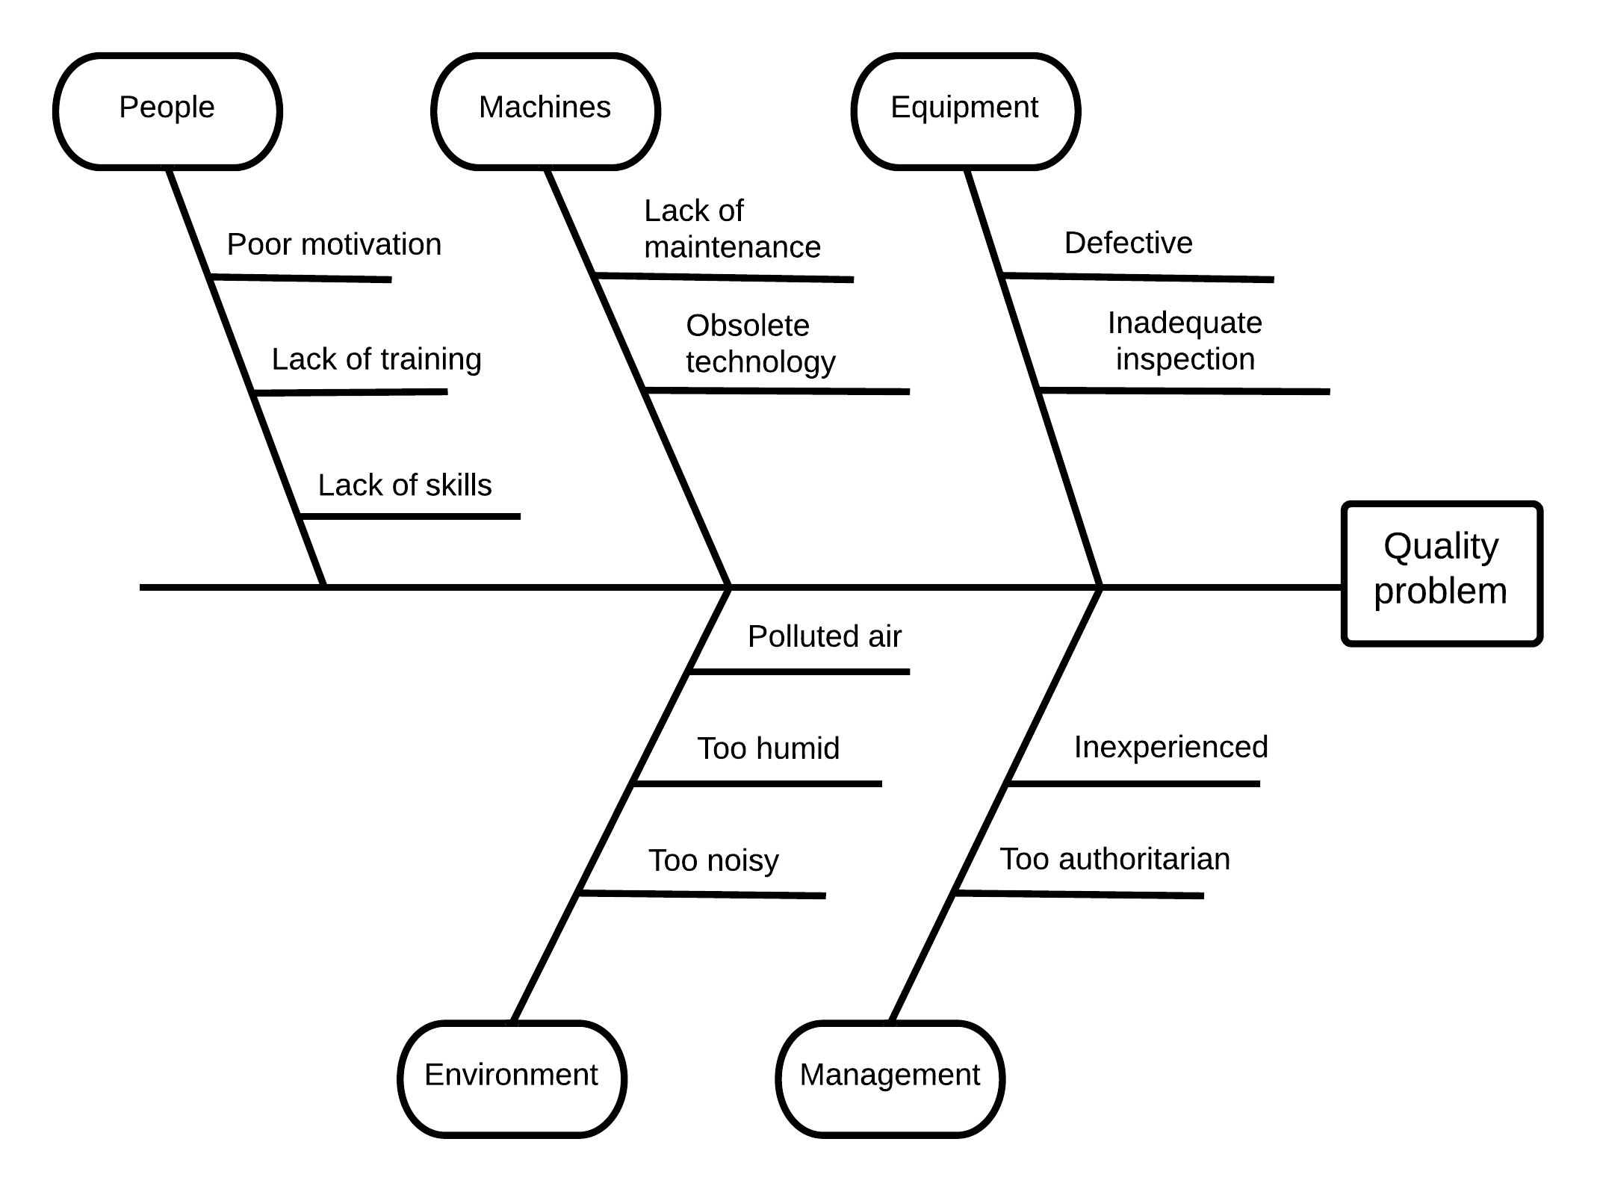
Using Ishikawa diagram
Ishikawa diagram (also called cause-effect diagram or fishbone diagram) is a widespread tool for representing problem causes, and used in Six Sigma. It is used to investigate and represent potential causes of a problem.
The diagram consists of a main horizontal line representing the problem and associated slanting lines representing direct problem causes, which in turn may be related to additional lines representing indirect problem causes. The causes can also be classified into different categories, as indicated in the figure:

Slide 50
Benefits and Drawbacks of Six Sigma
Benefits:
Effectively eliminates the cause of problems in operations
Customer and cost-focused approach
Support process improvements efficient
Successful results
Drawbacks:
Costly to implement and work with - for example, requires training of the employees
Difficult to apply for a long time

Slide 51
Why Lean?
Lean is a method that is satisfying a need of a customer
This is done by focusing on the added value for that customer in the process.
Value is any action or process that a customer would be willing to pay for given his/her need

Slide 52
Why Lean?
Lean is based on the Toyota Production System (TPS) created after World War II in Japan.
After WWII, Toyota had a lack of resources. Therefore, Toyota focused on an order-based production: nothing was produced that has not been ordered, and resources for producing cars were delivered just-in-time. The technology used for car production was also rather simple.
TPS has its base in Taylor’s Scientific Management and Ford’s production system.
The term and concept of Lean was introduced by John Krafcik in the Sloan Management Review, 1988. The article was based on his master thesis. He questioned the myth that productivity is created through economies of scale and advanced technology, and claimed that Toyota's success was built on small stocks (just-in-time) and simple technology

Slide 53
What is not Lean?
The traditional view of efficiency is resource efficiency. Resource efficiency is focused on making effective use of the resources that adds value to a process.
The question posed by resource efficiency is how much a resource used in relation to a particular time period, such as how many surveys a specialist performs during a period of time.
Patient with health issue
Patient with no health issue
Resource
Resources that is used to add value to a stream object
Resource

Slide 54
What is not Lean?
To focus on resource efficiency, however, create different problems that could lead to extra work
This might not increase value for the customer given his/her need
Consider what can happen if a patient need to wait for several specialists' ability to carry out investigations and/or treatments. New problems can easily arise during that time for the patient – worrying, impact family and work. Although, the specialists are used efficient (because of the focus on resource efficiency)
Consider what happens if you wait with answering email or doing your travel expenses. You may forget to answer important email, and, thereby, loose good opportunities, receipts can get lost, etc

Slide 55
What is Lean?
Lean is focused on making obvious what adds value for a customer by reducing everything else (read: waste).
Lean emphasizes flow efficiency, that is, the unit that flows (called steaming object) through the process in order to meet an identified need.
More precisely, the focus is on how much the streaming object increases in value given a certain need.
The need can be direct needs (such as getting a diagnosis, be cured, a produced car, be amused by the rides at the amusement park) and indirect needs (met with empathy and courtesy, be stimulated all the time when visiting an amusement park)

Slide 56
What is Lean?
It is important to decide what is the steaming object and what is value adding activities and what is waist, that is not value added activities
Steaming object may be:
people (patients, visitors to the amusement park),
materials (sample / test responses, car during production),
information (referral, application).

Slide 57
What is Lean?
Lean provides a set of means/tools/instruments.
The core of the tools is to
eliminate all factors in a process that do not create value for the customer; and thereby elimininate waste;
to involve the employees in the change of the way of working;
to make small and continous changes, and, thereby, create a continously learning organisation
Example of tools in Lean:
Value stream mapping
Five S
Kanban
…

Slide 58
Lean tool: Value stream mapping
Value stream mapping is one of the tools in Lean. It is a method for analysing the current state of a business process and designing a future state of a process
First, create an as-is description of the process and then identify and eliminate waste and create a to-be process. This should be done by together with, or driven by, the employees working in the process.
A key metric associated with value stream mapping is lead time = value added time + not value added time + waiting time.
The lead time can usually be reduced up to 50-70 percent in a lean projects, according to consultants
Stream efficiency is focussed on the object (streaming object) that is streaming through the process to create value for a customer.
The focus on the value stream efficiency/flow efficinecy and NOT local resource efficiency. (Local resource efficiency is the efficiently of how the local resources that add value to the streaming object are used)

Slide 59
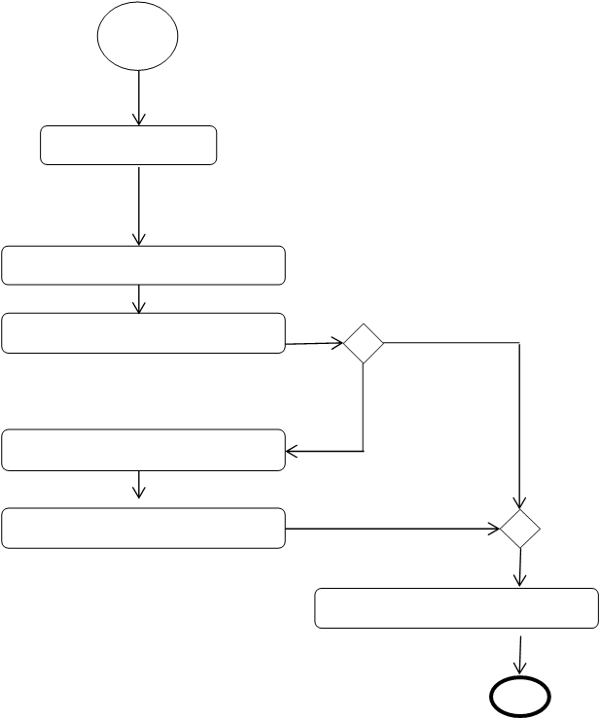
Different process techniques supporting value stream mapping
Streaming object
Product (ordered)
Patient
Patient with health issue
Patient with no health issue
Patient
Resource
Not a value adding activity to be eliminated
Resource

Slide 60
Benefits and drawbacks of Lean
Benefits:
Support process improvements efficient
Successful results
Drawbacks:
Easy to focus too much on the tools of lean, and fail to focus on the philosophy and culture of lean

Slide 61
Why Activity Based Costing (ABC)?
In traditional cost management the actual cost of design, development, production, marketing and sale of goods and services is not calculated in detail.
Instead, indirect costs / overhead is added on top of the direct costs by a certain percentage on all goods/services, that is, the percentage is the same for all goods/services.
However, some products or services may use a higher part of the indirect costs / overheads than others.
That means in practical terms, a particular product or service may be subsidized at the expense of another
The aim of ABC is that strategic, tactical and operational decision about goods and services should be based accurate information, that is, the actual cost to produce and manage them

Slide 62
Why Activity Based Costing?
Activity Based Costing (ABC) was developed in the US during the 1970s and 1980s in order to solve the problem presented on previous slide.
ABC was introduced to a wider public in the late 1980s by Robin Cooper and Robert Kaplan. They presented the ABC in a series of articles in the Harvard Business Review

Slide 63
What is Activity Based Costing?
Activity Based Costing (ABC) is a method for assigning real costs to the all activities related goods and services, including activities such as design, develop, promoting, selling and marketing
This means that what usually called indirect costs / overhead costs are actually assigned to goods and services
An example: The cost for a service at a bank is calculated by including the real cost for design, marketing, sales, customer service, etc, of that service

Slide 64
Benefits and drawbacks of Activity Based Costing
Benefit:
Strategic, tactical and operational decision about goods and services are based accurate information, that is, the actual cost to produce and manage them
Drawback:
Costly to implement and work with the ABC

Slide 65
Why Balance Scorecard?
BS is a performance management system or performance measuring system
BS aims to to give managers and executives a more 'balanced' view of organizational performance, that is, not only focus on the financial view but also consider customer relations, human capital, etc
BS can be used to describe an organisations strategy for how to create value to stakeholders, customers and citizens from both tangible and intangible assets
BS provides a language that executive teams can use to discuss the strategic choices, that is, directions and priorities in their enterprise
Kaplan&Norton, 2004

Slide 66
Why Balance Scorecard?
Robert Kaplan and David Norton at Harvard Business School developed Balance Scorecard (BS) in the beginning of 1990s (although they were not first with the ideas)
Kaplan&Norton, 2004

Slide 67
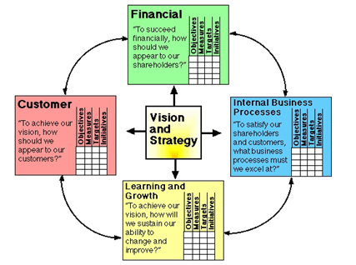
What is Balance Scorecard?
The BS suggests that we view the organization from four perspectives, and to develop KPI, collect data and analyze the data relative to each of these perspectives:
financial
customer
internal business processes
learning and growth

Slide 68
What is Balance Scorecard?
Financial perspective
This perspective measures an organisation’s success using financial terms
Examples of KPIs: cash flow, ROI, financial result, return on capital employed
Kaplan&Norton, 2004

Slide 69
What is Balance Scorecard?
Customer perspective
This perspective measures the customers value proposition (that is, the mix of quality, performance and service, time and cost that an organisation offers to its customers) and the result of the customers value proposition (for example, customer satisfaction).
”Success with the targeted customer provides a principal component for improved performance”
Examples of KPIs: delivery performance to customer - by date or by quality, customer satisfaction rate
Kaplan&Norton, 2004

Slide 70
What is Balance Scorecard?
Internal process perspective
This perspective measures the internal processes that create and deliver the customer value proposition.
Kaplan and Norton propose to group similar processes into four clusters:
operations management (i.e. improving asset utilisation, supply chain management, order management, etc)
customer management (i.e. expanding and deepening relations)
innovation (i.e. developing new products and services)
regulatory & social (i.e. establishing good relations with the external stakeholders)
Examples of KPIs: number of activities, success rate, accident ratios, overall equipment effectiveness
Kaplan&Norton, 2004

Slide 71
What is Balance Scorecard?
Learning and Growth perspective
This perspective measure the intangible assets of an organisation.
Intangible assets can be classified into three categories:
- human capital (i.e. strategic competencies)
- information capital (i.e. strategic information)
- organisation capital (i.e. culture, leadershíp, alignment of goals and means, teamwork)
Focusing on the learning and growth perspective may decrease short-term financial results, whilst contributing to long-term success
Examples of KPIs: investment rate, illness rate, internal promotions, gender ratios
Kaplan&Norton, 2004

Slide 72
Improved version of BS - Strategy map
Improved version of BS in the middle of the 1990s:
Kaplan and Norton claimed that KPI shall be selected based on a set of "strategic objectives”. The objectives should be related to each other via cause-effect linkage - called strategic map.
Strategy map provides a visual representation of the linked components of an organisation’s strategy
Kaplan&Norton, 2004

Slide 73
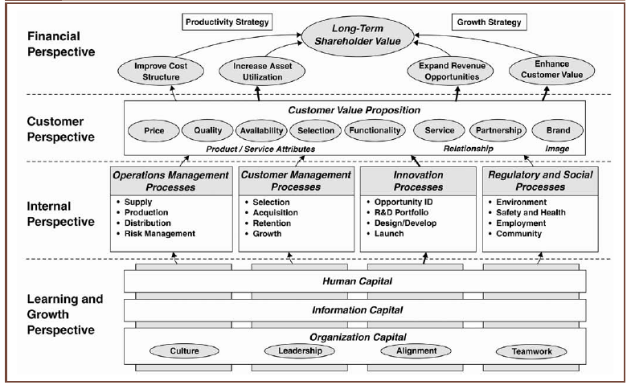
Strategy Map
Kaplan&Norton, 2004

Slide 74
Strategy Map
In a strategy map, the four perspectives are organised from financial, as the highest perspectives, via customer and internal process perspective, to learning&growth, which is the lowest perspective.
The basic idea is that we start off by looking at a higher perspective to identify what we want to achieve (represented as stratetic objectives). We then see what work need to be done at the lower perspective in order to achieve higher perspectives stratetic objectives.
Thereby, strategy maps ”enables human, information and organisational capital to be represented as assets that eventually get converted into cash, the ultimate liquid asset, through higher sales and lower spending”
KPI are the means for measuring and relating these measures to each other
Kaplan&Norton, 2004

Slide 75
Report 5, Task 1
Use the web to find a knowledge management software system and describe its
Functions
Benefits
Drawbacks
Discuss why you classify it as a knowledge manangement system
Describe how an organisation can use the system

Slide 76
Report 5, Task 2
Browse the paper of digital infrastructure and answering the following questions:
What is a digital infrastructure and how is it different from other IT systems?
The paper discuss the paradoxical nature of digital infrastructure. Discuss the paradoxical nature.
Discuss the relationships between digital infrastructure and knowledge management.

