Slide 1
Presentation: Theory, part 1
Erik Perjons
DSV, Stockholm University

Slide 2
Knowledge types

Slide 3
Knowledge types in science
Definitional knowledge
Descriptive knowledge
Explanatory knowledge
Predictive knowledge
Explanatory and predictive knowledge
Prescriptive knowledge

Slide 4
Definitional knowledge
Definitional knowledge consists of concepts, constructs, terms, definitions, classifications
Definitional knowledge DOES NOT include statements about reality that are claimed to be true
Instead, definitional knowledge is used as a basis for all other types of knowledge in the sense that it provides the basic concepts that are required to express that knowledge

Slide 5
Definitional knowledge
Examples of definitional knowledge:
A right triangle is a triangle in which one angle is a right angle
A unicorn is a mythical creature depicted as a white horse with a large, pointed, spiralling horn projecting from its forehead
A relation is in third normal form, within relational database theory, if all of its attributes are dependent on the key, the whole key and nothing but the key

Slide 6
Descriptive knowledge
Descriptive knowledge describes an existing or past reality
In contrast to definitional knowledge, descriptive knowledge DOES include statements that are claimed to be true
In other words, descriptive knowledge claims to describe the world “as is” or “have been”

Slide 7
Descriptive knowledge
Examples of descriptive knowledge:
The height of the Eiffel tower is 300 meters
A majority of large companies in Europe use ERP systems

Slide 8
Explanatory knowledge
Explanatory knowledge provides answers to questions of ‘why’
Explanatory knowledge explains how phenomena, that is, events/mechanisms/factors/outcomes are related
Explanatory knowledge goes beyond descriptive knowledge, because it not only describes, but also explains in order to offer a deeper understanding

Slide 9
Explanatory knowledge
Explanations often take the form of cause-effect chains, showing how phenomena (such as events, mechanisms, factors, outcomes) are causally related
For example, the increased acceptance of Internet banking among the public can be partially explained by improvements in security infrastructures
To show the relationships between phenomena, these are represented by dependent and independent variables

Slide 10
Explanatory knowledge
In order to show the relationships between phenomena, these phenomena are represented as dependent and independent variables
cause/have effect on
perceived usefullnes with the system
system use
independent variable
dependent variable

Slide 11
Dependent and independent variables
The dependent variable – is a variable that is dependent on one or several other variables (which are the independent variables).
Den independent variable – is a variable that cause, that is, have effects on, the dependent variables
Note! Correlation does not imply causation. A correlation between two variables does not necessarily imply that one causes the other
cause/have effect on
perceived usefullnes with the system
system use
independent variable
dependent variable

Slide 12
Explanatory knowledge
Explanatory knowledge, on a higher level, provides explanations how the world can be viewed in a certain way
Such knowledge is usually presented as a theory
For example, a theory can be used to explain why information systems introduced for improving productivity might evolve into instruments for monitoring and control

Slide 13
Explanatory knowledge
Explanatory knowledge, on a lower level, provides explanations for particular situations, in a certain organisation, where it explains why and how specific factors unfold.
For example, the introduction of a reward system in an organisation can be a major cause for the employees’ acceptance of a new ERP system

Slide 14
Explanatory knowledge
Examples of explanatory knowledge:
The earthquake in Japan 2011 was a consequence of displacements of tectonic plates.
The failure to introduce social software into the company was caused by its authoritarian organisational culture.

Slide 15
Predictive knowledge
Predictive knowledge offers black-box predictions, i.e. it predicts outcomes based on underlying factors but without explaining causal or other relationships between them.
The goal of predictive knowledge is accurate prediction, not understanding
Therefore, predictive knowledge is usually not described as a theory, since a prediction does not explain why things happen

Slide 16
Predictive knowledge
Examples of predictive knowledge:
The treatment of patients by physicians with unwashed hands may result in diseases
Heavy exposure to sunlight may result in skin diseases

Slide 17
Explanatory and predictive knowledge
Explanatory and predictive knowledge offers both explanations and predictions
It predicts outcomes and explains how these are related to underlying mechanisms and factors, often through causal relationships.

Slide 18
Explanatory and predictive knowledge
This kind of knowledge is considered the most common in natural science. It is much less common in the IT area, but there are examples such as the Technology Acceptance Model (TAM) (Venkatesh and Davis 2000), and DeLone and McLean’s model of information system success (DeLone and McLean 2003).

Slide 19
Explanatory and predictive knowledge
Examples of explanatory and predictive knowledge:
Microorganisms can survive in dirt and infect people that come into contact with them
Exposure to the ultraviolet radiation of sunlight may cause a burn of the skin, which may result in skin diseases

Slide 20
Presciptive knowledge
Prescriptive knowledge consists of prescriptive models and methods that help solve practical problems
Prescriptive methods are guidelines and procedures that help people to work in systematic ways when solving problems.
Prescriptive models can be seen as blueprints for developing, for example, business processes or IT systems

Slide 21
Presciptive knowledge
Typical examples of prescriptive methods are systems and software development methods, such as the Rational Unified Process (RUP) (Kroll et al. 2003), or agile methods, such as XP and SCRUM (Cohn 2009).
Typical examples of prescriptive models are conceptual reference models, such as SCOR (Bolstorff and Rosenbaum 2007), or architectural models, such as OSI (Day and Zimmerman 1983).

Slide 22
Presciptive knowledge
Prescriptive models and methods can be viewed as comprising two parts.
The first part - is the model or method itself
The second part - is a statement about some desirable effect of using the model or method.
This predictive statement (the second part) implies that if a prescriptive model or method is used in a certain practice, this will contribute to effects desired by some stakeholders.
In this sense, prescription can be seen as a special case of prediction.

Slide 23
Presciptive knowledge
Examples of prescriptive knowledge:
Apply sun lotion before sun bathing!
Develop your software system iteratively!

Slide 24
Theories

Slide 25
Theories
Theories are key instruments for structuring and organizing large bodies of scientific knowledge

Slide 26
Theories
A theory aims to explain how phenomena in a domain are related to each other, typically through cause and effect relationships.
A theory should contain logical (sometimes called theoretical) argument for why a cause and effect relationships exist – that is, it is explicating the causal logic using logical arguments
A “theory is the answer to queries of why” (Sutton & Straw, 1995)

Slide 27
Teorier
Teorier – förklarar varför företeelser inträffar eller uppstår, som varför en händelser inträffar eller ett objekt beter sig på visst sätt
Teorier – ger oss en god grund att agera rationellt om vi baserar våra beslut på teorier som är välgrundade, alltså teorier som är väl testade
Teorier – kan också presentera relationer mellan företeelser som inte är uppenbara för oss - som vi inte kan observera med våra ögon och som till och med kan ifrågasätta vårt sunda förnuft
Teorier – ger nya insikter och idéer kring empiriska företeelser
(Cuncliffe, 2008)

Slide 28
Theories vs emprical data
Empirical data can be used to describe empirical relationships or pattern that have been observed in the real world, however, they do not explain why these relationships or pattern exists.
A theory is needed for explaining why the empirical relationships or patterns are observed by providing logical argument
Empirical data do not generate theories – reseachers do
Note, however, empirical data can provide support for a theory

Slide 29
Teorier och empiriska data
Teoretisk nivå
Teorier – är logiska/teoretiska argument/påståenden om varför orsak-verkan-relationer mellan empiriska företeelser inträffar eller uppstår
Empirisk nivå
- det vi kan observera, mäta
Empiriska data – beskriver relationer mellan data som vi kan observera, men förklarar inte varför dessa relationer finns. Förklaringar hittar vi i stället i teorier

Slide 30
Theories
Theories also provide a lens or a way of thinking of phenomena and their behaviour
Different theories give different perspectives on what is happening in a system (such as an organisation)
(Cuncliffe, 2008)

Slide 31
Theory vs. theoretical framework
A theoretical framework describes the major concepts and their relationsships in projects or initiative
It provides a lens or a way of thinking of phenomena and their behaviour.
While a theory explain and/or predict, a theoretical framework does NOT explain how phenomena and behaviour in a domain are related to each other in cause and effect relationships

Slide 32
Different levels of theories
Theories can vary widely in scope, from addressing narrowly defined phenomena to covering entire disciplines:
Grand theories
Middle-range theory
Micro-range theory

Slide 33
Different levels of theories
A grand theory is comprehensive in scope, highly abstract, and aims at providing grand theoretical schemes for explaining a wide variety of phenomenons.
A grand theory is typically not testable but can inform and provide a basis for theories on a lower level.
Within the social and behavioural sciences, some examples of grand theories are Marxism, Psychoanalysis, and Structuration theory.

Slide 34
Different levels of theories
A middle-range theory explains some phenomenons on an intermediate level across different contexts.
A middle-range theory is testable
An example of a middle-range theory is Technology Acceptance Model (TAM) (Venkatesh and Davis 2000), which is an information systems theory that explains and predicts how users come to accept and use a technology. Another example of a middle-range theory is Agency theory.

Slide 35
Different levels of theories
A micro-range theory deals with specific phenomenons in a particular setting, e.g. patient care in urban hospitals.
The distinction between middle-range and micro-range theories is more one of degree than of kind, where middle-range theories address more general phenomena and wider contexts.

Slide 36
Scientific theory – definition
A scientific theory is a well-substantiated explanation of some aspect of the natural world that is acquired through the scientific method and repeatedly tested and confirmed through observation and experimentation.
Scientific theories are inductive in nature (As with most, if not all, forms of scientific knowledge)
Scientific theories aim for explanatory force and maybe also predictive power
(Wikipedia)

Slide 37
Inductive reasoning
Inductive reasoning is reasoning in which the premises seek to supply strong evidence for (not absolute proof of) the truth of the conclusion.
The truth of the conclusion of an inductive argument is supposed to be probable, based upon the evidence given
An example of an inductive argument: All life forms that we know of depends on liquid water to exist. Therefore, if we discover a new life form, it will probably depend on water to exist
(Wikipedia)

Slide 38
What theory is not
Researchers do not agree on what constitute a theory. Easier is to agree on what do not constitute a theory:
References are not theory
Data are not theory
List of variables or constructs are not theory
Diagrams are not theory
Hypothesis are not theory
(Sutton& Straw, 1995)

Slide 39
References are not theory
When presenting a new theory, references from other research papers cannot replace the need for researchers to explicating the causal logic behind the theory
Instead, references should be used to presents which concepts are adopted from other researchers, and make it clear how the theory differs from other researchers theories
(Sutton& Straw, 1995)

Slide 40
Data are not a theory
Data in the real world are used for describing observed empirical patterns
Such empirical patterns does not describe why these patterns occurs
A theory is needed to explain why the empirical patterns occurs – it provides logical reasoning
Data do not generate theories – reseachers do!
An example of brute empirism: We expect certain patterns to occure from our data gathered not because we have a theory, but just because others had reported such findings. That is, we provide a hypothesis motivated by earlier findings without presenting a theory
(Sutton& Straw, 1995)

Slide 41
List of variables or constructs are not theory
Variables and definitions are important parts of a theory – but do not constitute one
A theory must explain why these variables were chosen in a theory, and how and and why they are related – in cause effect relationsships
(Sutton& Straw, 1995)

Slide 42
Diagrams are not a theory
Diagrams can be used to show cause effect relationships, but they do not explain why this cause effect relationships exists
Theories need to have some textual/verbal descriptions of why this cause effect relationships exists
Textual descriptions ”convey the logical nuances behind the causal arrows” in the diagrams
(Sutton& Straw, 1995)

Slide 43
Hypotheses are not a theory 1(3)
Hypotheses shows how variables and their relationships – which is part of the theory - shall be operationalised so that the theory can be tested
Hypotheses do not contain logical arguments of why certain empirical relations and patterns are expected to occure.
Hypotheses state what should happen – not why
That is, a theory is not a simple statement in form of a hypothesis
(Sutton& Straw, 1995)

Slide 44
Hypotheses are not a theory 2(3)
Theory is not the same as a hypothesis
A theory provides an explanatory framework for some observation
From the assumptions of the explanation follows a number of possible hypotheses that can be tested in order to provide support for, or challenge, the theory.
(Wikipedia)

Slide 45
Hypotheses are not a theory 3(3)
A hypothesis connects:
the theoretical work presenting logical connected arguments, and
the empirical world showing empirical relationships and patterns in data

Slide 46
More about theories
Weick: ”A good theory explain, predicts and delights”
That is, a theory can show us relationships that we cannot observe with our eyes or that contradicts our common sense

Slide 47
Common IS theories
Technology Acceptance Model
Resource Based View
Theory of Reasoned Action
Theory of Planned Bahavior
Diffusion of innovation theory
…
[Lim, S., Saldanha, T., Malladi, S., & Melville, N. P. (2009). Theories Used in Information Systems Research: Identifying Theory Networks in Leading IS Journals.]

Slide 48
Vanligaste teorierna inom IS-området
Technology Acceptance Model
Resource Based View of the Firm
Game Theory
Cognitive Fit
Decision Theory
Theory of Reasoned Action
Transaction Cost Theory
Media Richness Theory
Innovation Diffusion Theory
[Lim, S., Saldanha, T., Malladi, S., & Melville, N. P. (2009). Theories Used in Information Systems Research: Identifying Theory Networks in Leading IS Journals.]

Slide 49
Agency theory
Agency theory is concerned with problems about conflicts between people with different interests in the same assets
For example, the owners of a company (principals) may have different interests than its managers (agents of the principals).
(Eisenhardt, 1989)

Slide 50
Agency theory
Agency theory consists of a number of basic concepts including principal, agent, risk, goal, contract, and monitoring. These concepts are used in formulating descriptive statements, such as “Often agents do not act in the interest of their principals”.
Agency theory also includes explanatory statements, such as “As the principal and the agent have different goals, the agent does not always act in the interest of the principal”
(Eisenhardt, 1989)

Slide 51
Technology Acceptance Model (TAM)
Technology Acceptence Model (TAM) was developed by Fred Davis (Davis 1989). It predict whether people will accept and use a technology.
(Boody et al, 2008, s 215-219)

Slide 52
Technology Acceptance Model (TAM)
TAM predicts that two factors (variables) mainly influence the acceptance and use of technology:
perceived usefullnes: "the degree to which a person believes that using a particular system would enhance his or her job performance"
perceived ease of use: "the degree to which a person believes that using a particular system would be free from effort"
(Boody et al, 2008, s 215-219)

Slide 53
Technology Acceptance Model (TAM)
TAM claims that the more useful a system is perceived to be and the easier it is perceived to use, the more likely it is that user accepts and uses the system.
Perceived usefulness
Faktiskt användning av systemet
External variable
Attitude towards using
Behavioural Intention
Use Behaviour
Recieved ease of use
(Boody et al, 2008, s 215-219)
Användarens inställning till systemet
Huruvida användaren avser att använda systemet. Även om användaren avser använda är det inte säkert att användaren använder systemet av brist på tid och budget.

Slide 54
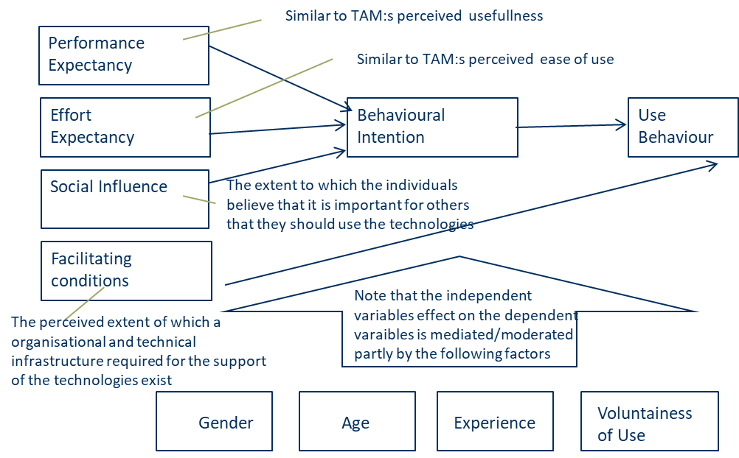
UTAUT
Unified Theory of Acceptance and Use (UTAUT) is a development of TAM developed by Venkatesh et al (2003). Research shows that UTAUT is better to predict result than TAM

Slide 55
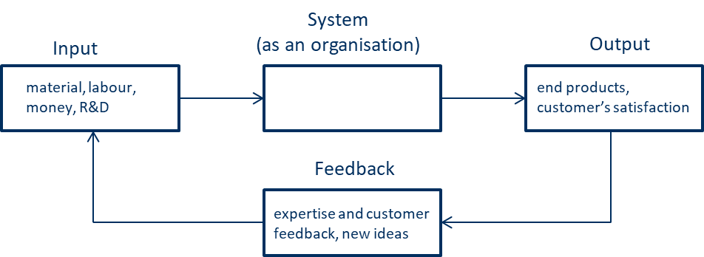
System theory
System theory – is the interdisciplinary study of systems in general, with the goal of elucidating principles that can be applied to all types of systems at all nesting levels in all fields of research (Wikipedia)
Major concepts in system theory are input, output, transformation, feedback.
There exists different types of system theory approaches, such as General System Theory
(Cuncliffe, 2008)

Slide 56
Sociotechnical theory
Sociotechnical theory – a theory that states that the interaction of social and technical factors creates the conditions for successful - or unsuccessful - organizational performance.
The optimization of each aspect alone (socio or technical) tends to create unexpected or negative system's performance, while positive performance is related to a joint optimization

Slide 57
Contingency theory
Contingency Theory - empasizes that there is no best way to manage an organisation – the theory emphasises a situational view on the organisation
Instead, the structure, management and organisational practices will depend on the characteristics of each situation: the environment, the tasks, the technology and the people
(Woodward, 1965/1980, Thompson, 1967, Scott, 1983)

Slide 58
Contingency theory
Contingency theory claims that changes in the way of working, new techniques, or the environment change will change the structure, management and practices
However, research has shown that such changes - in many cases – do not lead to changes in structure, management and practices – and this contradicts the theory
(Woodward, 1965/1980, Thompson, 1967, Scott, 1983)

Slide 59
Resourse dependency theory
Resource Dependency Theory claims that organisations need to control the resources they need in order to survive.
Resources are products (goods and services), labour, capital, IT and other tools as well as knowledge
An analysis of the dependency of resources consist of identification of 1) which resources that an organization needs and produce, and 2) which actors that can support and hinder the resource exchanges
(Pfeffer&Salancik, 1978)

Slide 60
Resourse dependency theory
Through the analysis, the organisation can understand power and dependecy relations related to resources – and, thereby, makes it possible to minimize its dependencies on other organisations, and maximize its control over resources of other organisations.
Tools to use in such an analysis can be high level input/output process models (such as IDEF0) , value network models, and Porter’s Five Forces
(Pfeffer&Salancik, 1978)

Slide 61
Institutions
Within organizational theory, one usually defines an institution as a form of social behavior - a pattern, a practices – that is taken for granted by a group of people, has a duration and has a normative explanation
This pattern or practice is arising from a repeated behavior and will become a social agreement of how to handle things among a group of people
This pattern / practice is transferred between employees, but also to new employees during a long time (over generations)
(Strannegård &Eriksson-Zetterquist, 2011)

Slide 62
Institutions
These patterns are good to follow for saving energy
They also creates order, stability, predictability
(Strannegård &Eriksson-Zetterquist, 2011)

Slide 63
Institutionell teori
Institutional theory - questions the idea that organizations are the rational tools that many times are taken for granted in discussions and analyzes, that is, an organization examines alternatives and selects the option that best meets the organization's goals
Instead, to explain organizational behavior, institutions - in the form of patterns and practices – are used

Slide 64
Institutionell teori
Institutional theory also points out that there is a difference between a formal structure and how the actual daily activities look, that is, the informal structure

Slide 65
Institutionell teori
According to institutional theory, the formal structure is what an organization shows upwards towards investors, authorities, competitors, and their own employees.
The formal structure is used to show that the organization is rational, modern and adaptable. In this way, the organization legitimizes

Slide 66
Institutionell teori
Institutional theory means that the formal structure is often the same in organizations in the same industry because of common rules, common norms and values - isomorphism occurs
You are usually talking about isomorphic forces that have compelling, normative and imitating institutional influences:
Compulsory - through laws and regulations (regulations)
Normative - through training, seminars (common standards)
Imitation-through how others do it (values)
(Strannegård &Eriksson-Zetterquist, 2011)

Slide 67
Institutionell teori
The informal structure, on the other hand, differs often from the formal - and is often also disconnected from the formal.
This means that changes in the formal structure do not have to lead to changes in the informal
In other words, people can act in a different way in the informal structure than is done to show off the formal structure outwardly, for example, to make things done
Therefore, it is important as a consultant to observe how the organization behaves in practice

Slide 68
Hur kan institutionell teori användas?
Institutional theory can be used to understand behavior by being aware that there is a difference between a formal and informal structure and behavior
Institutional theory can be used to understand non-rational behaviors in organizations as some patterns / practitioners are inherited in the organization (over generations)
Institutional theory can be used to understand why some solutions are used to address certain problems

Slide 69
Institutional theory
Institutional theory emphasizes that organisations adapt to political, cultural and social values and demands, and not only to economical and technical
This means that the behavior of organisations cannot be explained by focusing on profitability and economic rationality
Political, cultural and social values and demands need to be considered when explaining decisions and actions taken in organisations.

Slide 70
Institutional theory
Political, cultural and social values can influence organisations to play certain roles in order to establish their legitimacy (that is, accepted as doing the right thing) in the eyes of their stakeholders (that is, customers, investors, government etc)

Slide 71
Institutional theory
Organisations in the same institutional environment might develop similar structures, practices and processes to deal with the demands. This similarity is called isomorphism
Institutions can be laws and rules, values and expectations and mimics of another organisations

Slide 72
Institutional theory
Example of decisions that are not rational from an economic point of view and that can be explained by institutional theory:
When there is a need in an investment in a new IT system, a system may be chosen because several other competitors have chosen that system. Other systems, not chosen, can, however, be more benefical for the organisation from an economic point of view
The choice of hiring an certain person can be made because it is expected by other employees that this person should be hired - even though another choice can be more benefical for the organisation from an economic point of view

