Slide 1
System Development Methods
Erik Perjons

Slide 2
Questions to answer
What is a system development method?
Why do you need system development methods?
Which different types of system development methods exists and which are their benefits and drawbacks?

Slide 3
System Development Methods

Slide 4
System Development is Complex
System development, sometimes called software development, is complex
Many system development projects fail (around 25 percent), others are delayed or do not produce the required functionality (around 45 percent) – mainly due to this complexity of the projects

Slide 5
System Development is Complex
Factors that makes system development complex are:
System development project are large project with many different people involved from different groups, departments and organizations. These people have different roles, and thereby, different views and expectations
Many times there are shortcomings in requirement engineering, that is, requirements are lacking and/or have low quality. Requirements can also change during the projects
The system to be developed also needs to be integrated with business processes and other IT systems in the IT system architecture of an organization, and this is a complex process

Slide 6
What is a System Developments Method?
A system development method is method that provide structure to the development of a system
A system development method does often contain the following phases/activities:
Requirement engineering – define the requirement of the system (this phase/activity is sometimes called analysis)
Design – define the overall architecture and structure of the system
Implementation – code the functions and build the database system
Test and deploy – test that the implemented system fulfill the requirements, and introduce the system in the organisation and integrate it with processes and other systems

Slide 7
Why System Developments Methods?
The goals of system development methods are:
to provide a better control of the project, such as better resource allocation and management of delays
to ensure that requirements are defined and fulfilled
to communicate information about the project throughout the organization – to all stakeholders (i.e. people and roles that has interest in the system, such as future users, developers, managements, owners)
to produce necessary documentation for maintaining the system after it has been deployed

Slide 8
Categorizing System Development Methods
System development methods can be categorized into methods based on the waterfall principle or the iterative principle
Example of methods based on waterfall principle – DOD-STD-2167A , MIL-STD-1521, both are standards from the military domain
Example of methods based on iterative principle – Rational Unified Process (RUP), XP, Scrum

Slide 9
Waterfall Principle
Waterfall principle - is based on the idea that all requirements should be defined before the overall design of the whole system is started. Moreover, the design, in its turn, needs to be finished before implemation/coding is started. Finally, first when the coding is finished, the system can be tested and deployed in the organization. That is, it is stictly sequential.
Requirement
Design
Implementation
Test & Deploy

Slide 10
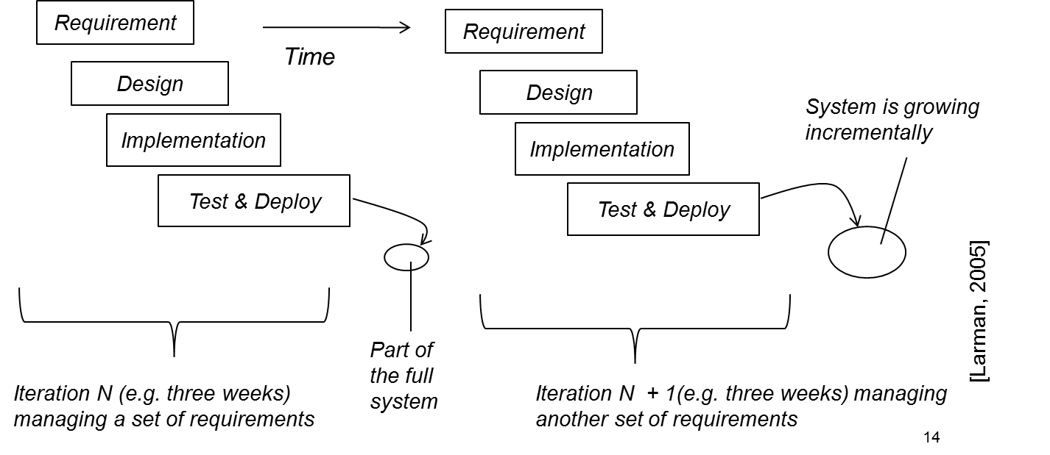
Iteration Principle
Iteration principle is based on the idea that a system should be developed in a set of mini project. Each miniproject, called an iteration, involve a limited set of requirements, which are designed, implemented and deployed to receive early user feedback

Slide 11
Waterfall Principle Evaluated
Benefit of the Waterfall principle:
easy to plan and estimate costs early in the project
the plan is easy to understand, and control/follow up
Drawback of Waterfall principle:
many systems developed using the waterfall principle are not successful, mainly due to limited customer feedback during the project
problem to handle changed requirments during development
often results in extensive production of documents that are not used (i.e. easily become bureaucratic)

Slide 12
Iteration Principle Evaluated
Benefit of the Iteration principle:
more successful results than projects based on the waterfall principle
the project receive early and rapid feedback from user
support replanning based on user feedback and changed requirements during the project
Drawback of Iteration principle:
hard to plan and estimate costs early
hard to introduce iterations and early user feedback in practice

Slide 13
Incremental/Evolutionary Development
Closely related to the interation principle are incremental and evaluationary development
Incremental development – the system is growing (in number of functions) step-by-step
Evolutionary development – the system is developed based on feedback, that is, the system is adapted given the feedback

Slide 14
Prototype
Before developing a system, a prototype can be developed.
There is no agreement on what a prototype is, but it can be seen as an early form of the final system, focusing on certain aspects of it. For example, a prototype of a system can be a drawing on a paper, or a software system focusing on the system’s user friendliness.
The prototype enables the designers to better understand design challenges for developing the final artefact, and the prototype is often constructed to obtain early user-feedback.

Slide 15
Agile Methods
Agile methods are a group of iterative system development methods that share a set of values and principles that should govern the system development – presented in the Agile Manifesto
Agiles methods also provide a set of practices to use for supporting the values and principles, for example pair programming and time boxing
Most well-known agile methods are: eXtreme Programming (XP), Scrum, Crystal, Lean Software Development

Slide 16
Agile Values
“Individuals and interactions over processes and tools”
“Working software over comprehensive documentation”
“Customer collaboration over contract negotiation”
“Responding to change over following a plan”
[Citations from Manifesto of Agile Software Development (http://agileManifesto.org)]

Slide 17
Agile Principles - Examples
“Our highest priority is to satisfy the customer through early and continuous delivery of valuable software”
“Working software is the primary measure of progress”
“Build projects around motivated individuals. Give them the environment and support they need, and trust them to get the job done”
“At regular intervals, the team reflects on how to become more effective, then tunes and adjusts its behavior accordingly”
[Citations from Manifesto of Agile Software Development (http://agileManifesto.org)]

Slide 18
Agile Practices – Examples
Pair programming – means that two programmers work together during the coding of the system. The first one, called the driver, carries out the coding, while the other, the observer, gives advices both regarding both the strategy and details
Time boxing – means that the time frame for each each iteration is specified early in the project and should not be changed. The time frames for each iteration force the develoment team to really develop the system incrementally using iterations

Slide 19
Agile Methods Evaluated
Benefits of Agile methods:
popular among system developers
very adaptive to new requirements – support constant replanning
the bureaucracy is limited – instead focus on individuals and their collaboration
Drawbacks of Agile methods:
provide limited governance support in large project
provide insufficient risk management

Slide 20
Rational Unified Process
Rational Unified Process (RUP) - also often called Unified Process
RUP is iterative and use case driven
RUP provides a loose structure of activities and instruments (including a number of UML models) that can be used
RUP needs to be configured for each projects, that is, it need to be specified which activities and instrument to be used and combined

Slide 21
RUP Evaluated
Benefits of RUP:
can be configured to suit a specific project
better in managing risk than agile methods
is use case driven which supports iterations
Drawbacks of RUP:
RUP is often criticized for being too bureaucratic if too many activities and instruments are used when configuring RUP for a project

Slide 22
Questions to answer
What is a system development method?
Why do you need system development methods?
Which different types of system development methods exists and which are their benefits and drawbacks?

