Slide 1
Fractal Enterprise Model (FEM)
– and its Usage for Business Model Innovation and Business Transformation
Ilia Bider, Erik Perjons
Dep. of Computer and Systems Sciences, Stockholm University

Slide 2
FEM in a Nutshell

Slide 3
FEM – step by step
To build a FEM, one starts with a process (in most cases a primary one) …
Sell books
over Internet

Slide 4
FEM – step by step
… then identify assets (resources) that are needed to run the process
Sell books
over Internet
Beneficiary
Workforce
Tech & Info
Infrastructure
Tech & Info
Infrastructure
Private Customer
- Book Readers
Packing and Delivering Staff
Webshop Software
IT Platform for Webshop Deployment

Slide 5
FEM – step by step
For each asset, identify how the asset is managed, that is identify the processes needed for the asset’s creation, maintenance and removal
Sell books
over Internet
Beneficiary
Workforce
Tech & Info
Infrastructure
Tech & Info
Infrastructure
Private Customer
- Book Readers
Packing and Delivering Staff
Webshop Software
IT Platform for Webshop Deployment

Slide 6
FEM – step by step
For each asset, identify how the asset is managed, that is identify the processes needed for the asset’s creation, maintenance and removal
Sell books
over Internet
Beneficiary
Workforce
Tech & Info
Infrastructure
Tech & Info
Infrastructure
Private Customer
- Book Readers
Packing and Delivering Staff
Webshop Software
IT Platform for Webshop Deployment

Slide 7
FEM – step by step
For each asset, identify how the asset is managed, that is identify the processes needed for the asset’s creation, maintenance and removal
Sell books
over Internet
Beneficiary
Workforce
Tech & Info
Infrastructure
Tech & Info
Infrastructure
Private Customer
- Book Readers
Packing and Delivering Staff
Webshop Software
IT Platform for Webshop Deployment
Aquire
Maintain
Retire
Create platform
Maintain platform
Phase out old platform

Slide 8
FEM – step by step
Then for each newly added process, once again, identify the assets that are needed for running that process
Sell books
over Internet
Beneficiary
Workforce
Tech & Info
Infrastructure
Tech & Info
Infrastructure
Private Customer
- Book Readers
Packing and Delivering Staff
Webshop Software
IT Platform for Webshop Deployment
Aquire
Maintain
Retire
Create platform
Maintain platform
Phase out old platform

Slide 9
FEM – the final model will present an hierarchy of processes and assets

Slide 10
FEM – the final model will present an hierarchy of processes and assets
Note, you can modell all - or some - of the processes and assets - depending on the goal of your modelling task

Slide 11
Build FEM – with archetypes (patterns)

Slide 12
How to identify the assets?
Sell books
over Internet

Slide 13
How to identify the assets?
Sell books
over Internet
Carry out an empirical investigation at the organization at hand

Slide 14
How to identify the assets?
Sell books
over Internet
Carry out an empirical investigation at the organization at hand
Apply archetypes (patterns)

Slide 15
How to identify the assets?
Sell books
over Internet
Carry out an empirical investigation at the organization at hand
Apply archetypes (patterns)
Combining the two activities above

Slide 16
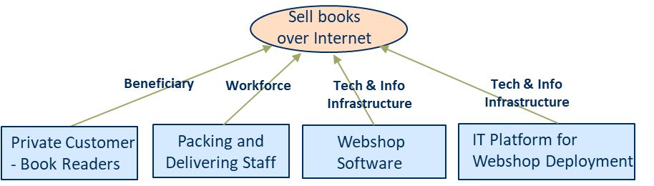
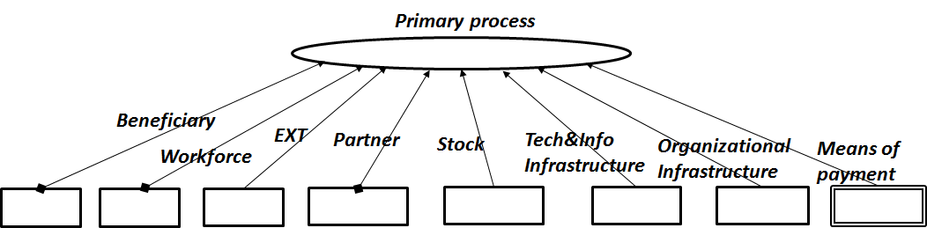
How to identify the assets?
A process-assets archetype (pattern) could be used to support the identification of assets

Slide 17
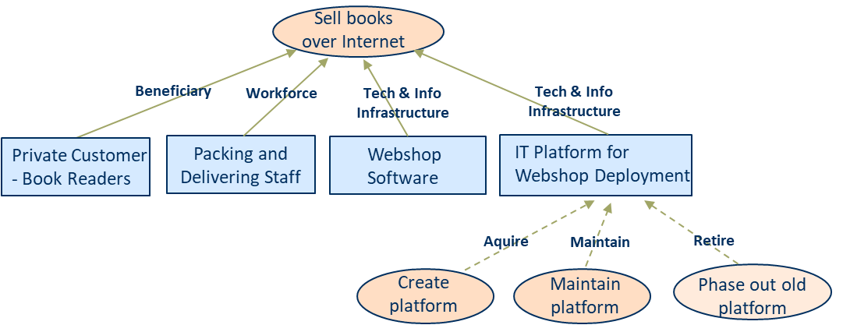
How to identify the processes?
An asset-processes archetype (pattern) could be used to support identification of processes

Slide 18
Build FEM – with archetypes (patterns)
FEM can be created by recursive application of archetypes (process-assets → asset-processes →…

Slide 19
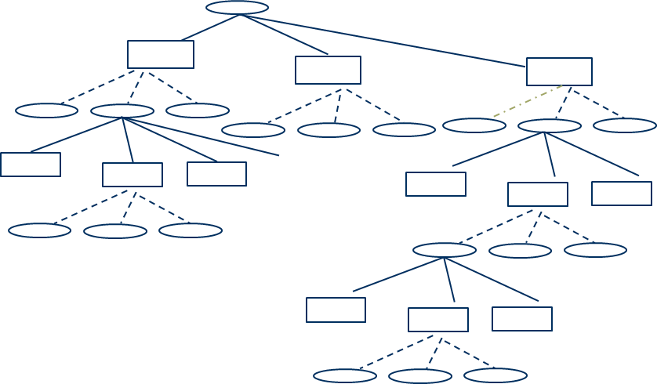
Build FEM – with archetypes (patterns)
FEM is created by recursive application of archetypes (process-assets → asset-processes →…

Slide 20
Why FEM?

Slide 21
Why FEM?
FEM visualizes the assets – the assets become central in the analysis – compared to a “traditional” business process model

Slide 22
Why FEM?
FEM relates assets to processes - showing in which process the assets are used

Slide 23
Why FEM?
Identify existing and non-existing processes and assets – by applying the archetypes and making an empirical investigation
This part could or should exist according to the archetypes, but may not exist in a specific organization. Therefore, archetypes provides a useful instrument for analysis for business analyst and/or managers

Slide 24
Why FEM?
FEM shows existing “capabilities” of the organization - that can be the base for identifying new business models

Slide 25
FEM and its Usage for Business Model Innovation

Slide 26

Have you thought ….
An organizations ’s business model
2019-2024
… that an organization’s main business model can be dead in 5-10 years … and … How does the organization addresses that?

Slide 27
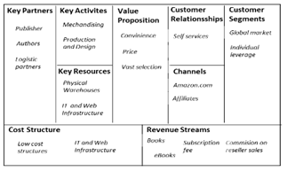
Solution: Use an existing model/method
Use an existing model/method, such as Business Model Canvas, for identifying new, innovative business ideas/models as a base for transforming the organization
Business Model Canvas
Osterwalder, A., Pigneur, Y. (2014).Business Model Generation: A Handbook for Visionaries, Game Changers, and Challengers. Wiley, Hoboken, NJ, US

Slide 28
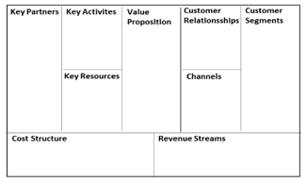
New problem
How to get from here to there?
Business Model Canvas
Business Model Canvas
AS-IS
TO-BE
?

Slide 29
Solution
Find and present (visualize) the organization’s assets (people, machines) and processes - and their relationships
Try to combine them in another way to get a new business model

Slide 30
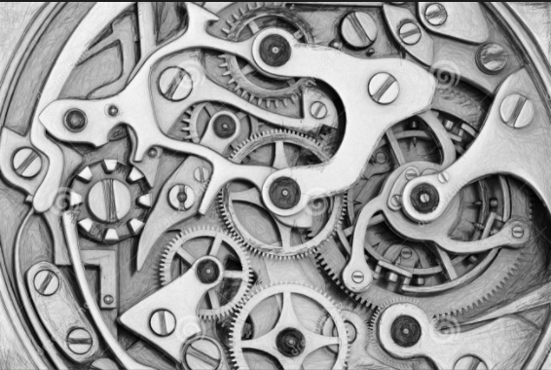
New problems
How to find the assets and processes?
  Very few, if any member of the staff, has an exact picture of how the company works
  Hoverstadt, P.: Why Business should take Enterprise Architecture seriously. In: Gøtze, J. and Jensen-Waud, A. (eds.) Beyond Alignment: Applying Systems Thinking in Ar-chitecting Enterprises. pp. 55–166. College Publications (2013)
  Assets and processes can be hidden for the management
How to show the relationships between assets and processes?

Slide 31
Solution: Model and method Support
Requirements on such model and method support:
Should visualize the processes and their assets – and the relationships between them

Slide 32
FEM and its usage for business model innovation
FEM can work as a means to identify and visualize the enterprise’s assets and processes, and show their relationships

Slide 33
Solution: Model and method support
Requirements on such Model and Method support:
Should visualize the processes and their assets – and the relationships between them
Should support generation of hypotheses of new business models

Slide 34
FEM and its usage for business model innovation
FEM can be used as a basis for generating hypotheses of new and complement business models
AS-IS
TO-BE
Existing assets and processes that can be used as a base for generating new business model

Slide 35
FEM and its usage for business model innovation
FEM facilitates generation and evaluation of hypotheses of new or complementing business models
AS-IS
TO-BE
Existing assets and processes that can be used as a base for generating new business model

Slide 36
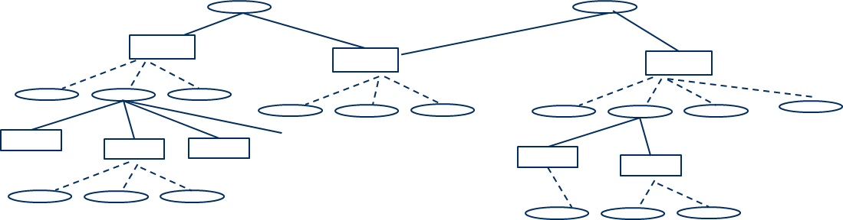
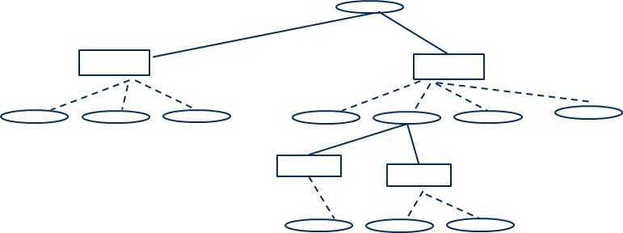
FEM and its usage for business model innovation
FEM facilitates generation and evaluation of hypotheses about new or complementing business models
Alternative 1: An organization’s to-be business model – using all existing parts as well as new parts
Alternative 2: An organization’s to-be business model – using only part of the existing business model as well as new parts

Slide 37
Solution: Model and method support
Requirements on such Model and Method support:
Should visualize the processes and their assets – and relationships between them
Should support generation of hypotheses of new business models

Slide 38
Solution: Model and method support
Requirements on such Model and Method support:
Should visualize the processes and their assets – and relationships between them
Should support generation of hypotheses of new business models
Should help to evaluate the hypotheses by identifying and analyzing needed transformations for implementing a new business model

Slide 39
FEM and its Usage for Business Transformation

Slide 40
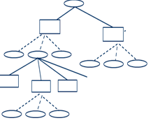
FEM and its usage for identifying and analyzing business transformation
AS-IS
TO-BE
How much extra assets are needed for supporting both processes?

Slide 41
FEM and its usage for identifying and analyzing business transformation
AS-IS
TO-BE
Can some assets and/or processes already existing in the organization be resused for the new parts – and how?

Slide 42
Applying FEM – a Demonstration

Slide 43
Applying FEM – a Demonstration

Slide 44
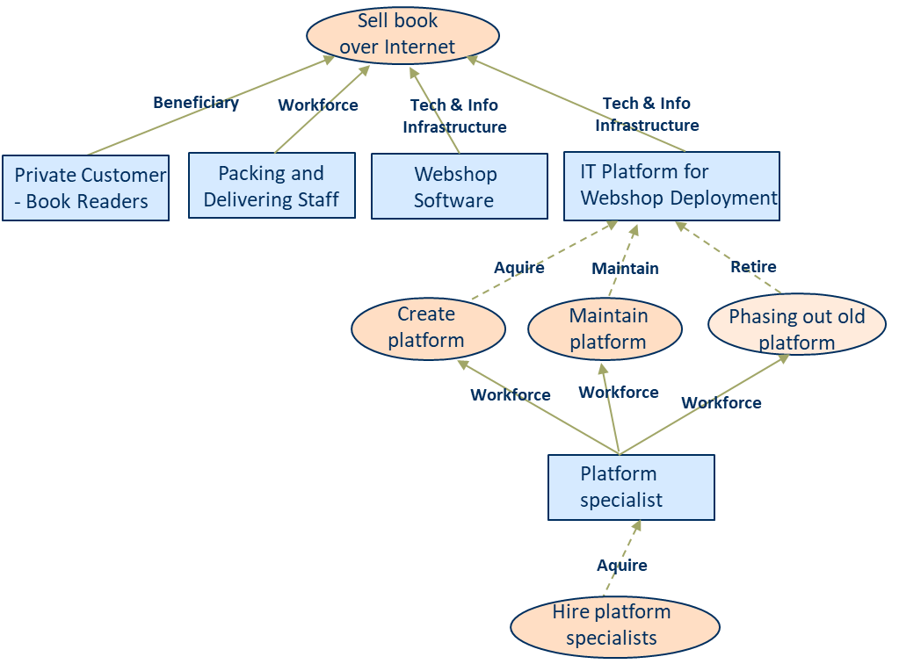
Applying FEM – a Demonstration
AS-IS

Slide 45
Applying FEM – a Demonstration
AS-IS

Slide 46
Applying FEM – a Demonstration
AS-IS

Slide 47
Applying FEM – a Demonstration
AS-IS
TO-BE

Slide 48
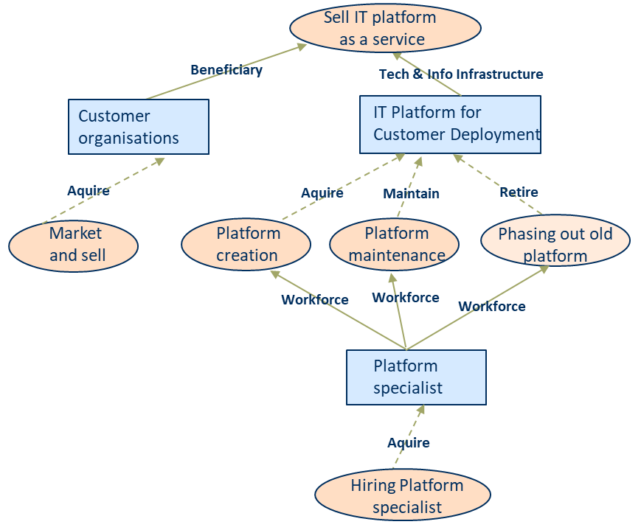
Applying FEM – a Demonstration
AS-IS
TO-BE

Slide 49
Applying FEM – a Demonstration
AS-IS
TO-BE

Slide 50
Applying FEM – a Demonstration
AS-IS
TO-BE

Slide 51
Applying FEM – a Demonstration
AS-IS
TO-BE

Slide 52
Applying FEM – a Demonstration
AS-IS
TO-BE

Slide 53
Applying FEM – a Demonstration
AS-IS
One platform vs. Several platforms
TO-BE

Slide 54
Applying FEM – a Demonstration
AS-IS
TO-BE
More platform specialists are needed

Slide 55
Applying FEM – a Demonstration
AS-IS
TO-BE
Organizational decision makers are often book readers, and the existing webshop/IT platform have good reputation among these readers

Slide 56
Comparing FEM with other Methods and Models

Slide 57
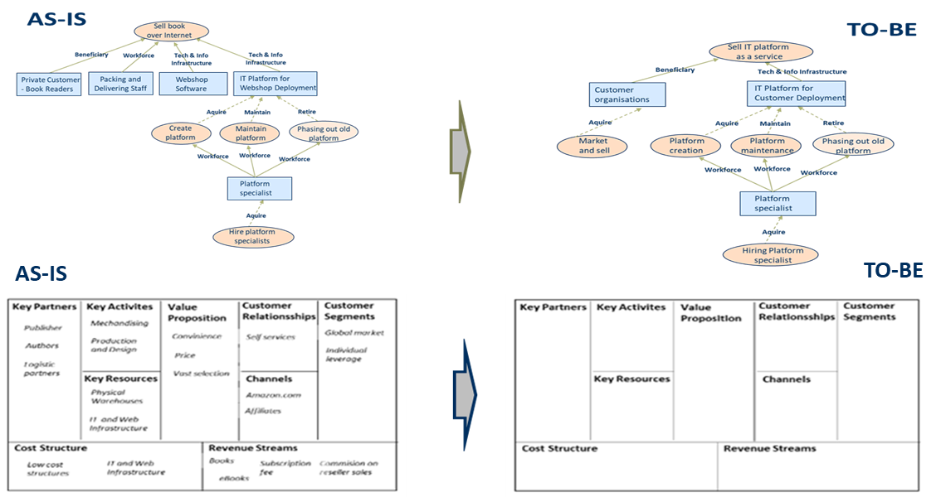
FEM vs. Business Model Canvas

Slide 58
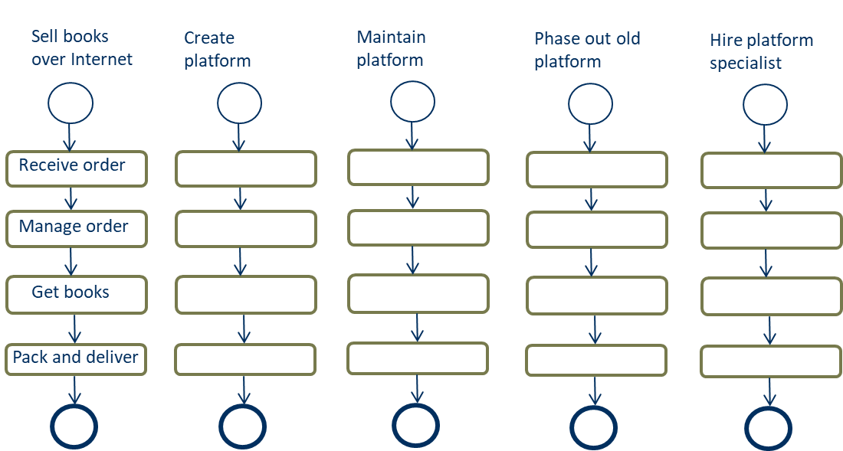

FEM vs. Workflow techniques (BPMN)

Slide 59
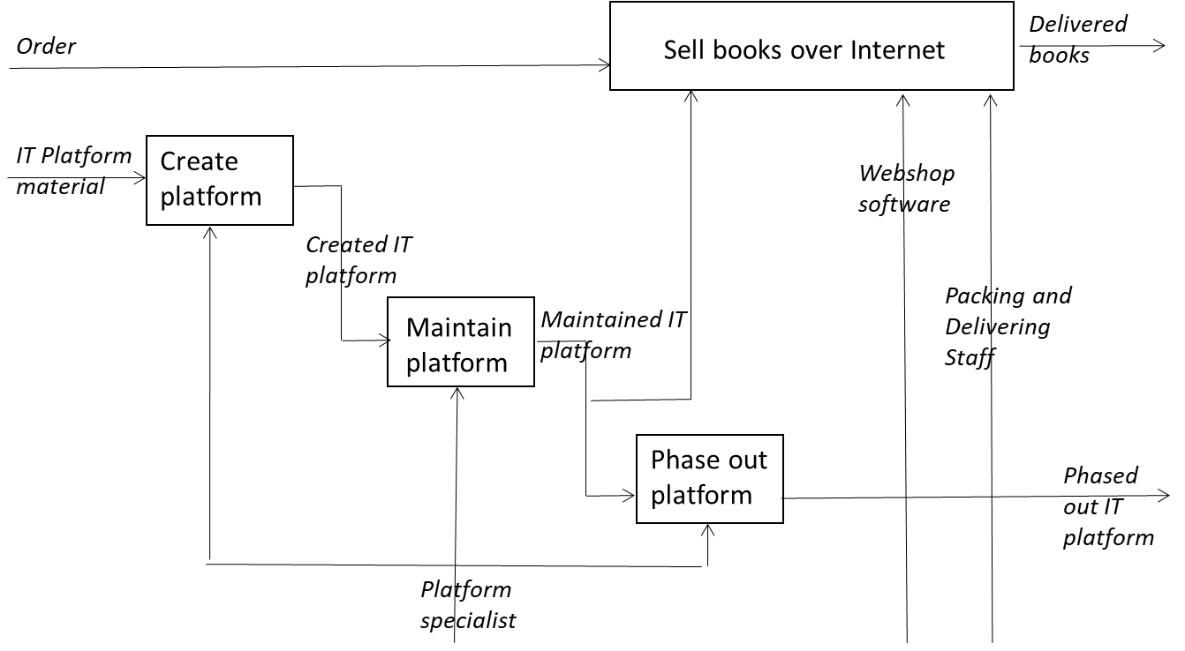
FEM vs. Input/output techniques (IDEF0)

Slide 60
IDEF0
Customer demands
Design and produce furnitures
Produced furnitures
Orders
Material
A0
Employees
Machines

Slide 61
IDEF0
Control
Customer demands
Design and produce furnitures
Produced furnitures
Orders
Material
A0
Employees
Mechanism
Machines
Input
Output

Slide 62
IDEF0
Design furniture models
Customer demands
Blueprints
A1
Routines
Produce
furnitures
Produced furnitures
Orders
Material
A2
Designers
Craftsmen
Employees
Machines

Slide 63
FEM vs. Input/output techniques (IDEF0)

Slide 64
Ongoing and Future Research

Slide 65
Ongoing and Future Research
Apply FEM in different types of organization to refine the archetypes and create best practices
Develop business transformation patterns – by identify and analyze existing business transformation in organizations
Develop a cost-benefit method for business transformations
Adapt FEM for different types of network organizations

Slide 66
Links
Info about FEM: http://bit.ly/2tMp6aM.

Slide 67
Contact
Ilia Bider, ilia@dsv.su.se
Erik Perjons, perjons@dsv.su.se

