Slide 1

Fractal Enterprise Model and its Usage for Business Model Innovation
Your company’s Business model
2017-2022
Tutorial
By Ilia Bider &
Erik Perjons
30th International Conference on Advanced Information Systems Engineering CAiSE 2018

Slide 2
Have you thought ….
Your company’s Business model
2017-2022
That you company’s main business model can be dead in 5-10 years … and how do you address that?

Slide 3
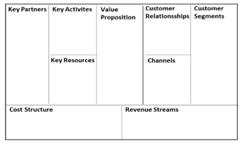
Solution: Business Model Innovation (BMI)
Three types of BMI
  Industry model innovation - which amounts to change the position in value change, entering new markets, and/or other type of radical changes.
  Revenue model innovation - which results in changes in how a company generates revenues, e.g. reconfiguring offerings and/or introducing new pricing models.
  Enterprise model innovation – which involves innovating the structure of an enterprise, such as enterprise goals, business processes, products and/or services
Osterwalder, A., Pigneur, Y.: Business Model Generation: A Handbook for Visionaries, Game Changers, and Challengers. Wiley, Hoboken, NJ,US (2014)
Giesen, E., Berman, S. J., Bell, R., Blitz, A.: Three ways to successfully innovate your business model. Strategy & Leadership, Vol. 35 Issue: 6, pp. 35(6), 27-33 (2007).

Slide 4
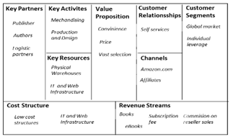
New problem
How to get from here to there?
AS-IS
TO-BE
?

Slide 5
Solution
Find the company’s assets (people, processes, machines)
Try to combine them in another way to get a new BM
In other words use destruction (of an old model) and creation (of a new one) by reconfiguring the existing elements
Boyd, J.R: Destruction and creation. Lecture presented to the U.S. Army Command and General Staff College (1976).

Slide 6
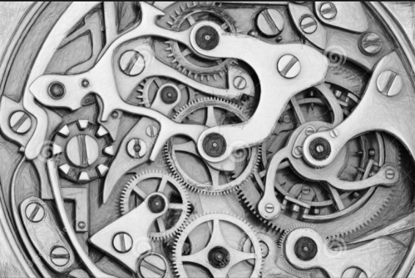
New problem
How to find the assets?
  Very few, if any member of staff has an exact picture of how the company works
  Hoverstadt, P.: Why Business should take Enterprise Architecture seriously. In: Gøtze, J. and Jensen-Waud, A. (eds.) Beyond Alignment: Applying Systems Thinking in Ar-chitecting Enterprises. pp. 55–166. College Publications (2013)
  Assets can be hidden for the management

Slide 7
Solution: Model and Method
Requirements om Model and Method support:
Should visualize the business and its assets
Should support generation of hypotheses for change
Should help to evaluate hypotheses

Slide 8
Fractal Enterprise Model (FEM)
FEM is a means to identify the enterprise’s assets that can be used as a basis for new and innovative business models

Slide 9
Fractal Enterprise Model (FEM)
FEM focuses on enterprise processes and assets and relations between them, and helps to visualize these relationships
Process
Asset (resource)

Slide 10
Fractal Enterprise Model (FEM)
FEM facilitates generation and evaluation of hypotheses about new or complementing business models based on the existing processes and assets - and helps to evaluate them
AS-IS
TO-BE

Slide 11
FEM – step by step
To build a FEM, one starts with a process (in most cases a primary one)
Book sales over Internet

Slide 12
FEM – step by step
… then assets that are needed to run process instances are identified
Book sales over Internet

Slide 13
FEM – step by step
… then assets that are needed to run process instances are identified
Book sales over Internet
Beneficiary
Workforce
Tech & Info
Infrastructure
Tech & Info
Infrastructure
Private Customer
- Book Readers
Packing and Devilvering Staff
Webshop Software
IT Plattform for Webshop Deployment

Slide 14
FEM – step by step
Then for each asset, identify how it is managed (created, maintained and removed)
Book sales over Internet
Beneficiary
Workforce
Tech & Info
Infrastructure
Tech & Info
Infrastructure
Private Customer
- Book Readers
Packing and Devilvering Staff
Webshop Software
IT Plattform for Webshop Deployment

Slide 15
FEM – step by step
Then for each asset, identify how it is managed (created, maintained and removed)
Book sales over Internet
Beneficiary
Workforce
Tech & Info
Infrastructure
Tech & Info
Infrastructure
Private Customer
- Book Readers
Packing and Devilvering Staff
Webshop Software
IT Plattform for Webshop Deployment

Slide 16
FEM – step by step
For each assets, identify the processes for its creation, maintenance and removal
Book sales over Internet
Beneficiary
Workforce
Tech & Info
Infrastructure
Tech & Info
Infrastructure
Private Customer
- Book Readers
Packing and Devilvering Staff
Webshop Software
IT Plattform for Webshop Deployment
Aquire
Maintain
Retire
Platform creation
Platform maintenance
Phasing out old platform

Slide 17
FEM – step by step
Then for each newly added process, once again, identify the assets that are needed for running its instances
Book sales over Internet
Beneficiary
Workforce
Tech & Info
Infrastructure
Tech & Info
Infrastructure
Private Customer
- Book Readers
Packing and Devilvering Staff
Webshop Software
IT Plattform for Webshop Deployment
Aquire
Maintain
Retire
Platform creation
Platform maintenance
Phasing out old platform

Slide 18
FEM – step by step
Then for each newly added process, once again, identify the assets that are needed for running its instances
Book sales over Internet
Beneficiary
Workforce
Tech & Info
Infrastructure
Tech & Info
Infrastructure
Private Customer
- Book Readers
Packing and Devilvering Staff
Webshop Software
IT Plattform for Webshop Deployment
Aquire
Maintain
Retire
Platform creation
Platform maintenance
Phasing out old platform

Slide 19
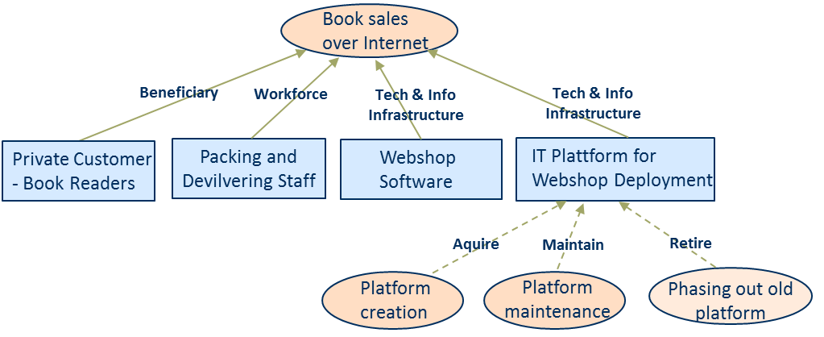
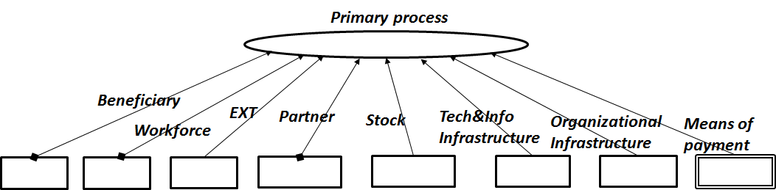
Build FEM – with archetypes (patterns)
To support identification of assets for a process one can use a process-assets archetype

Slide 20
Build FEM – with archetypes (patterns)
“Process-assets” archetype

Slide 21
Build FEM – with archetypes (patterns)
To support identification of processes for an asset one can use a process-assets archetype

Slide 22
Build FEM – with archetypes (patterns)
“Asset-processes” archetype

Slide 23
Build FEM – with archetypes (patterns)
FEM is created by recursive application of archetypes (process-assets → asset-processes →…

Slide 24
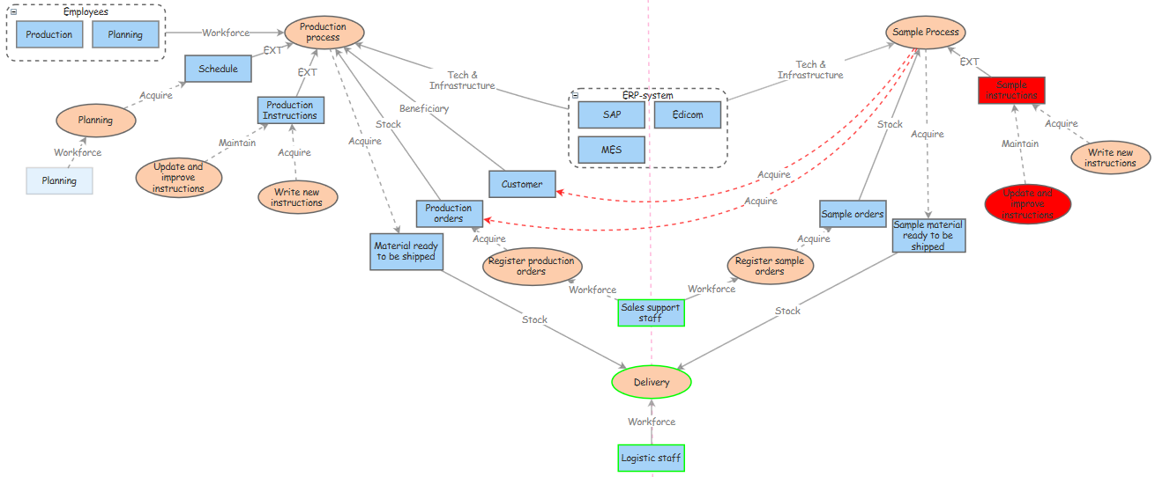
Examples of FEM

Slide 25
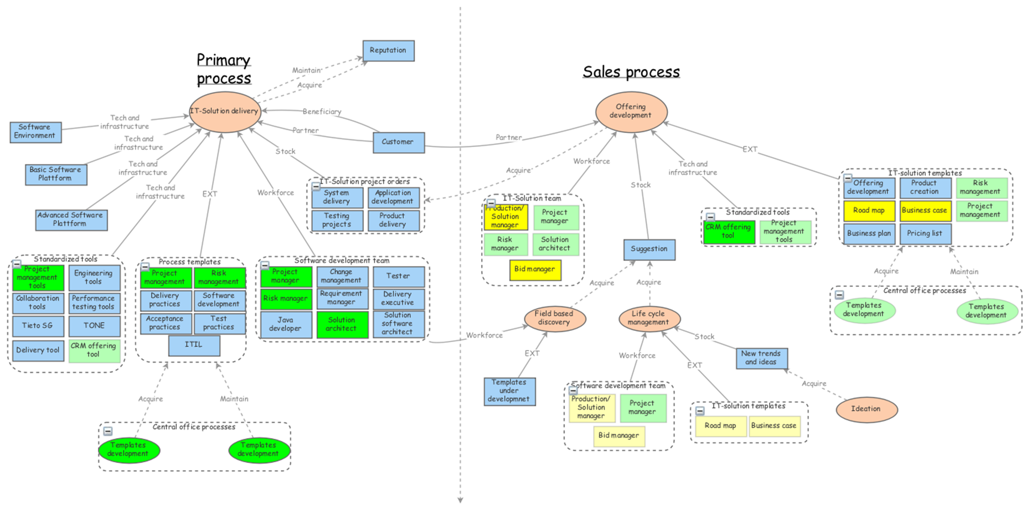
Examples of FEM

Slide 26
What is special with FEM?
It is possible to build a FEM relatively quickly using archetypes

Slide 27
What is special with FEM?
Reveals all assets that exists in the enterprise that can be used for BMI

Slide 28
What is special with FEM?
Relates assets to the processes which gives an overview where they are used

Slide 29
What is special with FEM?
Supports the process of finding the enterprise’s assets (and processes) that can be a foundation for a new BM

Slide 30
What is special with FEM?
Supports evaluation of hypothesis

Slide 31
Publications of FEM
  Bider, I., Perjons, E., Elias, M., & Johannesson, P. (2016). A fractal enterprise model and its application for business development. Software & Systems Modeling, 1-27.
  Josefsson, M., Widman, K. &Bider, I. (2015). Using the Process-Assets Framework for Creating a Holistic View over Process Documentation. In : Enterprise, Business-Process and Information Systems Modeling, LNBIP, Vol. 214. Springer, Stockholm (2015) 169-183,
  Henkel, M., Bider, I. & Perjons, E. (2014, June). Capability-based business model transformation. In International Conference on Advanced Information Systems Engineering (pp. 88-99). Springer International Publishing.
  Elias, M., Bider, I. & Johannesson, P. (2014). Using Fractal Process-Asset Model to Design the Process Architecture of an Enterprise: Experience Report. In BPMDS 2014 and EMMSAD 2014. LNBIP 175, Thesalonniki, Greece. Springer, pp.287-301.
  Bider, I., Perjons, E. & Elias, M. (2012). Untangling the Dynamic Structure of an Enterprise by Applying a Fractal Approach to Business Processes. In Proceedings of PoEM 2012. LNBIP 134, Oslo, Norway. Springer, pp.61-76.

Slide 32
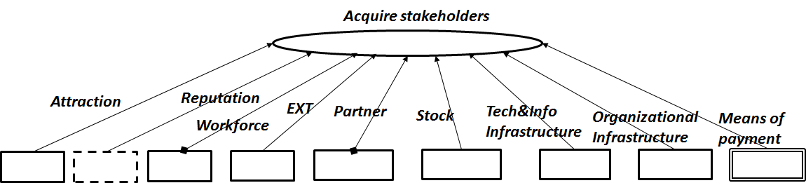
Archetypes

Slide 33
Archetypes - Instantiation

Slide 34
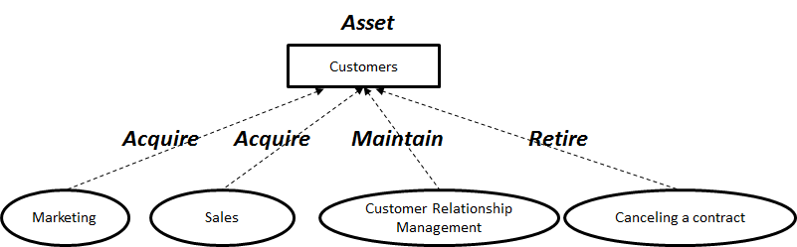
Archetypes - Instantiation

Slide 35
Links
-The presentation of the CAiSE 2018 tutorial:
https://people.dsv.su.se/~perjons/FEM/
- Example of Business Model Innovation from the CAiSE 2018 tutoral:
http://bit.ly/2qakWJR or use this link:
https://insightmaker.com/insight/67969/Debating-Businesss-Model-Transformation-an-Example (Press "View story" in the left bottom corner and use Step forward in the right bottom corner)
- A short paper that takes this example:
http://ceur-ws.org/Vol-1859/bpmds-02-paper.pdf
- Erik's slides when presenting the above paper at a research conference. A YouTube recording is included
https://www.slideshare.net/ilia12/using-a-fractal-enterprise-model-for-business-model-innovation
- Research paper with detailed information, but might be too heavy to read:
https://link.springer.com/article/10.1007/s10270-016-0554-9
- One more example of a FEM model, from the paper above, related to teaching& learning
https://insightmaker.com/insight/19994/Teaching-Learning

Slide 36
Contact
Ilia Bider, ilia@dsv.su.se
Erik Perjons, perjons@dsv.su.se

