Slide 1

Presentation:
Summary
Erik Perjons
DSV, Stockholm University

Slide 2
The goals of and requirements on the data warehouse
Kimball/Roll’s bedrock requirements for the DW/BI system can be interpreted as the goals of a data warehouse (since requirements on a system can seen as a type of a system)
The DW/BI system must make information easily accessable (simpe and fast)
The DW/BI must present information consistently
The DW/BI system must present information in a timely way
The DW/BI system must adapt to change
The DW/BI system must serve as the authoritative and trustwothy foundation for improved decision making
The business community must accept the DW/BI system to deem it successfully

Slide 3
The goals of and requirements on the data warehouse
Also Inmons’ data warehouse definition can be interpreted as containing requirements on - or goal of - a data warehouse
A data warehouse is a subject oriented, integrated, non-volatile, and time-variant collection of data in support of management’s decisions”.
This definition can be interpreted as following:
  A data warehouse - aims to be - or needs to be:
    subject oriented
    integrated
    non-volatile
    time-variant

Slide 4
The goals of and requirements on the data warehouse
In the beginning of Lecture 1, I also presented some requirements on - or goals of – a Data warehouse, based on some problem stated by Kimball/Ross (page 3)
We need Accessibility to the data for users not very familiar with IT and data structures
We need Data integration on the basis of a standard enterprise model
We need Query flexibility to maximise advantages obtained on the run
We need Information conciseness allowing target oriented and effective analysis
We need Correctness and Completeness of integrated data
We need a solution that captures Historical data
We need to optimize Read performance

Slide 5
The benefits of data warehouse
Time saving for users
More and higher quality of information
Better decisions
Improvement of business processes
Support for accomplish strategic business goals
easy to measure/local impact
hard to measure/global impact
(Watson, H. J., Goodhue, D. L., & Wixom, B. H. (2002). The benefits of data warehousing: why some organizations realize exceptional payoffs. Information & Management, 39(6), 491-502.)

Slide 6
DW characteristics
What is characteristics regarding data warehouse, according to Chaudhuri&Dayal (1997):
SQL extensions (operators like Cube, Crossjoin)
Index structures (bit map indexes, join indexes)
Materialized views (pre-calculated aggregations)
(Chaudhuri, S., & Dayal, U. (1997). An overview of data warehousing and OLAP technology. ACM Sigmod record, 26(1), 65-74.)

Slide 7
More about DW characteristics
The data is organised differently, i.e. “multidimensional”
  star-joins schemas
  snowflake schemas
The data is viewed differently
  multidimensional view
The data is stored differently
  vector (array) storage for MOLAP solutions
The data is indexed differently
  bitmap indexes
  join indexes

Slide 8
Different DW Archtectures
Kimball/Ross’ DW/BI Architecture
Inmon’s Hub-and-Spoke Corporate Information Factury Archiecture?
Kimball’s/Ross’ suggested Hybrid Architecture
Centralized Architecture
Federated Architecture
Independent Data Mart Architecture
(See Lecture 5, papers as part of the course literature, and Kimball & Ross, chapter 1)

Slide 9
Other archtectural and strategic issues
Data marts – independent and dependent
Operational data store (note, not the same as staging tables used in the ETL process)
Master data and master data management system

Slide 10
Other archtectural and strategic issues
BI vs. Big Data
Data lake
The future for DW in business intelligence
BI strategy and DW
Data brokers
Metadata repository

Slide 11
Operational Data Store (ODS)
Operational data store is a system sitting between the operational systems and the data warehouse providing operational reporting, especially when neither other operational (OLTP) systems or the data warehouse can provide near real time – and somewhat integrated – operational data
Note the discussion about dependent
and independent data marts
Note that ETL could exist also here
Note that a data warehous also could feed a ODS

Slide 12
Four steps to design a star schema
Select a Business Process
1
Declare the Grain
2
Identify the Dimensions
3
Identify the Facts
4

Slide 13
Dimensional modelling patterns
Transaction Fact Table, Periodic Snapshot Fact Table, Accumulating Snapshot Fact Table
Factless fact table
  Event tracking tables
  Coverage tables
Heterogenous products: Core and custom fact tables

Slide 14
Dimensional modelling patterns
Slowly changing dimensions Type 1, 2 and 3
Minidimension
Degenerated dimensions
Junk dimensions
Time dimension

Slide 15
Other dimensional modelling concepts
Conformed dimension, conformed fact
Denormalized dimensions
The use of surrogate key, concatenated key, natural key, smart keys etc.
Additive, semi-additive and non-additive facts
Sparse fact table

Slide 16
Other dimensional modelling concepts
Textual values in fact vs dimensional columns/attributes
Hierarchies of attributes
Preaggregated fact tables
The concept of cube
Data integrity
Declare the grain
Fiscal year

Slide 17
Other dimensional modelling concepts
Enterprise Data Warehouse Buss Matrix
Outriggers
Different kind of aggregations
Snowflake schema

Slide 18
Why dimensional modelling?
the logical model is easy understand
a predictable standard framework for end user applications
the logical design can be done nearly independent of expected query pattern
handle changes easy - adding new dimensional attributes, and adding new dimensional tables

Slide 19
Why dimensional modelling?
high performance “browsing” across the attributes and query performance, eliminating joins and make use bit vector indexes
strategy to handling aggregates, e.g. summery records that are logical redundant with base table to enhance query performance
the database engine can make strong assumption how to optimise
strategies for handling slowly changing dimensions, heterogeneous products, event-handling (“factless fact tables”)

Slide 20
ETL architetures
Different architecture
  Staggered staging
  Persistent staging
  Pipeline staging
  Chuncked Accumulated staging
  Ackumulated staging
Staging tables

Slide 21
ETL issues
Source system issues
Extract issues
Data cleansing issues
Dimensional building issues
Fact building issues
One time historic load processing vs. incremental load processing

Slide 22
Kimball/Ross’ ETL process
Subprocess 1: Develop a plan (and its substeps 1-4)
Subprocess 2: Develop on-time historic load processing (and its substeps 5-6)
Subprocess 3: Develop Incremental ETL Processing (and its substeps 7-10)

Slide 23
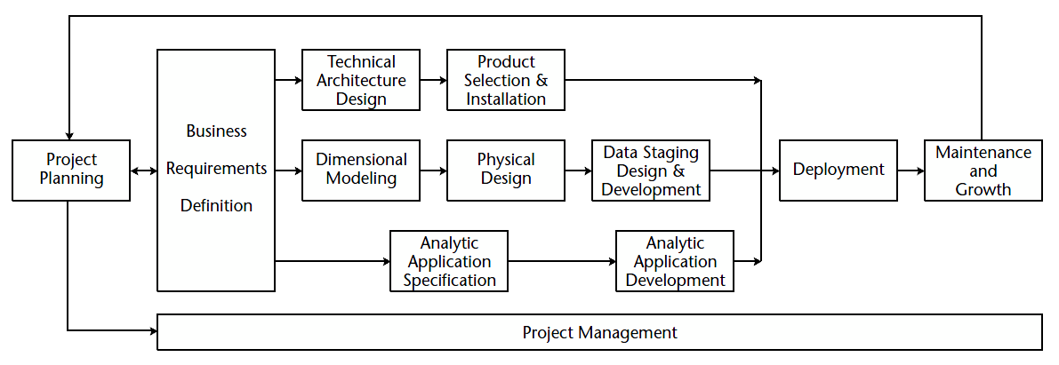
DW/BI Lifecycle

Slide 24
OLAP
OLAP – the concept of OLAP
MOLAP, ROLAP, HOLAP solutions
Loading the cube in MOLAP

