Slide 1
Presentation: OLAP and DW/BI Lifecycle, Part 1
Erik Perjons
DSV, Stockholm University

Slide 2
OLAP

Slide 3
OLAP – as an approach
OLAP (Online Analytical Processing) is an interactive approach for analyzing data from multidimensional perspectives/views/dimensions
OLAP is often contrasted to OLTP (Online Transaction Processing).
OLAP - aims to answer complex queries for business analysis, most often involving several transactions in order to provide aggregated information about the business. OLAP also aims to answer such complex queries quickly. Moreover, OLAP is optimized for answering such queries and not for operations such as update, delete and insert
OLTP - aims to process large volume of non-complex queries (including create, read, update, delete, insert) supporting operational business processes. OLAP queries often involve only one transaction at a time

Slide 4
OLAP – as an approach
OLAP use three basic operations for analyzing data:
roll-up/consolidation (aggregation of base data computed in one or more perspectives/views/dimensions, usually by climbing up hierarchy or by dimension reduction)
drill-down (navigate from higher level summary to lower level summary or detailed data, or introducing new dimensions)
slicing and dicing (slicing/take out a specific set of data and dicing/view the slices from different perspectives/views/dimensions)

Slide 5
OLAP – and the cube
OLAP is closely related to the concept of a data cube
A concept of the cube provide a way of structure the data and express relationships between the data using numeric facts/measures and dimensions/viewpoints
The dimensions provide the context or metadata (or label) to the numeric facts/measures.
The numeric facts/measures are placed in the intersection (in the cell of a cube) of user selected dimensional attributes and values

Slide 6
OLAP – and the cube
An example:
Sales amount $ 30 (fact, measure) does not say so much.
Dimensional attributes and values are added to give the $30 meaning, such as Month of Dec 2018 (dimensional attribute and value) and Store in the city of Falun, Sweden (dimensional attribute and value).
That is $ 30 is the amout sales during Dec 2018 in the store in Falun.

Slide 7
OLAP – and the cube
The use of pre-aggregated measure are an important part of OLAP cube
This pre-aggregated measures is a mechanism that provide rapid answers to complex analytic queries
An aggregate function is used to aggregate base data. This is called loading or building och processing the cube

Slide 8
OLAP – and the cube
The aggregate function aggregate data along dimensional attributes, organized in hierarchies (such as date, month, and year in the date dimension, or product, and product category in the product dimension)
These loading or building the OLAP cube with aggregated data is done in so called MOLAP servers.

Slide 9
OLAP - and the data model
OLAP is supported by a specific data model used by databases, called the dimensional data model (or the multidimensional data model)
The dimensional data model makes it possible to answers complex and ad hoc queries rapidly
The dimensional data model structures the data, as in the concept of cube described earlier, in facts (also called measures) and dimensions (context or metadata to the facts)

Slide 10
OLAP - as a system
There are three basic forms of OLAP systems: ROLAP, MOLAP and HOLAP

Slide 11
Multidimensional OLAP (MOLAP)
MOLAP (Multidimensional OLAP) – is a OLAP system that support the OLAP operations (that is, Roll up, Drill down and Slicing and Dicing) by loading data in a multidimensional array, called the MOLAP cube or data cube
OLAP server
End-user access tools
MDX
request
server5
response
Multi-dimensional Storage
OLAP Server

Slide 12
Multidimensional OLAP (MOLAP)
MOLAP store data in an array that provide very fast answers to queries due to:
multidimensional indexing (natural indexes in MOLAP since the indexes can be part of the array)
pre-calculating aggregrations (carried out in an automated way during data load, based on the dimensional hierarchies). The result of such pre-calculating aggregrations is sometimes refered to as the data cube or OLAP cube. The data cube consist of all possible answers given a certain range of queries

Slide 13
Benefits of MOLAP
Rapid answer to queries
Less storage space due to smart compression techniques
Possibility to automated the aggregation function, thereby perform pre-calulation of aggregations, that is loading the data cube or OLAP cube

Slide 14
Drawbacks of MOLAP
The load of data into the cube is time consuming, especially if the data volumes are large (however, this can be manage by just updating the last changed data)

Slide 15
Relational OLAP (ROLAP)
ROLAP (Relational OLAP) – is a OLAP system that support the OLAP operations (that is, Roll up, Drill down and Slicing and Dicing) by using a dimensional data model in a relational database
Relational Database server
OLAP server
End-user access tools
server5
request
request
server5
response
response
SQL
OLAP Server
Database

Slide 16
Relational OLAP (ROLAP)
That is, ROLAP, manipulate the data stored in a relational database so that it looks like a MOLAP solution
Relational Database server
OLAP server
End-user access tools
server5
request
request
server5
response
response
SQL
OLAP Server
Database

Slide 17
Relational OLAP (ROLAP)
ROLAP provide OLAP operations (Slicing and Dicining) by adding ”WHERE” clausuls in SQL statements
ROLAP does not use pre-calculated data cubes

Slide 18
Relational OLAP (ROLAP)
ROLAP can provide fast aggregated result (Roll up) by either:
carry out aggregation on the fly by using the dimensional data model, and calculate the facts given the dimensional attributes and attribute values selected
make use of pre-aggregated data by using the dimensional data model again, but this time adding new fact tables with pre-aggregrated data. Also some new dimensional tables need to be added, for exampel, a dimensional table where the grain is based on month and not date

Slide 19
Benefits of ROLAP
ROLAP solutions scale better than MOLAP if the data volumes are large
No cube to load, as in MOLAP. Such data load in MOLAP is time consuming, especially if the data volumes are large
SQL tools can be used for manipulating the data since data is stored in a relational database
Datamodelling become simpler in ROLAP if the data do not fit in the dimensional data model

Slide 20
Drawbacks of ROLAP
Lower query performance than MOLAP
Preaggregation must be manage via the ETL process (you do not load a cube), which require more time to develop the ETL system
It is not practical to create a large number of pre-aggregregated fact and dimensional tables to store pre-calulated aggregation

Slide 21
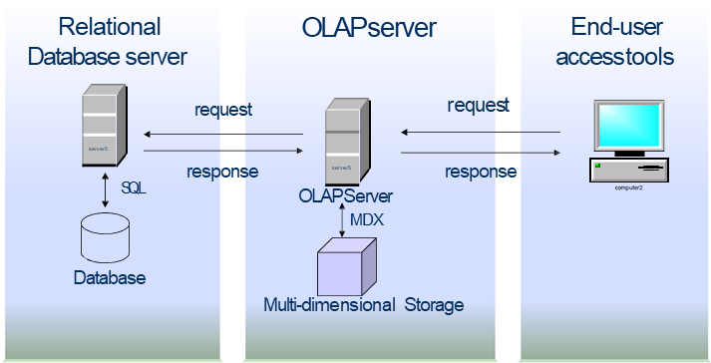
Hybrid OLAP (HOLAP)
HOLAP (Hybrid OLAP) is a OLAP system that combine both MOLAP and ROLAP functionalities, that is, use both relational database sources for data (ROLAP) and pre-calculated cubes of data (MOLAP)

Slide 22
Hybrid OLAP (HOLAP)
The designers/developers can select which data to be stored in the MOLAP solution and which data to be stored in the ROLAP solution

Slide 23
Hybrid OLAP (HOLAP)
Two strategies for combining MOLAP and ROLAP solutions:
Vertical partitioning:
HOLAP store aggregations in MOLAP – for fast querying
HOLAP store detailed data in ROLAP – for lessen the time to load data in a cube by not loading detailed data in the cube, and for better scalability by using ROLAP
Horizontal partitioning
HOLAP store most recent data (or some other slice of data) in MOLAP – for fast querying
HOLAP store the rest of the older data i ROLAP – for lessen the time to load data in a cube by not loading detailed data in the cube, and for better scalability by using ROLAP

Slide 24
Aggregates

Slide 25
What is aggregates?
Aggregates are pre-calculated summary data

Slide 26
Why aggregates?
Aggregates are introduced to answer complex queries more rapidly

Slide 27
Different types of aggregations
MOLAP aggregates
pre-calculated aggregrates in the cube (pre-calulated during data load of the cube)
ROLAP aggregates
Pre-calculated aggregrates stored in new aggregated fact tables in star schemas (pre-calculated during the ETL process)
ROLAP – Aggregation on the fly
Aggregations on the fly (summing up additive and semiadditive facts using the star schema structure)

Slide 28
Aggregated fact tables (ROLAP)
Pre-calculated aggregates are stored in new aggregated fact tables in star schemas (pre-calculated during the ETL process)
These aggregate are stored together with atomic base fact tables in star schemas
That is, in a dimensional data model there will be both star schemas with aggregated fact tables and star schemas with atomic fact tables
Also new, so called, rolled up dimensional tables, need to be added to fit the aggrated fact tables. Rolled up dimensions are shrunken versions of the dimensions associated with the granular base facts.

Slide 29
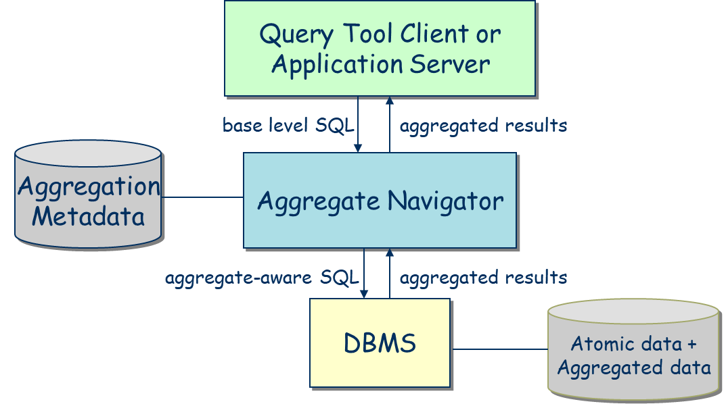
Aggregation navigator
An aggregation navigator is a software that are using aggregation metadata to identify if there exist aggregated tables that could handle a query or if atomic base tables are need for handling the query

Slide 30
Aggregation navigator
If the aggregation navigator identify – using aggregation metadata - that a SQL query could be send to aggregrated tables, the aggregation navigator will automatically change the SQL code to fit the aggregrated tables

Slide 31
HOLAP solutions
A similar solution as the aggregation navigator could be used for deciding if a query should be send to a MOLAP or a ROLAP system in a HOLAP solution

Slide 32
Metadata repository

Slide 33
Metadata repository
Data staging
Monitoring & Administration
Analysis
Analytic applications
 | Productt | Time1 | Value1 | Value11
 | Product2 Product3 | Time2 Time3 | Value2 Value3 | Value21 Value31
 | Product4 | Time4 | Value4 | Value41
OLAP
cubes
Metadata repository
Data warehouse
Operational DBs
Ad hoc Query/Reporting
Extract Transform Load Refresh
Access
External sources
Forecasting, scoring, Data mining
Data marts
Falö aöldf flaöd aklöd falö alksdf
Data sources
Staging Tables & ODS
RDBMS, Rolap, Molap, Holap
End User Applications

Slide 34
Metadata repository
A metadata repository is integrated complete source of metadata
The metadata repository is at the heart of the data warehouse architecture
The metadata repository supports the information needs of system developers, data administrators, system administrators, users, applications of the data warehouse
The metadata repository must always be up to date

Slide 35
Different types of metadata 1(2)
Administrative metadata - information necessary for setting up and managing the data warehourse:
source databases
fact and dimension tables
aggregates
hierarchies
predefined queries
physical organisation
rules, script, staging tables for ETL
back-end and front end tools

Slide 36
Different types of metadata 2(2)
Business metadata:
business terms and definitions
ownership of data
quality rules
etc
Operational metadata - information collected during the operations of the DW:
usage statistics
error reports

Slide 37
Index

Slide 38
What is a database index?
A database index is a data structure that speed up the data retrieval operations in database tables
A database index is a type of copy of the data in database table columns and this copy can be searched efficiently
The index also contain a link or address to the real data in table column

Slide 39
Why using indexes?
Without indexes, the DBMS may be forced to conduct a full table scan, i.e., reading every row in the table to locate the right data.
Instead, index scans are much more efficient than searches of data base tables

Slide 40
Indexes used in DW and OLAP
The increased focus on DW and OLAP and complex queries has resulted in the development and use of “bit map indexes” and “join indexes”

Slide 41
Bitmap Index
Base Table
Region Index
Rating Index
SELECT Cust
FROM Base Table
WHERE Region = W AND Rating = L
Notes:
Text from Ramakrishnan&Gehrke, sid 691 (men exempeln är det samma som jag hade förra året)
Consider a table that describes customers:
CUST(Custid:Int, Region:String, Rating:String, …)
where Domain(Region) = {N,W,S,E} and Domain(Rating) = {H,M,L}
Columns with few possible values are called sparse [like, Region and Rating]. We can exploit sparsity to construct a new kind of index that greatly speeds up queries on these columns.
The idea is to record values for sparse columns as a sequence of bits, one for each possible value.” For example, a rating value is 100, 010, or 001, a 1 in first position denotes ‘high’, a 1 in second position denotes ‘medium’, and a 1 in third position denotes ‘low’. Similarly, for region, 1000 denotes ‘North’, 0100 denotes ‘Sought’, 0010 denotes ‘East’, and 0001 denotes ‘West’.
If we consider the rating values for all rows in the Customer table, we can treat this as a collection of three bit vectors, one of which has the associated value ‘high’, the other one the associated value ‘medium’ and the third one has the associated value ‘low’. Each bit vector has one bit per row in the Customers table, indication whether the value in that row is the value associated with the bit vector. The collection of bit vectors for a column is called a bitmap index for that column.

Slide 42
Bitmap Index
Base Table
Region Index
Rating Index
Region = W
AND
Rating = L
Notes:
Bitmap indexes offer two important advantages over conventional hash and tree indexes. First, they allow the use of efficient bit operations to answer queries. For example, consider the query “How many customer from the West region are rated as low”. We can take the fourth bit vector for Region and do a bit-wise and AND with the third bit vector for Rating to obtain a bit vector that has 1 for every West-living customer with rating Low. We can then count the number of 1s in this bit vector to answer the query.
Second, bitmap indexes can be much more compact than a traditional B+ tree index and are very amenable to the use of compression techniques.

Slide 43
Bitmap Index
Base Table
Region Index
Rating Index
Region = W
AND
Rating = L

Slide 44
Bitmap Index
An effective indexing technique for attributes with low-cardinality domains
There is a distinct bit vector BV for each value V of the domain

Slide 45
Join Index
Providing good performance from queries that require multitable joins of large tables has been an ongoing challenge for DBMS architects
Join index can be seen as a ”pre-computed” join. That is, the indexes consist of references to those rows in two or more tables that satified the join condition

Slide 46
Example

Slide 47
Join Index - Ex

Slide 48
Join Index - Ex

Slide 49
Join Index - Ex

Slide 50
Snowflake schema

Slide 51
What is a snowflake schema?
A snowflake schema is a star schema where some dimensional hierarchy is normalized into a set of smaller dimension tables, forming a shape similar to snowflake

Slide 52
Snow-flake schema
Year
Service used
- service name
Month
Time
- date
Telephone calls
Quarter
Service group
- sum ($)
- number of calls
Region
Customer
Sales Dimension
- customer name
- address
- seller name
Income group
Office

Slide 53
Kimball and snowflaking
Kimball’s critics against snowflaking:
a more complex structure
numerous tables and joins usually translate into slower performance
insignificant disk space savings
slow down the users’ ability to brows within the dimension
defeat the use of bit map indexes

Slide 54
Coverage table

Slide 55
Factless fact tables
Some fact tables quite simply have no measured facts
These fact tables are useful to describe events and coverage, i.e. the tables contain information that something has (event tracking) or has not (coverage table) happened
There are several types of factless fact tables, two of the most common are:
event tracking tables
coverage tables

Slide 56
Event tracking (factless fact) tables
An event tracking table - records events, e.g. records every time a student attends a course (see figure), or people involved in accidents and vehicles involved in accidents
Notes:
Interesting questions:
Which classes were most attended?
Which teatchers taught the most students?
Which facilities were most used?

Slide 57
Coverage (factless fact) tables
Covarage tables is a table that contain information of what has not happened

Slide 58
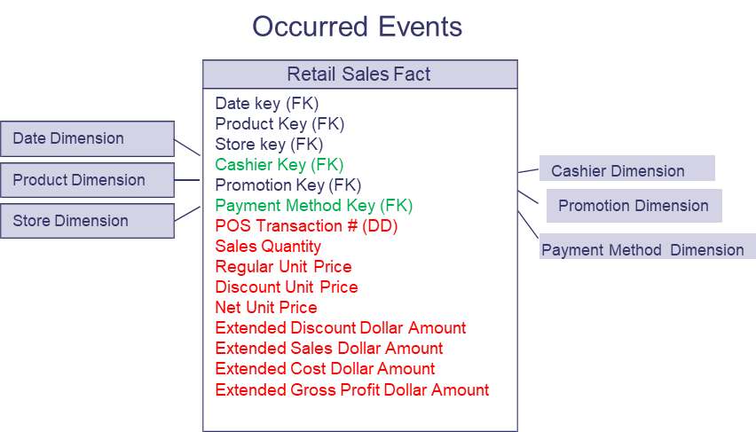
Coverage (factless fact) table
An example: What products were on promotion but did not sell?
The sales fact table records only the SKUs actually sold.
Therefore, we need to create a factless fact table that cover all product that is part of the promotion

