Slide 1
Presentation: DW Architechtures
Erik Perjons
DSV, Stockholm University

Slide 2
Four types of Data Warehouse architectures

Slide 3
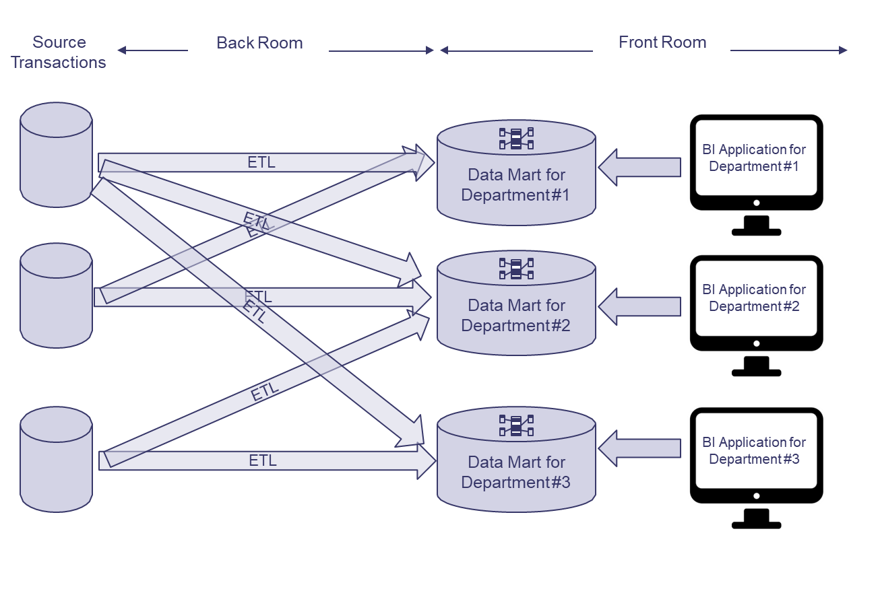
Independent Data Mart Architecture
(Kimball & Ross, 2013)

Slide 4
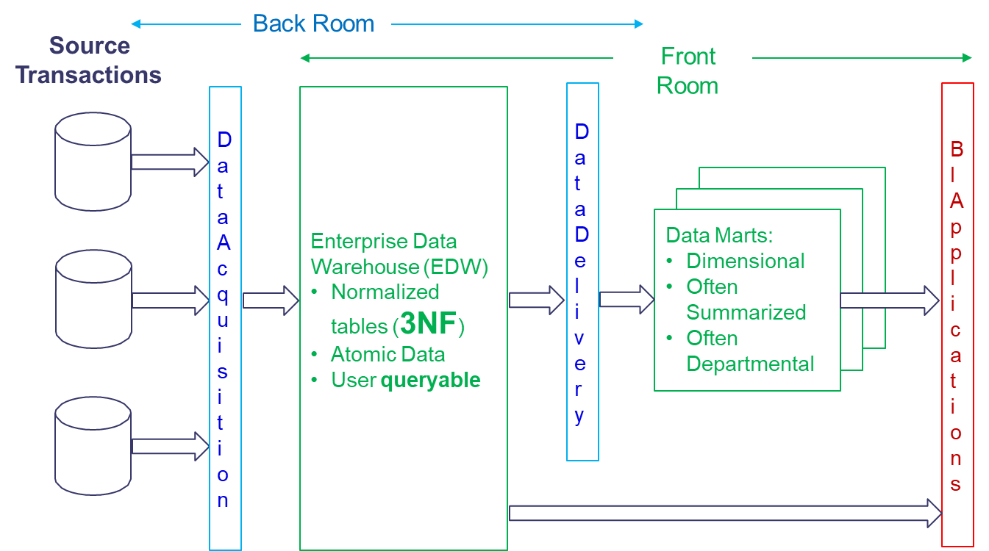
Hub-and-Spoke Corporate Information Factury Archiecture (Inmon)
(Kimball & Ross, 2013)

Slide 5
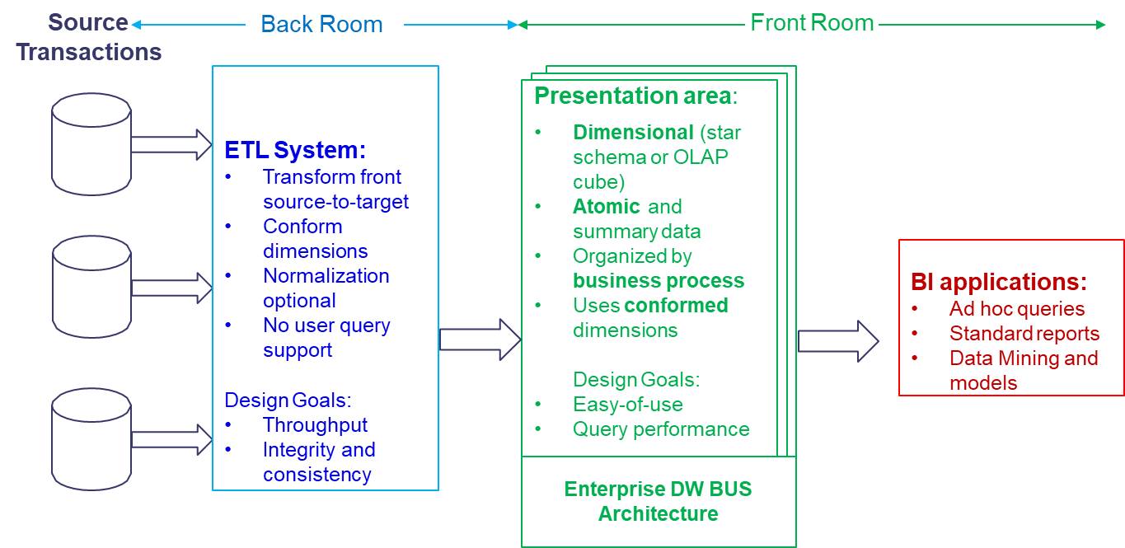
Kimball/Ross DW/BI Architecture
(Kimball & Ross, 2013)

Slide 6
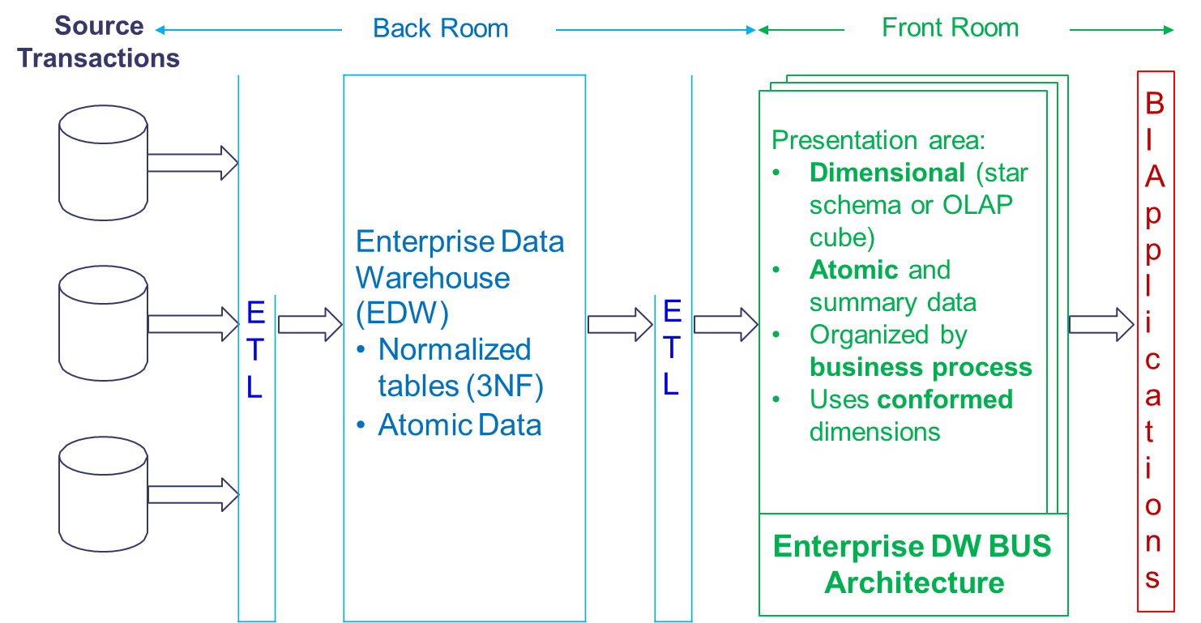
Hybrid Architecture
(Kimball & Ross, 2013)

Slide 7
Two additional types of Data Warehouse architectures

Slide 8
Centralized Architecture
Centralized (Enterprise) Data Warehouse
Normalized (3NF)
Atomic data
Some summerized data
E
T
L
BI
apps

Slide 9
Federated Architecture
E
T
L
Data Warehouse
Logisk eller
fysisk integration of common data
E
T
L
BI
apps
Data Mart
E
T
L
Data Mart

Slide 10
Which factor impact the selection of data warehouse architechture?

Slide 11
Which factors affect architecture selection?
Which of these factors affect?
High interdependence between departments, units, employees?
High urgency for a DW solution?
Tasks in the organization are relatively less routine?
DW as a short-term point solution or strategic infrastructure project?
Low resource availability?
IT staff with low perceived ability?
Upper management sponsorship?
(Ariyachandra, T., & Watson, H. (2010). Key organizational factors in data warehouse architecture selection. Decision support systems, 49(2), 200-212.)

Slide 12
Data Lake and Data Warehouse

Slide 13
What is a Data Lake?
“A data lake is a storage repository that holds a vast amount of raw data in its native format, including structured, semi-structured, and unstructured data.”
(https://www.kdnuggets.com/2015/09/data-lake-vs-data-warehouse-key-differences.html)

Slide 14
What is a Data Lake”
A data lake is “a methodology enabled by a massive data repository based on low cost technologies that improves the capture, refinement, archival, and exploration of raw data within an enterprise.”
"Yesterday's unified storage is today's enterprise data lake"
(Huang Fang, Managing Data Lakes in Big Data Era: What’s a data lake and why has it became popular in data management ecosystem, The 5th Annual IEEE International Conference on Cyber Technology in Automation, Control and Intelligent Systems, June 8-12, 2015, Shenyang, China.)

Slide 15
What is a Data Lake?
“The basic idea of Data Lake is simple, all data emitted by the organization will be stored in a single data structure called Data Lake.”
“Data will be stored in the lake in their original format.”
“Once data are placed in the lake, it’s available for analysis by everyone in the organization.“
(Khine, P. P., & Wang, Z. S. (2018). Data lake: a new ideology in big data era. In ITM Web of Conferences (Vol. 17, p. 03025). EDP Sciences.)

Slide 16
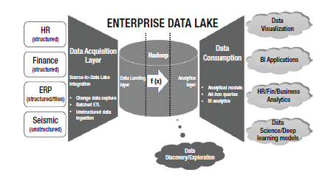
An example of a Data Lake Architecture
Gupta, S., & Giri, V. (2018). Introduction to Enterprise Data Lakes. In Practical Enterprise Data Lake Insights (pp. 1-31). Apress, Berkeley, CA.

Slide 17
Data Lake vs Data Warehouse
Comparison | Data Warehouse | Data Lake
Data | Structured, processed data | Structured, semistructured and unstructured data, raw data, unprocessed data
Processing | Schema-on-write | Schema-on-read
Storage | Expensive, reliable | Low cost storage
Agility | Less agile, fixed configuration | High agility, flexible configuration
Security | Matured | Maturing
Users | Business professional | Data scientists

Slide 18
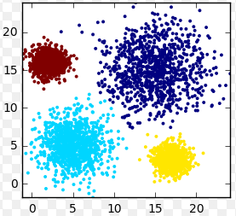
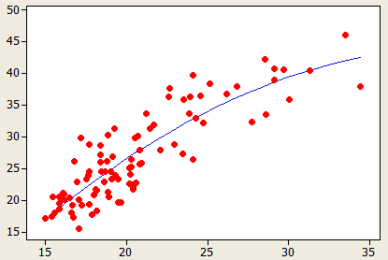
Data Lake
Data are
fed into a Hadoop
Data Lake
Data Lake
Analytic Sandbox
(Bill Schmarzo, Big Data MBA, Wiley, 2016)

Slide 19
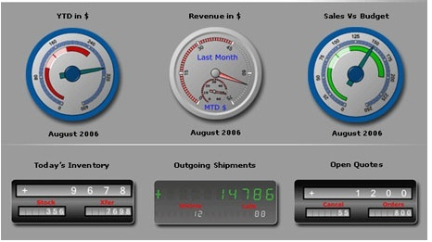
The analytics dilemma
How does an organization supports both the data warehouse/BI and an analytics environment?
DW/BI environment
Static and pre-planned process – a production process
Pre-planned use of data (via ETL)
DW
Analytic environment
Exploratory, experimental process
On the fly use of large amount of data
Loosely governed
Analytic Sandbox
(Bill Schmarzo, Big Data MBA, Wiley, 2016)

Slide 20
Data Lake can support both environments
DW/BI environment
DW
Data are
fed into a Hadoop
Data Lake
Data Lake
Analytic environment
Analytic Sandbox
(Bill Schmarzo, Big Data MBA, Wiley, 2016)

Slide 21
Off-load ETL processes from DW
DW/BI environment
DW
ETL
Data are
fed into a Hadoop
Data Lake
Data Lake
Analytic environment
Perform the ETL work in the data lake using Hadoop
Analytic Sandbox
(Bill Schmarzo, Big Data MBA, Wiley, 2016)

Slide 22
Actions to exploit the value of Data Lake
Action 1: Create a Hadoop-Based Data Lake
Action 2: Introduce the Analytics Sandbox
Action 3: Off-load ETL Processes from Data Warehouses
(Bill Schmarzo, Big Data MBA, Wiley, 2016)

Slide 23
Lessons learned
There shall be one Data Lake, not several – facititating sharing of the corporate data assets across the organization
Data governance is a life cycle, not a project
Data Lake sits before your data warehouse, not after it
(Bill Schmarzo, Big Data MBA, Wiley, 2016)

Slide 24
Benefits of using a Data Lake
Eliminate data silos – consolidating the data in one repository result in increased data use and sharing
Reduce cost for IT infrastructure – according to Schmarzo, it is 20 to 50 times cheaper to store, manage and analyze a hugh amount of data in a big data/analytics environment, compared to store, manage and analyze data in a traditional data warehouse environments
(Bill Schmarzo, Big Data MBA, Wiley, 2016)

Slide 25
Benefits of using a Data Lake
Provide a scalable, flexible and shared storage platform - that support both BI, analytic and next generation environments
Store all data - Store data even if the organization has not decided if it is going to use the data and how to use the data
(Bill Schmarzo, Big Data MBA, Wiley, 2016)

Slide 26
Business Intelligence vs Big Data/Data science

Slide 27
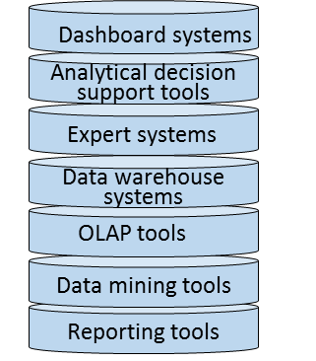
Business intelligence – an overview
Goals
(vision, enterprise goals, objectives)
BI systems/tools
BI related methods
Other areas related
Performance management
Business processes
Means
(mission, strategies, tactics, business processes)
Six sigma
Business rules
Balanced scorecard
Models for decision
Lean
Data governance
Decisions on strategic level
Activity based costing
Master data management
Decision models
Decisions on tactical level
Data and process mining
Meta data management
Decision and risk analysis
Org structures
System integration tools
Decisions on operational level
IT architecture
Visualization
Visualization techniques
Data repository
Cloud computing
Systems supporting decision making and data sources
Security
Operational systems: System that support the daily business, such as business systems (ERPs), BPM system, CRM system, etc
Business case/ROI

Slide 28
Business Intelligence – a definition
Business intelligence (BI) is an umbrella term that is commonly used to describe the technologies, applications, and processes for gathering, storing, accessing, and analyzing data to help users make better decisions.
Wixom and Watson, 2010

Slide 29
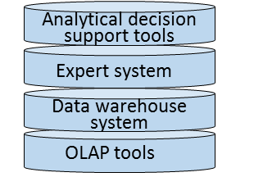
Two different approaches within BI
BI system
BI related methods
Steering /governing methods, models
and systems
Performance management
Six sigma
Balanced scorecard
Decision methods, models and systems
Decision and risk analysis

Slide 30
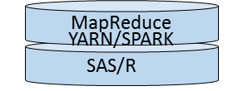
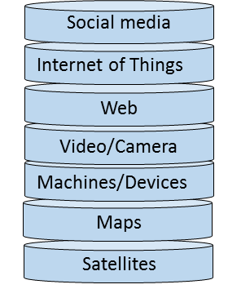
Big data/Data science – an overview
Big data related systems/techniques
Big Data related methods for data analysis
Other areas related
Goals
(vision, enterprise goals, objectives)
Data mining
Business processes
Means
(mission, strategies, tactics, business processes)
Machine learning
Business rules
Language technology
Models for decision
Additional data sources
Process mining
Data governance
Decisions on strategic level
Web mining
Master data management
Decision models
Meta data management
Decisions on tactical level
Processes for data analysis
CRISP-DM
Org structures
IT architecture
Decisions on operational level
Knowledge Discovery in Databases (KDD)
Data repository
Visualization
Cloud computing
Systems supporting decision making and data sources
Visualization techniques
Security
Operational systems: System that support the daily business, such as business systems (ERPs), BPM system, CRM system, etc
Business case/ROI

Slide 31
Data Science – a definition
Data science is about finding new variables and metrics that are better predictors of performance
Lewis (2004) Moneyball: The Art of Winning an Unfair Game

Slide 32
Big Data – a definition
Big data is a key enabler of a new discipline called data science that seeks to leverage new sources of structured and unstructured data, coupled with predictive and prescriptive analytics, to uncover new variables and metrics that are better predictors of performance
Bill Schmarzo, 2016, based on Lewis (2004) Moneyball: The Art of Winning an Unfair Game

Slide 33
Business intelligence vs. Data science
Predictive analytics
Prescriptive analytics
On the fly use of large amount of data
Exploratory, experimental process
Focus on pattern, correlations
Data model – schema on query/read
Data quality – good enough, propabilities
High
Data science
Value for the business
Business intelligence
Desciptive analytics
Pre-planned use of data (via ETL)
Static and pre-planned process
Focus on trends, use of KPIs
Data model – schema on load
Data quality – high quality, single source of truth
Low
Past
Current
Future
Time
(Bill Schmarzo, Big Data MBA, Wiley, 2016)

Slide 34
Business intelligence vs. Data science
The differences between BI and Data science
The questions are different
The analyst characteristics are different
The analytic approaches are different
The data models are different
The views on business are different
(Bill Schmarzo, Big Data MBA, Wiley, 2016)

Slide 35
BI vs. Data science: The questions are different
Business Intelligence
Focus on descriptive analytics: ”What happend?” type of questions: How many units of products X did we sell in Jan 2017
Data Science
Focus on predictive analytics: ”What is likely to happend? type of questions: How many units of products X will we sell in Jan 2018?
Focus on prescriptive analytics: ”What should we do?” type of question: How many components A, B, C should I order to support the sales of product X?
(Bill Schmarzo, Big Data MBA, Wiley, 2016)
To answer the predictive and prescriptive questions, the data scientist build analytic models in order to quantify cause and effect relationships

Slide 36
BI vs. Data science: The analysts’ characteristics are different The attitude and work approach among BI analysts and data scientists differs:
AREA | BI ANALYST | DATA SCIENTIST
Focus | Trends, KPIs | Pattern, Correlations, Models
Process | Static | Exploratory, experimentation, visual, agile
Data sources | Pre-planned, added slowly | On the fly, as needed
Transform data | Carefully planned | On demand, enrichment
Data quality | Single version of truth | ”Good enough”, probabilities
Data model | Schema on load | Schema on query
Analysis | Descriptive | Predictive, prescriptive
(Bill Schmarzo, Big Data MBA, Wiley, 2016, based on EMC )

Slide 37
BI vs. Data science: The analytic approaches are different 1(2)
BI analytic approach
Data science analytic approach
Step 1: Pre-build a data model (Schema on load)
Step 1: Define hypothesis (test/prediction)
Step 2: Make use of (visualisation) tools that automatically generated SQL commands from drag and drop using attributes/dimensions/facts
Step 2: Gather data (Data Lake)
Step 3: Build data model (Schema on query)
Step 3: Make use of the generated SQL commands to generate reports automatically
Step 4: Build analytic models (SAS, R)
Step 5: Evaluate model goodness of fit
What would happend if you want to add new data into the data warehouse/BI environment? What is the benefit with schema on the load?
(Bill Schmarzo, Big Data MBA, Wiley, 2016)

Slide 38
BI vs. Data science: The analytic approaches are different 2(2)
Schema on load
– a schema must be built prior to loading data into the data warehouse
Schema on query/read
– a schema is defined as needed based on data being used, and the data scientist will go through different versions of the schema until finding a schema that support the analytical model
(Bill Schmarzo, Big Data MBA, Wiley, 2016)

Slide 39
BI vs. Data science: The data models are different
Business Intelligence
Schema on load
Often star join schemas – multiples tables, many (comparable slow) joins
Data Science
Schema on query/read
Often flattened tables – few (flattened) tables with a lot of data, few joins
(Bill Schmarzo, Big Data MBA, Wiley, 2016)

Slide 40
BI vs. Data science: The views on business are different
Business Intelligence
Aggregated data on business entities, such as customers, products
Data Science
Build analytic profiles on each business entity. Example of business entities are customers, partners/suppliers, devices, machines
For exampel, analytic profiles for customers could be used for managing customer rentension/attrite rate
(Bill Schmarzo, Big Data MBA, Wiley, 2016)

Slide 41
Master Data

Slide 42
What is master data?
Domain data
Transactional data
Master data
Domain data – is data about the business and the area of the business, and it can be devided in:
Transactional data – is data about transactions, such as order request, ATM machine transcations, mobile calls. Transaction data represent different kinds of business events in the organization. Transactional data must be related to master data to receive a meaning
Master data – is data about central business entities that are be used in several processes and systems, such as customers, suppliers, products, assets, locations

Slide 43
What is master data?
Master data has the following characteristics:
Master data are not transactional – but master data are linked to transactions to give the transaction meaning
Master data have meaning independent of transactional data –master data are linked to transactional data but they have meaning also without the transactional data
Master data have known provenance/place of origin – that is, you know where the data come from
[Graham A. (2015) Mastering You Data, Koios Associated Ltd]

Slide 44
Master Data Management System

Slide 45
Why a master data management system (MDM-system)?
Problems addressed by a MDM-system: When you have several IT systems, there may exist incorrect and/or inconsistent data about customers, suppliers, and products in the systems. For example, a name of a customer or a product can be incorrectly spelled in some systems, a customer can have two different delivery addresses in two different systems
Manufacturing department
Shipping department
Order management
Produkt ID 202233. Samsung, SMART-TV
Produkt ID 202233
Produkt Samsung 202233
IT
IT
IT

Slide 46
Why a master data management system (MDM-system)?
Business consequenses of incorrect data in different IT system
Customers may not receive in time what has been ordered
If the same product has different spellings or there are incorrect info about the customer – the trust of the company can get damaged
Reports to governmental organizations may be harder to perform
Incorrect data about a customer’s delivery address
cause
The customer does not receive the ordered product in time

Slide 47
What is a MDM system?
A MDM-system – is a system that contain correct info about customers, suppliers and products, etc
In the MDM system, you can find the correct spelling, abbrevations, descriptions of customers, suppliers and products
In the MDM system, you can also find allowed categorizations, and hierarchies of categorizations (for example the hierarchy: food - fruit – berry - strawberry eller the hierarchy: food – perishable - strawberry)
”One version of the truth”
MDM
system

Slide 48
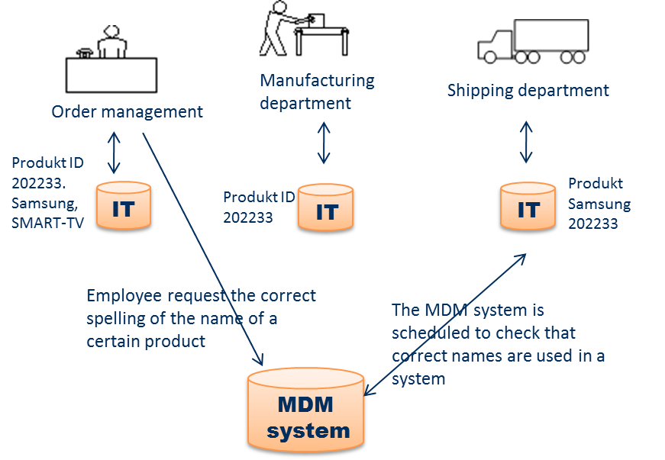
Hur to use a MDM system?
Employees can request correct spelling and attributes of data element

Slide 49
Hur to use a MDM system?
The MDM system could be used for automatically correct info in the operational systems

Slide 50
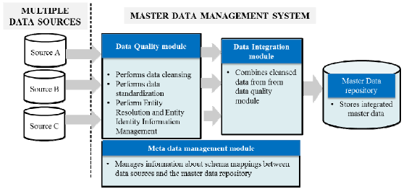
Architecture of a MDM system
Haneem, F., Ali, R., Kama, N., & Basri, S. (2017, July). Resolving data duplication, inaccuracy and inconsistency issues using Master Data Management. In Research and Innovation in Information Systems (ICRIIS), 2017 International Conference on (pp. 1-6). IEEE.

Slide 51
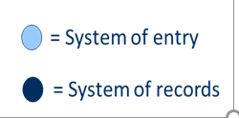
Define where your single source of truth for data elements are?
= place where the master is created and maybe also maintained
= master data = golden copy = single place where master data i garanteed to be accurate and up to date
[White C. (2007) Using master data i business intelligence, BI research]

Slide 52
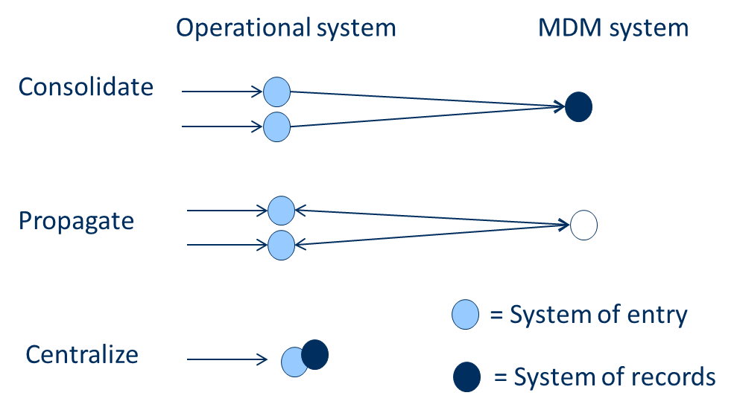
Define where your single source of truth for data elements are?
Approaches for managing master data
Master Data Management system
Syncronize master data changes between systems so master data in all systems are kept consistens
= place where the master is created and maybe also maintained
= master data = golden copy = single place where master data i garanteed to be accurate and up to date
[White C. (2007) Using master data i business intelligence, BI research]

Slide 53
Define where your single source of truth for data elements are?
Approaches for managing master data
Master Data Management system
Another approach could also be to use both approaches = consolidate and propagate
Syncronize master data changes between systems so master data in all systems are kept consistens
= place where the master is created and maybe also maintained
= master data = golden copy = single place where master data i garanteed to be accurate and up to date
Often the long term goal
[White C. (2007) Using master data i business intelligence, BI research]

Slide 54
Hur to use a MDM system?
MDM
system
Data warehouse
How could the MDM system support a Data Warehouse?
ETL

Slide 55
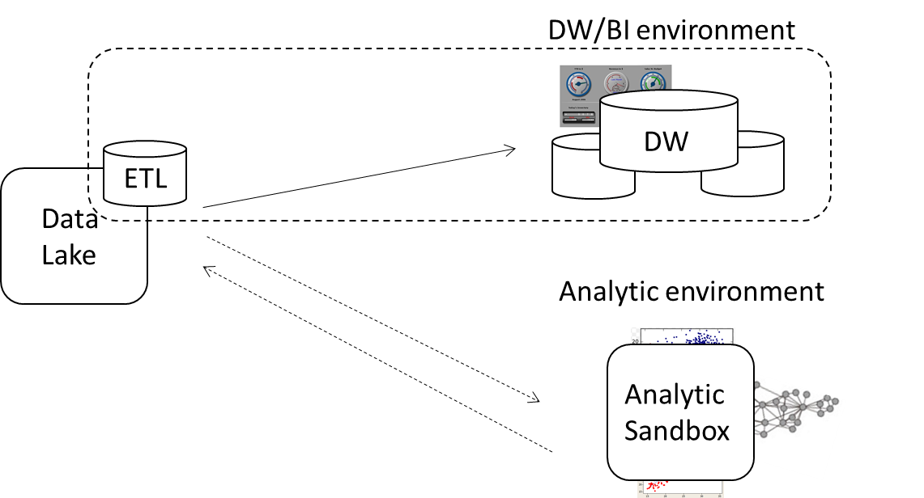
Hur to use a MDM system?
MDM
system
How could the MDM system support a Data Lake?

