Slide 1
Presentation: Dimensional Modelling 3
Erik Perjons
DSV, Stockholm University

Slide 2
More about facts and fact tables

Slide 3
Type of Facts
Additive Facts
Semi-Additive Facts
Non-Additive Facts

Slide 4
Additive Facts
Additive Facts – are facts that are additive across all dimensions
Example: Sales amount, Cost dollar amount, Sales quantity

Slide 5
Additive Facts
Aggregate on date
28/3, paper1, store1, 15, 150
29/3, paper1, store1, 35, 350
OK to aggregate the facts quantity sold (qnt_sold) and revenue
50, 500
28/3, paper1, store1, 25, 250
28/3, paper1, store2, 45, 450
OK to aggregate the facts quantity sold (qnt_sold) and revenue
70, 700
28/3, paper1, store1, 25, 250
28/3, paper2, store1, 10, 150
35, 350
Aggregate on store
OK to aggregate the facts quantity sold (qnt_sold) and revenue
Aggregate on store

Slide 6
Semi-Additive Facts
Semi-Additive Facts – are facts that are additive across some dimensions
Example: Account balance, Inventory level
Often not additive using the Date dimension

Slide 7
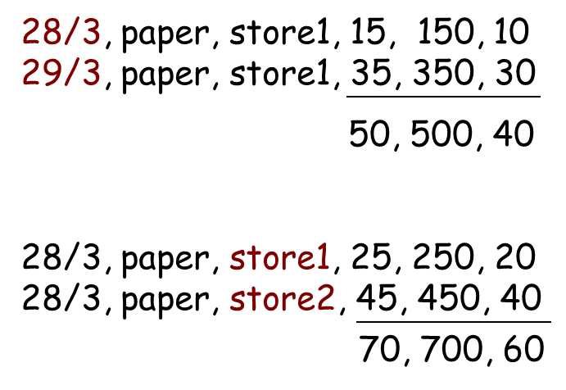
Semi-Additive Facts
Aggregate on product
28/3, paper1, store1, 25, 250, 20
28/3, paper2, store1, 35, 350, 30
60, 600, 50
NB! customer_count is not additive across the product dimension
OK to aggregate the facts quantity sold (qnt_sold), revenue, and customer_count
Is the number of customers who bought either paper towels or tissue paper 50?
No, the number could be anywhere between 30 and 50.
Customer_count is a semi-additive fact in this case
Aggregate on date
OK to aggregate the facts quantity sold (qnt_sold), revenue, and customer_count
Aggregate on store

Slide 8
Semi-Additive Facts
All measures that record a static level, such as account balance and inventory level, are non-additive across time.
However, these measures may be usefully aggregated across time by averaging over the number of time periods.

Slide 9
Non-Additive Facts
Non-Additive Facts – are facts that cannot be added at all, i.e., not be added along any dimension
Example: percentages, ratios, unit price, temperature, blood pressure
Yan still do some form of calculations on these facts, for example, apply median or average

Slide 10
Type of Fact Tables
Transaction Fact Table
Periodic Snapshot Fact Table
Accumulating Snapshot Fact Table

Slide 11
Transaction fact tables
Transaction fact tables represent an event that occurred at an instantaneous point in time
A row exist in the fact table for a given customer or product only if the transaction event has occurred
Order Transaction Fact
Product#
Date#
Customer#
Amount
Date
Customer
Product
Notes:
Many of our dimensional designs revolve around some kind of control document like an order, an invoice, a bill or a ticket. Usually these control documents are a kind of container with one ore more line items inside. The natural granularity for a fact table in this cases is the individual line item.
It is no point in making a dimension table because it would contain nothing. But the generate key itself is still necessary since it may for instance be used to group together line items.

Slide 12
Transaction fact tables
Transaction fact table may also have been aggregated on date, for example all transaction for a day, week, month – and is still called a transaction fact table
Order Transaction Fact
Product#
Month#
Customer#
No of order
Amount
Month
Customer
Product
Notes:
Many of our dimensional designs revolve around some kind of control document like an order, an invoice, a bill or a ticket. Usually these control documents are a kind of container with one ore more line items inside. The natural granularity for a fact table in this cases is the individual line item.
It is no point in making a dimension table because it would contain nothing. But the generate key itself is still necessary since it may for instance be used to group together line items.

Slide 13
Periodic snapshot fact tables
Periodic snapshot fact table – shows a picture/state of, for example, the quantity of products in different stores’ inventories, at an end of a day, week, or month, then another picture in the end of next period, and so on.
The periodic snapshots are stacked consecutively into the fact table
Inventory Snapshot Fact
Product#
Date#
Store#
Quantity
Date
Store
Product
Notes:
Many of our dimensional designs revolve around some kind of control document like an order, an invoice, a bill or a ticket. Usually these control documents are a kind of container with one ore more line items inside. The natural granularity for a fact table in this cases is the individual line item.
It is no point in making a dimension table because it would contain nothing. But the generate key itself is still necessary since it may for instance be used to group together line items.

Slide 14
Periodic snapshot fact tables
Periodic snapshot fact table represents a snapshot of data (facts) at specific point in time
Store inventory periodic snapshot schema
Date Dimension
Store Inventory Snapshot Fact
Date Key (FK) Product Key (FK) Warehouse Key (FK) Quantity on Hand Quantity Sold
Inventory Dollar Value at Cost
Inventory Dollar Value at Latest Selling Price
Product Dimension
Warehouse Dimension
Warehouse Key (PK) Warehouse Number (NK) Warehouse Name Warehouse Address
...
Notes:
Many of our dimensional designs revolve around some kind of control document like an order, an invoice, a bill or a ticket. Usually these control documents are a kind of container with one ore more line items inside. The natural granularity for a fact table in this cases is the individual line item.
It is no point in making a dimension table because it would contain nothing. But the generate key itself is still necessary since it may for instance be used to group together line items.

Slide 15
Periodic snapshot fact tables
Periodic snapshot fact table is often the only place to easily retrieve a regular, predictable, trendable view of on some key business performance metrics
Inventory Snapshot Fact
Product#
Date#
Store#
Quantity
Date
Store
Product
Notes:
Many of our dimensional designs revolve around some kind of control document like an order, an invoice, a bill or a ticket. Usually these control documents are a kind of container with one ore more line items inside. The natural granularity for a fact table in this cases is the individual line item.
It is no point in making a dimension table because it would contain nothing. But the generate key itself is still necessary since it may for instance be used to group together line items.

Slide 16
Periodic snapshot fact tables
All measures that record a static level, such as account balance and inventory level, are non-additive across time, but note, they may be semi-additive using other dimensions
However, these measures may be usefully aggregated across time by averaging over the number of time periods.
Inventory Snapshot Fact
Product#
Date#
Store#
Quantity
Date
Store
Product
Notes:
Many of our dimensional designs revolve around some kind of control document like an order, an invoice, a bill or a ticket. Usually these control documents are a kind of container with one ore more line items inside. The natural granularity for a fact table in this cases is the individual line item.
It is no point in making a dimension table because it would contain nothing. But the generate key itself is still necessary since it may for instance be used to group together line items.

Slide 17
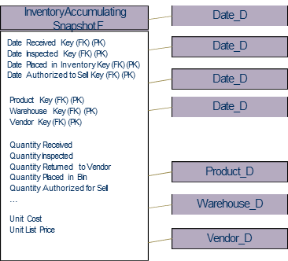
Accumulating snapshot fact tables
Accumulating snapshot fact table - represents an indeterminate time span, covering a the complete life of a transaction
Almost always the fact tables have multiple time/date stamps, representing the predictable major events or phases that take place during the course of lifetime
Notes:
Many of our dimensional designs revolve around some kind of control document like an order, an invoice, a bill or a ticket. Usually these control documents are a kind of container with one ore more line items inside. The natural granularity for a fact table in this cases is the individual line item.
It is no point in making a dimension table because it would contain nothing. But the generate key itself is still necessary since it may for instance be used to group together line items.

Slide 18
Accumulating snapshot fact tables
Accumulating snapshot fact tables are used for processes that have a definite beginning, definite end, and identifiable milestones in between
Recieve Product
Inspect Product
Assign Bin Placement
Ship Product

Slide 19
Accumulating snapshot fact tables
In sharp contrast to the other fact table types, we purposely revisit accumulation snapshot fact table rows TO UPDATE (!!!) them. That is, we revisit them as more information becomes available
Since many of these dates are not known when the fact row is loaded, we must use surrogate date key to handle undefined dates
There need to be a row in the date dimension with the date=“unknown” or “to be determined”, when we first load the row in the fact table
Notes:
Many of our dimensional designs revolve around some kind of control document like an order, an invoice, a bill or a ticket. Usually these control documents are a kind of container with one ore more line items inside. The natural granularity for a fact table in this cases is the individual line item.
It is no point in making a dimension table because it would contain nothing. But the generate key itself is still necessary since it may for instance be used to group together line items.

Slide 20
Factless fact tables
Some fact tables quite simply have no measured facts
These fact tables are useful to describe events and coverage, i.e. the tables contain information that something has (event tracking) or has not (coverage table) happened
There are several types of factless fact tables, two of the most common are:
event tracking tables
coverage tables

Slide 21
Event tracking (factless fact) tables
An event tracking table - records events, e.g. records every time a student attends a course (see figure), or people involved in accidents and vehicles involved in accidents
Notes:
Interesting questions:
Which classes were most attended?
Which teatchers taught the most students?
Which facilities were most used?

Slide 22
Event tracking (factless fact) tables
An event tracking table - contains a concatenated key that represent a focal event which is identified by the combination of conditions referenced in the dimension tables

Slide 23
Other types of factless fact tables
Another problem that can be addressed by factless fact tables
Many to many relationships (M-to-M) between entities (tables) are difficult to deal with in any database design situation. For example, a customer can have many accounts and an account may belong to many customers
A factless fact table can be created to capture the relationship between the tables

Slide 24
Coverage (factless fact) tables
How we can answer questions for which there is no event in the business process?
We can store all possibilities in a factless fact table in form of a coverage fact table

Slide 25
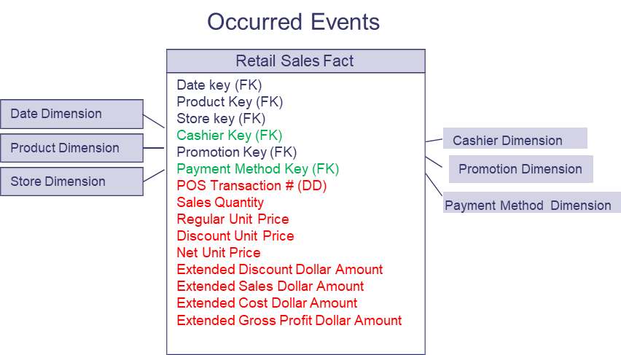
Coverage (factless fact) table
An example: What products were on promotion but did not sell?
The sales fact table records only the SKUs actually sold.
Therefore, we need to create a factless fact table that cover all product that is part of the promotion

Slide 26
More about dimensions

Slide 27
Slowly Changing Dimensions
Problem to solve:
Dimension attribute values change over time, e.g., a product that belong to a department or product category, later belong to another department or category
The assumption:
The key does not change, but some of the attribute values does.

Slide 28
Slowly Changing Dimensions
Type 1: Overwrite the dimension record (attribute value) with the new values, thereby losing history
Type 2: Create a new additional dimension record using a new value of the surrogate key
Type 3: Create a new field in the dimension record to store the new value of the attribute

Slide 29
Type 1
Overwrite the old value of an attribute with a new one
e.g.
+ easy to implement
+ OK, if there is no use in keeping the old value (e.g., mobile number)
- avoids the real goal of data warehousing, which is to accurately track history
- any pre-aggregates based on the attribute values for married (singe/married) need to be rebuilt
Product Key | Description | Department |  | SKUNumber (NK)
12345 | IntelliKidz 1.0 | Education |  | ABC922-Z
 |  |  | Strategy
Change name of a department

Slide 30
Type 2
Create a new additional dimension record
The predominant technique for handling slowly changing dimensions
A generalised (surrogate) key is required (which is a responsibility of the data warehouse team)
PrimaryKey | Product description | Department | SKU Number (Natural key)
12345 | IntelliKidz 1.0 | Education | ABC922-Z
25984 | IntelliKidz 1.0 | Strategy | ABC922-Z

Slide 31
Type 2
We can use/constrain the attribute Production description (“IntelliKidz 1.0”) or SKU number (“ABC922-Z”) and the query will automatically fetch both IntelliKidz product dimension rows and join the fact table for the complete product history
PrimaryKey | Product description | Department | SKU Number (Natural key)
12345 | IntelliKidz 1.0 | Education | ABC922-Z
25984 | IntelliKidz 1.0 | Strategy | ABC922-Z

Slide 32
Type 2
We can add also add additional attributes:
Row Effective Date,
Row Expiration Date (default: December 31, 9999)
Current Row Indicator
 | Product Dimension
 | Product Key (PK) SKU Number (Natural Key) Product Description Department Name ...
 | Row Effective Date Row Expiration Date
 | Current Row Indicator

Slide 33
Type 2
+ history is stored
+ can track as many dimensional attribute value changes as required
+ no need to rebuilt pre-aggregations
- could lead to an accelerated dimensional table growth of rows.

Slide 34
Type 2
Another solution Use of smart keys using extra digits in the end of the key. Recommended by Kimball 1996
Fact table
Dimension table

Slide 35
Type 3
Create a new field in the dimension record
+ Allow us to see new and historical fact data by either the new and prior attribute values. Enable alternate reality, i.e., see two views of the world simultaneously
- What if an attribute change values several times?

Slide 36
Rapidly changing dimensions
What if the changes are fast?
Break off some of the attributes into their own separate dimension(s), a minidimension(s).
force the attributes selected to the minidimension to have relatively small number of discrete values
build upp the minidimension with all possible discrete attributes combinations
construct a surrogate key for this dimension

Slide 37
Minidimension
Three values
Two values
3*2*2=12 rows
Two values

Slide 38
Demographic Minidimension

Slide 39
Two Minidimensions

Slide 40
Using Minidimension
Advantages
frequent ‘snapshoting’ of customers profiles with no increase in data storage or data complexity
Drawbacks
the demographic attributes are clumped into banded ranges of discrete values – and it is impractical to change the set of value bands at a later time
the demographic dimension itself can not be allowed to grow too large
Notes:
The customer is associated with demographics only when fact table record is created.
- if the fact table is sparse (e.g., the sales are so sparse) then a demographic event can be defined. It is still saved in the fact table, but it lacks the rest of the measured attributes.
- another alternative is to in the customer table create a FK to the demographic table. (NB! What is then the difference between DM and ER modelling?)

Slide 41
Another problem with minidimensions
If a customer are not involed in any transaction, there is no information about this customer demographic state in this star-join schema
Solutions: add a demograhic key as a foreign key in the customer dimension
demog_key (FK)

Slide 42
Minidimension vs Outriggers
Minidimension = If the demograhic key is part of the fact table composite key
Outrigger = if the demograhic key is a foreign key in the customer dimension
demog_key (FK)

Slide 43
Another example of minidimension
Demographics Key Age Band Purchase Frequency Score Income Level
1 | 21-25 | Low | <$30,000
2 | 21-25 | Medium | <$30,000
3 | 21-25 | High | <$30,000
4 | 21-25 | Low | $30,000-39,999
5 | 21-25 | Medium | $30,000-39,999
6 | 21-25 | High | $30,000-39,999
... | ... | ... | ...
142 | 26-30 | Low | <$30,000
143 | 26-30 | Medium | <$30,000
144 | 26-30 | High | <$30,000
... | ... | ... | ...
Fact Table
Date Key (FK) Customer Key (FK)
Customer Dimension
Demographics Key (FK)
Customer Key (PK) Customer ID (NK) Customer Name Customer Address Customer City-State Customer State
More FKs... Facts...
Demographics Dimension
Customer ZIP-Postal Code Customer Date of Birth
Demographics Key (PK) Age Band
Purchase Frequency Score Income Level
Date Key Customer Key Demographics Key … …2
20160119 | 1 | 1 | … | …
20160518 | 1 | 2 | … | …

Slide 44
Degenerate Dimension
A degenerate dimension is represented by a dimension key attribute(s) with no corresponding dimension table
Often transaction number, receipt number, etc
Notes:
Many of our dimensional designs revolve around some kind of control document like an order, an invoice, a bill or a ticket. Usually these control documents are a kind of container with one ore more line items inside. The natural granularity for a fact table in this cases is the individual line item.
It is no point in making a dimension table because it would contain nothing. But the generate key itself is still necessary since it may for instance be used to group together line items.

Slide 45
Junk Dimension
A junk dimension - is a convenient grouping of attributes and flags into a useful dimensional framework to get them out of a fact table or to avoid adding a number of extra dimensions into a useful dimensional framework
.
Notes:
Sometimes when you are extracting from a complex production data source, after identifying source attributes for a number of obvious dimensions, you are left with a number of miscellaneous flags and text attributes. These flags and attributes do not seem to be organised in any coherent way. Often the meaning of the flags and text attributes is obscure. Many of the fields are filled sporadically, or their content seems to vary depending on the context of the record.
alt1 is bad because it might cause the fact table to swell alarmingly. It would be a shame to leave several uncompressed 20 byte text fields in the fact table. It may also be extensive to build indexes for constraining and browsing on these fields as well.
alt2 does not work either since a 5-dimensional design could balloon into a 25-dimensional design.
alt3: shipping out this information could be a mistake if there is demonstrated business relevance to any of these fields. It is worthwhile to examine this question carefully. If the flags and the text attributes are incomprehensible, noisy, inconsistently filed in, or only of operational significance, they should be left out.
A simple example of a useful junk dimension would be taking ten Yes/No indicators out of the fact table and putting them into a single dimension with. At the worst you have 2¹⁰=1024 records in this dimension.

Slide 46
Junk Dimension
When a number of miscellaneous text attributes or flags exist, the following design alternatives should be avoided:
Leaving the flags and attributes unchanged in the fact table record (the fact table will become large)
Making each flag and attribute into its own separate dimension (the fact table will become large)
Stripping out all of these flags and attributes from the design (missing info/constrain alternatives)
Notes:
Sometimes when you are extracting from a complex production data source, after identifying source attributes for a number of obvious dimensions, you are left with a number of miscellaneous flags and text attributes. These flags and attributes do not seem to be organised in any coherent way. Often the meaning of the flags and text attributes is obscure. Many of the fields are filled sporadically, or their content seems to vary depending on the context of the record.
alt1 is bad because it might cause the fact table to swell alarmingly. It would be a shame to leave several uncompressed 20 byte text fields in the fact table. It may also be extensive to build indexes for constraining and browsing on these fields as well.
alt2 does not work either since a 5-dimensional design could balloon into a 25-dimensional design.
alt3: shipping out this information could be a mistake if there is demonstrated business relevance to any of these fields. It is worthwhile to examine this question carefully. If the flags and the text attributes are incomprehensible, noisy, inconsistently filed in, or only of operational significance, they should be left out.
A simple example of a useful junk dimension would be taking ten Yes/No indicators out of the fact table and putting them into a single dimension with. At the worst you have 2¹⁰=1024 records in this dimension.

Slide 47
“Combined” dimensions
Problem to address: Different services could be used in the same time
Solution1 : Create a new dimension for each service – and they could be combined in the fact table (however: many foreign keys in the fact table)
Solution2 : Create a new row for each service (however: problems with aggregation on the fly)
Solution3 : Create a dimension consisting of all service combinations, which means that there is a row/instance for each combination in the dimension tables (compare the minidimension solution)
Transaction Fact Table – (including used services)
PK | Service 1 | Service 2 | Service 3
1 | Y | N | N
2 | N | Y | N
3 | N | N | Y
Service dim
Solution 3
Primary Key
Service 1
Service 2
Service 3
4 | Y | Y | N
5 | Y | N | Y
6 | N | Y | Y
7 | Y | Y | Y
Notes:
Many of our dimensional designs revolve around some kind of control document like an order, an invoice, a bill or a ticket. Usually these control documents are a kind of container with one ore more line items inside. The natural granularity for a fact table in this cases is the individual line item.
It is no point in making a dimension table because it would contain nothing. But the generate key itself is still necessary since it may for instance be used to group together line items.

Slide 48
Heterogenous products

Slide 49
Heterogeneous Products
Problem to address:
Some products have many distinguishing attributes and many possible permutations (usually on the basis of some customised offer).
This results in immense product dimensions and bad browsing performance
Notes:
Cf. horisontal partitioning

Slide 50
Heterogeneous Products
Solution:
In order to deal with this, fact tables with accompanying product dimensions can be created for each product type - these are known as custom fact tables
Primary and common core facts on the products types are kept in a core fact table (but can also be copied to the conformed fact tables)
Notes:
Cf. horisontal partitioning

Slide 51
Heterogeneous Products

Slide 52
Aggregrations

Slide 53
Aggregations
Aggregations can be created on-the-fly or by the process of pre-aggregation
An aggregate is a fact table record representing a summarisation of base-level fact table records
Category-level product aggregates by store by day
District-level store aggregates by product by day
Monthly sales aggregates by product by store
Category-level product aggregates by store district by day
Category-level product aggregates by store district by month
Notes:
The use of prestored summaries (aggregates) is the single most effective tool the data warehouse designer has to control performance.
An aggregate is a fact table record representing a summarisation of base-level fact table record. An aggregate fact table record is always associated with one or more aggregate dimension table records.
For example, in a base level fact table dimensioned by UPC (Unified product code) level products, individual stores, and individual days, we can imagine the following aggregate records:
Not only do we have these new fact table records, but we must have aggregate dimension table entries describing category level products, store districts, and months.

Slide 54
New Tables for Aggregates

Slide 55
New Tables for Aggregates

Slide 56
Family of stars again

Slide 57
A family of stars

Slide 58
A family of stars
A dimensional model of a data warehouse for a large data warehouse consists of between 10 and 25 similar-looking star-join schemas. Each star join will have 5 to 15 dimensional tables
Conformed (shared) dimensions for drill-across

Slide 59
Conformed dimensions and facts
Conformed dimensions – has consistent dimension keys, consistent attribute column names, consistent attribute definitions and consistent attribute values. This make drill-across possible from one fact table to another via the conformed dimension
Conformed facts – means conformed fact definition, i.e., definitions of revenue, profit, standard costs, measures of quality and customer satisfaction.
Note: If it is impossible to conform a fact exactly, then you should give different name to the different interpretation

