Slide 1
Presentation: Dimensional Modelling 2
Erik Perjons
DSV, Stockholm University

Slide 2
DW Architecture
Data staging
Monitoring & Administration
Analysis
Analytic applications
 | Productt | Time1 | Value1 | Value11
 | Product2 Product3 | Time2 Time3 | Value2 Value3 | Value21 Value31
 | Product4 | Time4 | Value4 | Value41
OLAP
cubes
Metadata repository
Data warehouse
Operational DBs
Ad hoc Query/Reporting
Extract Transform Load Refresh
Access
External sources
Forecasting, scoring, Data mining
Data marts
Falö aöldf flaöd aklöd falö alksdf
Data sources
Staging Tables & ODS
RDBMS, Rolap, Molap, Holap
End User Applications

Slide 3
OLAP tools: User interface
Product
Region
Year
Sales (kSEK)
Product Group
Office
Quarter
Cost (kSEK)
Salesperson
Month
Number of transactions
Product Group
Region
Quarter
Sales (kSEK)
Group A
Region ABC
Quarter 1 - 2018
100
Group A
Region DEF
Quarter 1 - 2018
400
Group B
Region ABC
Quarter 1 - 2018
200
Group B
Region DEF
Quarter 1 - 2018
900

Slide 4
DW Architecture
Data staging
Monitoring & Administration
Analysis
Analytic applications
 | Productt | Time1 | Value1 | Value11
 | Product2 Product3 | Time2 Time3 | Value2 Value3 | Value21 Value31
 | Product4 | Time4 | Value4 | Value41
OLAP
cubes
Metadata repository
Data warehouse
Operational DBs
Ad hoc Query/Reporting
Extract Transform Load Refresh
Access
External sources
Forecasting, scoring, Data mining
Data marts
Falö aöldf flaöd aklöd falö alksdf
Data sources
Staging Tables & ODS
RDBMS, Rolap, Molap, Holap
End User Applications

Slide 5
Dimensional modelling/Star schema
Date Dimension
Service Dimension
date (PK)
month
quarterOfYear
year
1
1
serviceKey (PK)
serviceName
serviceGroup
1..*
1..*
Service Usage Fact Table
1..*
serviceKey (PK) (FK)
sellerKey (PK) (FK)
customerKey (PK) (FK)
date (PK) (FK)
sum
noOfCalls
1..*
Customer Dimension
Seller Dimension
customerKey (PK)
postadress
region
incomeGroup
1
sellerKey (PK)
sellerName
office
1

Slide 6
Service Dimension
Date Dimension
1
Service Usage Fact Table
1
Number
Sum
of calls
C210
S1
F11
991011
25:00
3
C210
S3
F11
991011
05:00
1
1..*
1..*
C212
S2
F13
991011
89:00
1
C213
S1
F13
991011
12:00
1
C214
S4
F13
991012
08:00
1
1..*
1..*
Customer Dimension
Seller Dimension
1
1

Slide 7
Towards Dimensional Modelling
A single fact table
A number of dimension tables
Denormalized dimensions
Hierarchies
Keys
Grain
Use understandble labels for attributes/columns and data
Managing queries

Slide 8
DW Architecture
Data staging
Monitoring & Administration
Analysis
Analytic applications
 | Productt | Time1 | Value1 | Value11
 | Product2 Product3 | Time2 Time3 | Value2 Value3 | Value21 Value31
 | Product4 | Time4 | Value4 | Value41
OLAP
cubes
Metadata repository
Data warehouse
Operational DBs
Ad hoc Query/Reporting
Extract Transform Load Refresh
Access
External sources
Forecasting, scoring, Data mining
Data marts
Falö aöldf flaöd aklöd falö alksdf
Data sources
Staging Tables & ODS
RDBMS, Rolap, Molap, Holap
End User Applications

Slide 9
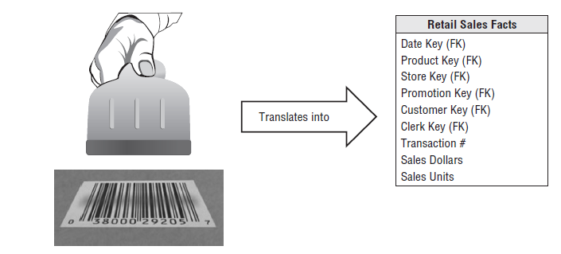
A business event/transaction

Slide 10
DW Architecture
Data staging
Monitoring & Administration
Analysis
Analytic applications
 | Productt | Time1 | Value1 | Value11
 | Product2 Product3 | Time2 Time3 | Value2 Value3 | Value21 Value31
 | Product4 | Time4 | Value4 | Value41
OLAP
cubes
Metadata repository
Data warehouse
Operational DBs
Ad hoc Query/Reporting
Extract Transform Load Refresh
Access
External sources
Forecasting, scoring, Data mining
Data marts
Falö aöldf flaöd aklöd falö alksdf
Data sources
Staging Tables & ODS
RDBMS, Rolap, Molap, Holap
End User Applications

Slide 11
Operational Systems
The operational systems/transactional systems are tuned to support known daily operations
They are normalized according to 3 NF
They are focusing is on data integrity
Operational DBs
Operational DBs
Operational DBs
External sources
Data sources

Slide 12
Database fundamentals
Relation and Relation schema
Relational database schema
Keys
Normalisation
Data integrity

Slide 13
Relation and relation schema
relation name/relation name
attribute/column
Customer
attribute name
domain/data type
customerNo: Integer | ssn: Integer | name: String | age: Integer
111122 | 111111-1111 | Melinda | 45
111123 | 222222-2222 | Martin | 30
111124 | 333333-3333 | Kayla | 21
111125 | 444444-4444 | Madison | 18
relation schema/table definition
tuple/rows
set of tupels = relation
element (is a member of a (data) domain)
attributes/columns
Attribute value = attribute name paired with an element that is part of the attribute’s domain)

Slide 14
Relational database schema
Registration
Course
registrationID (1..1) (PK)
regDate (1..1)
courseOccasionID (1..1) (FK to
CourseOccasion.courseOccasionID)
studentID (1..1) (FK to Student.studentID)
courseID (PK)
courseName
Student
studentID (PK)
studentName
CourseOccasion
courseOccasionID (PK)
startDate
courseID (FK to Course.courseID),

Slide 15
Relational database schema
Registration
Course
registrationID (1..1) (PK)
regDate (1..1)
courseOccasionID (1..1) (FK to
CourseOccasion.courseOccasionID)
studentID (1..1) (FK to Student.studentID)
courseID (PK)
courseName
Student
studentID (PK)
studentName
CourseOccasion
courseOccasionID (PK)
startDate
courseID (FK to Course.courseID),
Registration
Course
1..1
registrationID (1..1) (PK)
regDate (1..1)
courseOccasionID (1..1) (FK)
studentID (1..1) (FK)
courseID (PK)
courseName
Student
studentID (PK)
studentName
CourseOccasion
0..*
0..*
courseOccasionID (PK)
startDate
courseID (FK)
1..1
1..1
0..*

Slide 16
Keys
Candidate key - is a minimal set of attributes/columns necessary to uniquely identify a tuple/row
Primary key - is a candidate key chosen to be the unique identifyer of the tuple/row
Alternate key - is a candidate key not chosen to be the primary key
Foreign key – is a key in a table that refers to a primary key in another table, representing the relation between two tables in a relational database schema

Slide 17
Keys
Natural key – is a candidate key derived from application data (that is, formed of attribute(s) that already exist in the real world)
Surrogate key – is a candidate key not derived from application data (that is, has no meaning outside the database environment) – assigned sequentially by the system (that is, an integer that starts by 1 and is increased by 1 when adding rows to the dimension table)
Composite key/Concatenated key - is a candidate key that consists of two or more attributes

Slide 18
Keys
Intelligent key/smart keys – is a key that includes encoded info into the key.
For example Stock keeping unit (SKU) can contain information about manufacturer, product type and product

Slide 19
Normalization
Normalization - is the process to restructuring a relational database in accordance with a series of so called normal forms in order to reduce data redundancy (that is, an activity aiming to store data in one place), prevent update, insertion, deletion anomalies, and, thereby, improve data integrity

Slide 20
1:st Normal Form (1NF)
1 NF is a property of a relation where each attribute in a tuple contains only a single value from a domain

Slide 21
1:st Normal Form (1NF)

Slide 22
2:nd Normal Form (2NF)
2 NF is a property of a relation that is in 1 NF and where ALL the attributes in a composite candidate key determines the values of the non-key attributes

Slide 23
2:nd Normal Form (2NF)

Slide 24
3:rd Normal Form (3NF)
3 NF is a property of a relation that is in 2 NF and all non-key attributes are determined only by the candidate keys (and not by any non-key attributes)

Slide 25
3:rd Normal Form (3NF)
Person

Slide 26
Data Integrity
Data Integrity – is the maintenance of the accuracy and consistency of data. Data integrity is enforced by a number of rules/constraints:
Entity Integrity - every tuple must have a primary key and the value of the primary key must be unique
Referential Integrity – the foreign key value must refer to a primary key value of some table in the database
...

Slide 27
Anomalies
Update anomalies – if redundant data is stored in several places there is a risk that an update is not done in all this places
Delete anomalies – data might be lost when some other data is delted if not stored properly
Insertion anomalies – it is not possible to add new data

Slide 28
Four steps to design a star schema
Select a Business Process
1
Declare the Grain
2
Identify the Dimensions
3
Identify the Facts
4

Slide 29
The retail case
The retail company has 100 grocery stores spread over a five state area
Each store has a number of departments, including grocery, frozen food, dairy, meat, produce, bakery, floral, health/beauty aids
Each store has roughly 60 000 individual products
The individual products are called Stock Keeping Units (SKU)

Slide 30
The retail case
Management is concerned with:
the logistics of ordering (the procurement are often done too late)
the stock levels (too high stock levels for some products and too low for other)
the selling of products (too low sales figure)
We can collect data:
at the back door of retail stores, where deliveries are made
at the depository where we keep our stock
at the cash registers, called point of sale (PoS), where customer purchases products.

Slide 31
Step 1. Select a business process
A business process is a “low-level activity” performed by an organization, such as taking orders, receiving payments, etc
Kimball: ”The first dimensional model built should be the one with the most impact – it should answer the most pressing business questions and be readily accessible for data extraction.”
Potential business impact
A dimensional model is based on a business process, therefore the focus on business process
Business process 1
Business process 2
Business process 3
Feasibility

Slide 32
Step 1. Select a business process
Which Business process should we select first?
the logistics of ordering can be interpreted as the order process
the stock levels can be interpreted as the inventory process
the selling of products can be interpreted as the sales process

Slide 33
Step 1. Select a business process
Which Business process should we select first?
the logistics of ordering can be interpreted as the order process
the stock levels can be interpreted as the inventory process
the selling of products can be interpreted as the sales process
More information is needed to select the business process with most impact and highest feasibility. In this case, we assume that a sales process in an important process since the management is concerned with the low sales figures, and increased sales will probably make a larger impact than the other two processes

Slide 34
Step 2. Declare the grain
The grains is the level of detail of data of the process or event. The grain means specifying exactly what an individual fact table row represent.
Typical grains are individual transactions, individual daily (or monthly) snapshots
Kimball: ”The less granular model is immediately vulnerable to unexpected user requests to drill down into the detail.”
Kimball: “Preferably you should develop dimensional models for the most atomic information captured by a business process.”

Slide 35
Step 2. Declare the grain
This is how you can express the most detailed level of data:
Most granular data (the more you go into details, the more granular data you have)
High granularity (the more you go into details, the higher granularity you have)

Slide 36
Step 2. Declare the grain
What grain shall we choose for our case study?
An individual line item on a POS transaction, i.e. the sale of a product, per store, per transaction)
The sale of a product, per store, per day
The sale of a product, per region, per day
The sale of a product, per store, per month
The sale of a product category, per region, per month

Slide 37
Step 2. Declare the grain
What grain shall we choose for our case study?
An individual line item on a POS transaction, i.e. the sale of a product, per store, per transaction
The sale of a product, per store, per day
The sale of a product, per region, per day
The sale of a product, per store, per month
The sale of a product category, per region, per month

Slide 38
Step 3. Identify the dimensions
Identify the dimensions that will be applied to each fact table tuple/record
Consider what aspects do you want to be able to slice and dice
Typical dimensions are date, product, customer, store, etc
Guideline: Use the declared grain of the selected process to determine dimensions: product, store
Guideline: Use the Who, What, When, Where, and How to identify possible dimensions

Slide 39
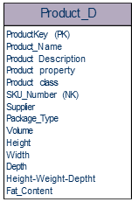
Step 3. Identify the dimensions
An example of a dimension: Product dimension

Slide 40
Dimensions
Use surrogate key as primary key - to keep history in if natural keys are changing in the organization
How to identify attributes:
“we do not measure them, we usually know them”
usually text fields, with discrete values, e.g., the flavor of a product, the size of a product
Denormalization is no problem since the ETL process ensure the data quality, and no advanced calculations (only filtering) are made on the dimensions

Slide 41
Dimensions
Use column names/labels that are easy to understand
Use names/lables of the values that are easy to understand
The end users will see these names/labels interacting with the system using an OLAP tool

Slide 42
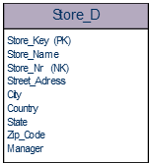
Step 3. Identify the dimensions
Another dimension: Store dimension
A geographic dimension - every store has a location
Dimensions have hierarchies - we can roll up and drill down on geographic attributes

Slide 43
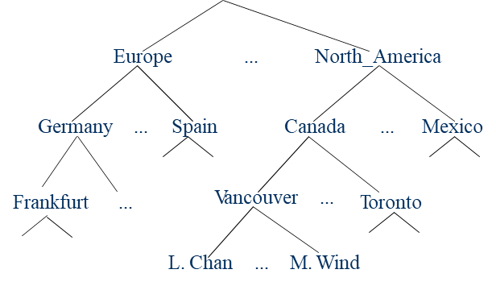
Dimensional hierarchies

Slide 44
Dimensional hierarchies
A hierarchy is a directed tree which nodes are dimensional attribute values/elements
There is a many-to-one relationship between the nodes in the hierarchy
Region
Country
City
Store

Slide 45
Dimensional Fact Model (DFM)
Dimensional Fact Model (DFM) is graphical formalism showing:
Facts in the fact table
Hierarchies of the dimensional tables
Developed by Golfarelli & Rizzo

Slide 46
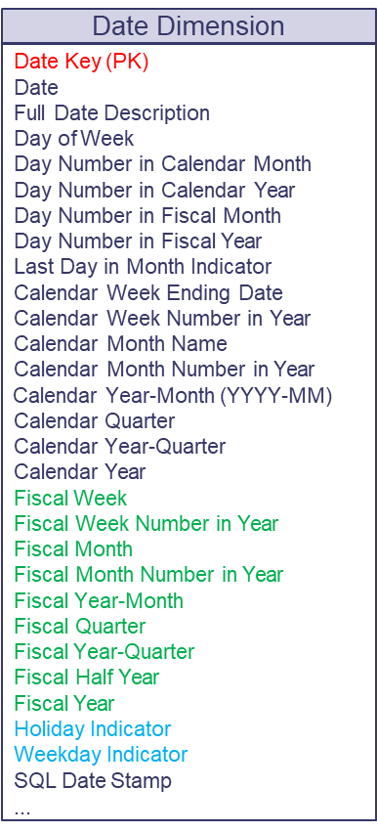
Step 3. Identify the dimensions
Date dimension – most star schema has a date dimension
Date Key | Date | Full Date Description | Day of Week | Calendar Month | Calendar Quarter | Calendar Year | Fiscal Year Holiday Month Indicator |  | Weekday Indicator
20130101 | 01/01/2013 | January 01, 2013 | Tuesday | January | Q1 | 2013 | F2013-01 | Holiday | Weekday
20130102 | 01/02/2013 | January 02, 2013 | Wednesday | January | Q1 | 2013 | F2013-01 | Non-Holiday | Weekday
20130103 | 01/03/2013 | January 03, 2013 | Thursday | January | Q1 | 2013 | F2013-01 | Non-Holiday | Weekday
20130104 | 01/04/2013 | January 04, 2013 | Friday | January | Q1 | 2013 | F2013-01 | Non-Holiday | Weekday
20130105 | 01/05/2013 | January 05, 2013 | Saturday | January | Q1 | 2013 | F2013-01 | Non-Holiday | Weekday
20130106 | 01/06/2013 | January 06, 2013 | Sunday | January | Q1 | 2013 | F2013-01 | Non-Holiday | Weekday
20130107 | 01/07/2013 | January 07, 2013 | Monday | January | Q1 | 2013 | F2013-01 | Non-Holiday | Weekday
20130108 | 01/08/2013 | January 08, 2013 | Tuesday | January | Q1 | 2013 | F2013-01 | Non-Holiday | Weekday

Slide 47
Step 3. Identify the dimensions
The data can be populated in advance.
It has one meaningful key (intelligent/smart key). That is, it does not have any surrogate key due to performance, ease of use, partitioning reasons

Slide 48
Step 3. Identify the dimensions
A fiscal year (or financial year, or sometimes budget year) is the period used by governments for accounting and budget purposes, which varies between countries. It is also used for financial reporting by business and other organizations. Laws in many jurisdiction require company financial reports to be prepared and published on an annual basis, but generally do not require the reporting period to align with the calender year (1 January to 31 December). (Wikipedia)

Slide 49
Step 3. Identify the dimensions
Time dimension – may exists in a dimensional model
Time should not be part of the date dimension
The time can be populated in advance – grain can be seconds, minutes, or hours
If you do not need to roll-up on time, from second to minutes, from minutes to hours – the time can be stored in the fact table

Slide 50
Step 4. Identify the facts
Establishing what we want to measure, that is, the process metrics or key performance indicators (KPI)
How to identify the facts?
“something not known in advance” (Note, the values of the dimensions we know in advance)
an observation
many facts (but not all) have numerical values

Slide 51
Step 4. Identify the facts
What facts shall we choose for our case study?
What can we find out of a PoS?
The number of products?
The total width of the products?
The total sum of the products

Slide 52
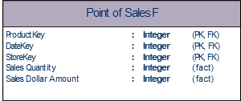
Step 4. Identify the facts
What facts shall we choose for our case study?
What can we find out of a PoS?
The number of products?
The total width of the products?
The total sum of the products
Sales Quantity
Sales Dollar Amount

Slide 53
Two kind of facts
There are two kinds of fact table attributes:
Classification attributes: Keys that captures the dimensions of the process
Keys are usually represented in integer form and do not require much memory space
Facts: Attributes that captures the measures of the process
Facts are often numeric properties and can usually be represented as integers
Contrast to dimensional attributes which are usually long text strings

Slide 54
Sparse fact tables important
It is important to have a sparse fact table since it is critical to the memory space consumption of the data warehouse calculations
The Primary key for the fact table is a concatenated key consisting of the foreign keys to (several of) its dimensions
Use surrogate keys in the dimension to avoid to end up with text/strings as foreign keys in the fact table

Slide 55
The final star schema

Slide 56
The final star schema
DateKey
StoreKey
ProductKey

Slide 57
A family of stars
Dimension tables (in this case in the figure the same dimension for all fact tables)
Fact tables (different fact tables)

Slide 58
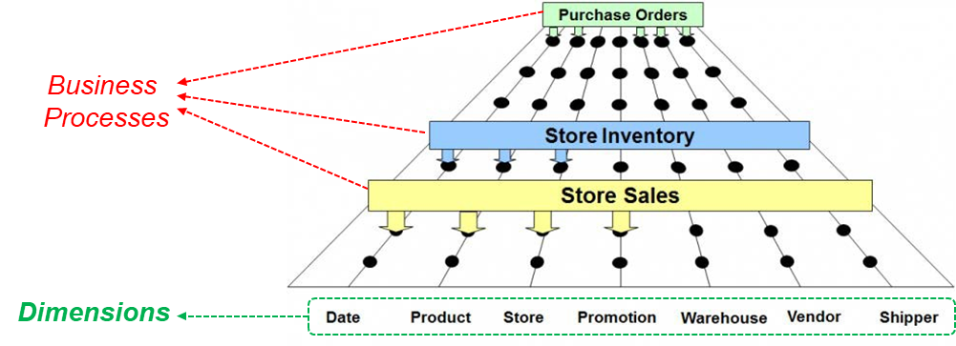
There are many processes
There are many business processes. Therefore, we need many stars schemas. Therefore, We need an enterprise architecture, called the Enterprise Data Warehouse Bus Architecture

Slide 59
Enterprise Data Warehouse Bus Matrix
Enterprise Data Warehouse Bus Matrix
Rows represent business processes
Columns represent dimensions
A dimension that is shared among several business processes is called conformed dimension
It is a good idea to create a list of core dimensions early
Benefits:
The matrix delivers the big picture perspective, regardless of database or technology preferences.

Slide 60
Enterprise Data Warehouse Bus Matrix
Enterprise Data Warehouse Bus Matrix
Dimensions
Facts
A Star Schema
The star schema is designed based on one business process

Slide 61
Enterprise Data Warehouse Bus Matrix
Conformed dimensions – the same dimensions are used by several facts
Thereby, it possible to join different star schemas if needed

