Slide 1
Presentation: Introduction to Data Warehousing
Erik Perjons
DSV, Stockholm University

Slide 2
Problems in Classic Information Systems

Slide 3
Problems to address
”We collect tons of data, but we can't access it"
– "Business people need to get the data easily”
– Lack of technical tools for extracting required information in a proper format (that is, a format easy to understand) for business users
We need Accessibility to the data for users not very familiar with IT and data structures
(Kimball & Ross, 2013)

Slide 4
Problems to address
“We spend entire meetings arguing about who has the right numbers rather than making decisions”
– Different operational systems (databases) devoted to specific business areas within one enterprise easily leads to inconsistencies between the systems (databases)
We need Data integration on the basis of a standard enterprise model
(Kimball & Ross, 2013)

Slide 5
Problems to address
“We want to slice and dice the data every which way!”
– Decision making processes are often ad hoc and we do not know in advance what is needed
We need Query flexibility to maximise advantages obtained on the run
(Kimball & Ross, 2013)

Slide 6
Problems to address
“Just show me just what is important!”
– Examining data on a maximum level of detail is self-defeating because it takes focus from meaningful information (although details are sometimes needed)
We need Information conciseness allowing target oriented and effective analysis
(Kimball & Ross, 2013)

Slide 7
Problems to address
“We want to people to use information to support more fact based decision making”
Data is often incorrect or unavailable
We need Correctness and Completeness of integrated data
(Kimball & Ross, 2013)

Slide 8
Problems to address
We want to see trends
In business analytics, trend and time-series analysis are essential to predict and meet future demands.
We need a solution that captures Historical data
(Navathe, 2010)

Slide 9
Problems to address
We do not want to wait for data
Fast read access even over a large volume of data is necessary in business analytics
We need to optimize Read performance
(Navathe, 2010)

Slide 10
Solutions to the problems

Slide 11
Solutions to the problems: DW/BI
Data warehouse (DW)
– “A decision support database that is maintained separately from the organisation’s operational databases.”
(Navathe)
Business Intelligence (BI)
– ”Business intelligence (BI) is an umbrella term that is commonly used to describe the technologies, applications, and processes for gathering, storing, accessing, and analyzing data to help users make better decisions” (Wixom and Watson)
Data warehousing (DW)
– ” a collection of decision support technologies, aimed at enabling the knowledge worker (executive, manager, analyst) to make better and faster decisions.”
(S. Chaudhiri & U. Dayal)
DW/BI
– Usually used together: BI applications utilizes data from DW:
not all BI requires DW

Slide 12
The bedrock requirements for the DW/BI systems
The DW/BI system must make information easily accessable
that is, data/info simple to understand and possuble to retrieve fast for the end user
The DW/BI must present information consistently
that is, not different definitions for the same term in different departments, or different facts
The DW/BI system must present information in a timely way
that is, present data within an hour, a day, a week, etc, after received in the transactional/operational system, depending on the requirement from business)
….
(Kimball & Ross, 2013)

Slide 13
The bedrock requirements for the DW/BI systems
….
The DW/BI system must adapt to change
that is, manage organizational change due to changes in environment etc
The DW/BI system must serve as the authoritative and trustwothy foundation for improved decision making
The business community must accept the DW/BI system to deem it successfully
(Kimball & Ross, 2013)

Slide 14
Two categories of systems
Operational system (database)
Manage transactions
Online Transactional Processing (OLTP)
Data warehouse
Manage data analysis
Online Analytical Processing (OLAP)
© Heidelberg University

Slide 15
Decisions on different levels
© Heidelberg University

Slide 16
Some influental people
Codd
The relational model
OLTP/OLAP
Imnon
– Data Warehousing
– DW 2.0
Kimball
– The Kimball Approach

Slide 17
The Data Warehouse - definition
”A data warehouse is a subject oriented, integrated, non-volatile, and time-variant collection of data in support of management’s decisions”.
(Inmon)
These four concepts can be seen as major requirements on the DW/BI systems
However, it is not clear what the meaning of these four terms are

Slide 18
Data Warehouse - Subject-Oriented
Classical operation systems is organized around applications and functions:
order handling
billing
sales
delivery
Data Warehouse systems is organized around subjects (”major nouns”):
customer
supplier
product
office
date
Answer questions such as Who, What, Where, When regarding business events/transaction (such as a sale or payments events)
Billing System
Order System
Customer Data
Production System
Supplier Data
Product Data

Slide 19
Data Warehouse - Subject-Oriented
Focusing on the modeling and analysis of data for decision makers, not on daily operations or transaction processing …
(Query flexibility)
… to provide a simple and concise view on particular subject issues … (Accessibility)
… by excluding data that are not useful in the decision support process (Information Conciseness)
Operational systems
- focussing on daily operations and transaction processing
Data Warehousing systems
- data organized around on subject, that is major business objects and events
Billing System
Order System
Supplier Data
Customer Data
Production System
Product Data

Slide 20
Data Warehouse - Integrated
Constructed by integrating multiple, heterogeneous data sources - relational or other databases, flat files, external data, etc - consolidating the organization’s info
Integrated are often described as “consolidated”, ¨”reconciled”, “centralized” or “in a consistent format”
(Data integration)
There may be different definition of the term ”customer” in the different systems
DW
One definition of the term ”customer”
Marketing System
Order System
Customer Data
All attributes/data about a customer is gathered
There may be different attribute/data about a customer in the different systems
Billing System
Operational Systems

Slide 21
Data Warehouse - Integrated
Data cleaning and data integration techniques are applied (Correctness and Completeness)
Ensure consistency in naming conventions, encoding structures, attribute measures, etc. among different data sources
When data is moved to the warehouse, it is converted to the same format
Cleansing
Integration techniques
Conversion to the same format
Restructure
Marketing System
Operational Systems
Order System
Customer Data
DW
Billing System

Slide 22
Data Warehouse - Time Variant
Time variant means that every unit of data in the data warehouse is accurate as of some moment in time
That is, we should have the ability to move the time and access and analyse the data at a certain point in time
This require that every transaction and snapshot stored in the DW must have a time-stamp

Slide 23
Data Warehouse - Time Variant
Note also, the time horizon for the data warehouse is significantly longer than that of operational systems
(Historical data)
Operational database: current data
Data warehouse data: provide information from a historical perspective (e.g., past 5-10 years)
Every core structure of data in the data warehouse contains an element of time
Operational Systems
DW
Order System
60-90 days
Stock level Data
5-10 years

Slide 24
Data Warehouse - Non-Volatile
Non-volatile implies that when new data is added to the system the old data are never removed or changed, instead they just remain there
Once data is in the data warehouse, it will not change.
Operational Systems
DW
Create Delete
Load
Order System
Stock level Data
Access
Update Read

Slide 25
Data Warehouse - Non-Volatile
Operational update of data does not occur in the data warehouse environment
– Does not require transaction processing, recovery, and concurrency control mechanisms
– Requires only: loading and access (read) of data
Operational Systems
DW
Create Delete
Load
Order System
Stock level Data
Access
Update Read

Slide 26
Summary: OLTP vs OLAP
OLTP vs. OLAP
holds current data ←→holds historic and integrated data stores detailed data ←→ stores detailed and summarised data
data is dynamic ←→ data is largely static
repetitive processing ←→ ad-hoc and unstructured processing predictable pattern of usage ←→unpredictable pattern of usage
transaction driven ←→ analysis driven application based ←→ subject based
support day-to-day decisions ←→supports strategic decisions
operational users ←→managerial users

Slide 27
Layers for Analysis – DW architecture
(based on Golfarelli & Rizzi Data Warehouse Design, 2009)

Slide 28
Single-Layer Architecture for Analysis
Analysis
Operational DBs
Source layer

Slide 29
Single-Layer Architecture for Analysis
Rarely used architecture
Does not separate analytical processing from transaction processing
Queries will affect transactional workloads (and disturb the operational system with complex queries)
Not effiecient in managing integration and correctness issues

Slide 30
Why separate Data Processing from Analysis?
The operational systems/transactional systems are tuned to support known daily operations
DW requires consolidating data from many heterogeneous sources
DW requires special data structures, access methods and implementation methods
DW may requires data that may be missing in the operational systems. Therefore, we need to acquire additional external data

Slide 31
DW Architectures: Two-Layer for Analysis
Data staging
Analysis
Data warehouse
Operational DBs
External sources
Data marts
Data sources
Source layer
Data Warehouse layer

Slide 32
DW Architectures: Two-Layer for Analysis
Data is stored separately in a data warehouse and/or data marts
Information is available even when sources are not
Queries for analysis do not affect transaction management in source systems
Data is structured to facilitate analysis rather than transactions
Data can be summarized
Historical data can be managed
Data warehouses can have specific design solutions for performance optimatition of analysis and report applications

Slide 33
Data Mart
“A data mart is a subset or an aggregation of the data stored to a primary data warehouse. It includes a set of information pieces relevant to a specific business area, corporate department, or category of users.”
Golfarelli & Rizzi
Data marts are useful:
They can be used as building blocks when incrementally building the data warehouse
They mark out information required by specific groups of users
Better performance as they are smaller than primary data warehouses
Data warehouse
Data Marts

Slide 34
Data Warehouse vs. Data Mart
Enterprise warehouse:
Collects all information about subjects that span the entire organization
(customer, product, assets, personnel, supplier)
Requires extensive business modelling
May take years to design and build
Data Mart:
Departmental subsets that focus on selected subjects:
Marketing data mart: customer, product, sales
Ordering data mart: Supplier, product, stock level
Faster roll-out
Complex integration in the long term

Slide 35
Data Mart architecture
Dependent architecture
Independent architecture
Data warehouse
Query/Reporting
Data marts
Data marts

Slide 36
DW Architectures: Three-Layer for Analysis
Data staging
Analysis
Data warehouse
Operational DBs
External sources
Data marts
Data sources
Staging Tables & ODS
Source layer
Reconciled layer
Data Warehouse layer

Slide 37
DW Architectures: Three-Layer for Analysis
Reconciled data layer
Can be a so called Operational Data Store (ODS)
ODS can be used in organisation if the organization need to access this data before it reach the DW – for example a bank needs to access data in the end of the data that is hard to get from the operational system/transactiional system
Holds operational data before it is manipulated for the DW
Can be an relational database in 3NF or flat files or both
Are used by ETL tools for transforming data from source systems. Such extracted data can be stored as flat files, staging tables, or in a database i 3NF

Slide 38
DW Architecture: The ETL Process
Data staging Analysis
Monitoring & Administration
Metadata repository
Data warehouse
Operational DBs
Extract Transform Load Refresh
External sources
Data marts
Data sources
Staging Tables & ODS
ETL

Slide 39
DW Architecture: The ETL Process
Extract (E)
Copying the data needed for the data warehouse into the staging area for further manipulation,
Usually from many (types of) sources
Transform (T)
Data conversion
Data cleaning
Data enrichment

Slide 40
DW Architecture: The ETL Process
Load (L)
data sorting
assigning warehouse keys
aggregation/summarisation
building indexes

Slide 41
DW Architecture: The ETL Process
Refresh
Incremental uploads
Replication server techniques
Data shipping (Push)
relying on triggers
Transaction shipping (Pull)
relying on transaction logs

Slide 42
DW Architecture: OLAP cubes
Data staging Analysis
Monitoring & Administration
OLAP
cubes
Metadata repository
Data warehouse
Operational DBs
Extract Transform Load Refresh
External sources
Data marts
Data sources
Staging Tables & ODS
OLAP

Slide 43
How to store data in a DW?
Two dimensional: Relational Star schema
Multidimensional OLAP Cubes

Slide 44
DW Architecture: End User Applications
Data staging
Monitoring & Administration
Analysis
Analytic applications
 | Productt | Time1 | Value1 | Value11
 | Product2 Product3 | Time2 Time3 | Value2 Value3 | Value21 Value31
 | Product4 | Time4 | Value4 | Value41
OLAP
cubes
Metadata repository
Data warehouse
Operational DBs
Ad hoc Query/Reporting
Extract Transform Load Refresh
Access
External sources
Forecasting, scoring, Data mining
Data marts
Falö aöldf flaöd aklöd falö alksdf
Data sources
Staging Tables & ODS
RDBMS, Rolap, Molap, Holap
End User Applications

Slide 45
DW Architecture: End User Applications
Query / Reporting
E.g sql output as reports and spread sheets
BI apps and OLAP tools
Microsoft Power BI, IBM Cognos, QlikView, Microsoft SSAS, Jaspersoft, SAP NetWeaver BI, Pentaho BI, Tableau BI
Data mining
e.g. Text mining

Slide 46
DW Architecture: End User Applications
Dashboard examples
On the fly analysis
Prediction sales
Jaspersoft©

Slide 47
GIS analysis
ESRI & SvD©

Slide 48
Four types of Data Warehouse architectures

Slide 49
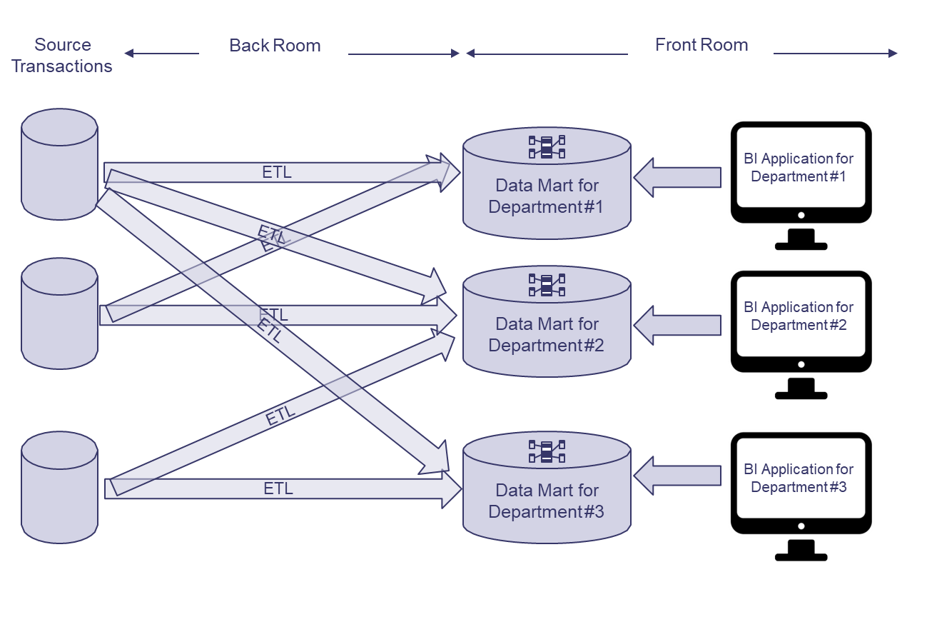
Independent Data Mart Architecture
(Kimball & Ross, 2013)

Slide 50
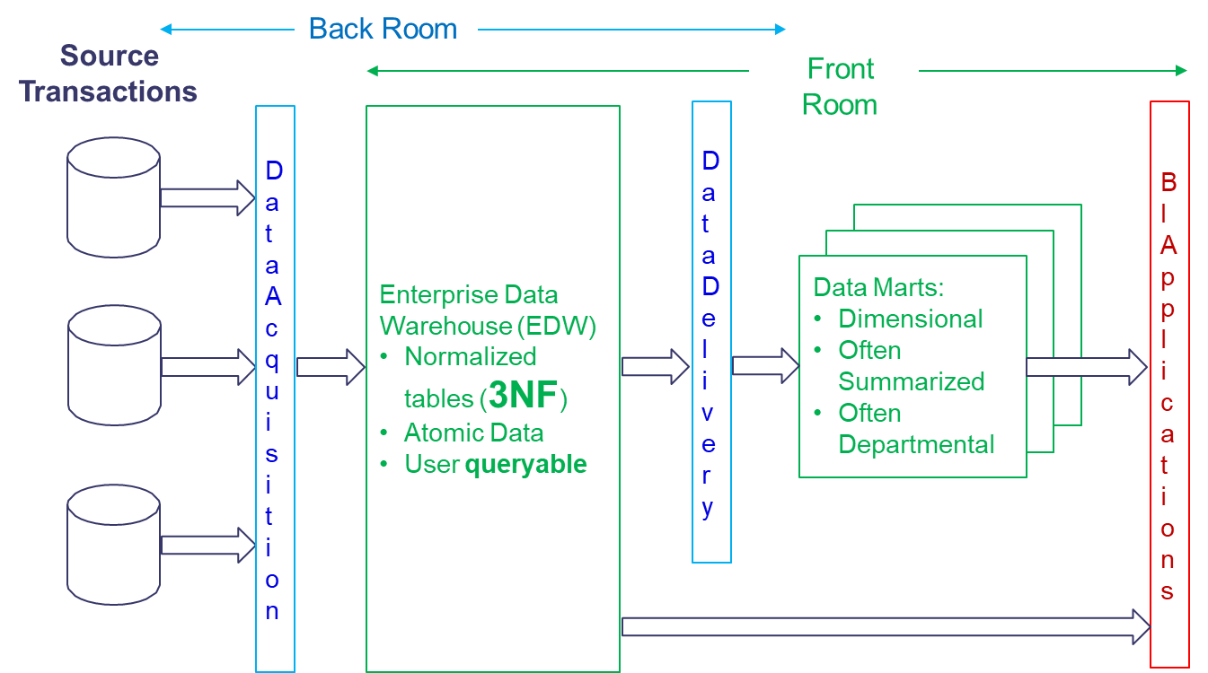
Hub-and-Spoke Corporate Information Factury Archiecture (Inmon)
(Kimball & Ross, 2013)

Slide 51
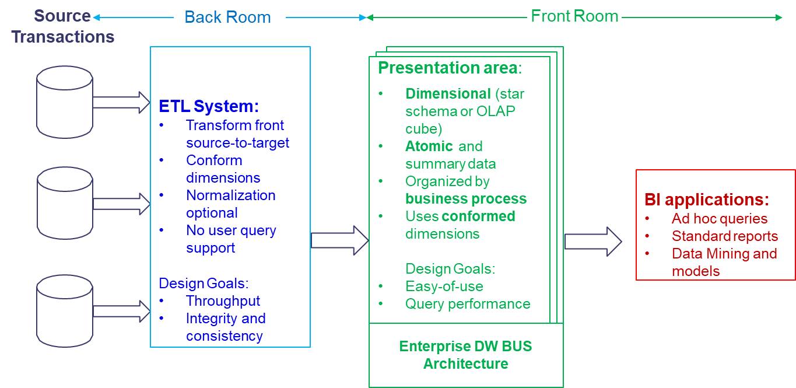
Kimball/Ross DW/BI Architecture
(Kimball & Ross, 2013)

Slide 52
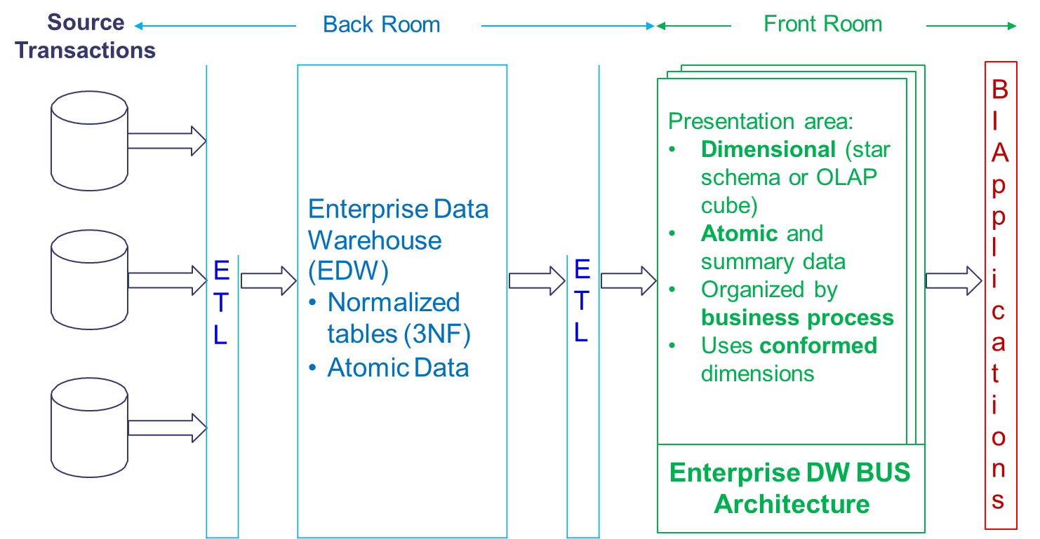
Hybrid Architecture
(Kimball & Ross, 2013)

