Slide 1
Marknaden för BI
Erik Perjons
DSV, Stockholm University

Slide 2
Background
This presentation is based on Gartner Group’s report ”Magic Quadrant for Analytics and Business Intelligence Platforms” (2019) written by Howson, C., Richardson, J., Sallam, R., Kronz, A.

Slide 3
Background
This presentation is based on Gartner Group’s report ”Magic Quadrant for Analytics and Business Intelligence Platforms” (2019) written by Howson, C., Richardson, J., Sallam, R., Kronz, A.

Slide 4
Traditional vs modern BI platforms
Gartner’s report makes a difference between traditional BI platforms and modern BI platforms, called ”modern analytics and BI platforms” in the Gartner’s report
The traditional BI platforms - require a significant support from IT staff, for example, to predefine data models, lagra och prepare data for analysis, etc
Modern analytic and BI platforms – are instead emphasing self-service for business users interested in data analysis (called citizen data scientist by Gartner), and support agility in the analytic work

Slide 5
Modern analytics and BI platforms
Gartner claims that modern analytics and BI platforms are already mainstream purchases
Modern analytics and BI platforms – are ”charaterized by easy-to-use tools that support the full analytic workflow — from data preparation and ingestion to visual exploration and insight generation”

Slide 6
Modern analytics and BI platforms
To summarize: Modern analytics and BI platforms aims to:
support user’s self-service
support agility in the analytic work
provide easy-to-use tools in a single platform
provide visual exploration and insight generation
support the full analytic workflow,
and
provide “augumented analytics”

Slide 7
Important trend: Augumented analytics (AA)
Augmented analytics (AA) can be seen as a umbrella term for several analytics and BI techniques that support – and partly automate - the different parts of the analytic workflow, that is, the workflow from data preparation, via data analysis, to the presentation of the result of the analysis
AA make use of, for example, machine learning (ML) and natural language processing (NLP) techniques
AA will support business users and citizen data scientist in their BI work, and make them less dependent on IT staff and IT experts
Gartner predicts that AA will be the main driver of purchases of BI and data science platforms

Slide 8
AA makes use of NLP/NLQ
Natural language processing (NLP) makes it possible for BI users to generate queries in plain language via text or voice –without writing queries in SQL or a script language. Also called Natural language query (NLQ)
An example of a question to ask in plain language: “Which are our ten most profitable customers?”
Gartner claims that NLP/NLQ will by 2021 boost the analytics and BI software adoptions to new groups of users in organizations, for example, the front-office workers

Slide 9
AA makes use of Data Discovery, Visualisation and Narration
Augumented Data Discovery – support the user to identify pattern and exceptions in data in order to achieve new insights
Augumented Visualization – innovative and smart visualizations support the user in analyzing data
Narration – means that techniques using ML, provide the user with written analysis of data sets or graphs. This helps the user to interpret the data

Slide 10
AA support Self Service Data Preparation
Self Service Data Preparation techniques using ML can support the user in carrying out data prepations without the need to writing code. It can help the user to better understand how different datasets are related but also warn the user to not connect certain data sets
Data preparation and data modelling are complex and time consuming task which requires expert knowledge

Slide 11
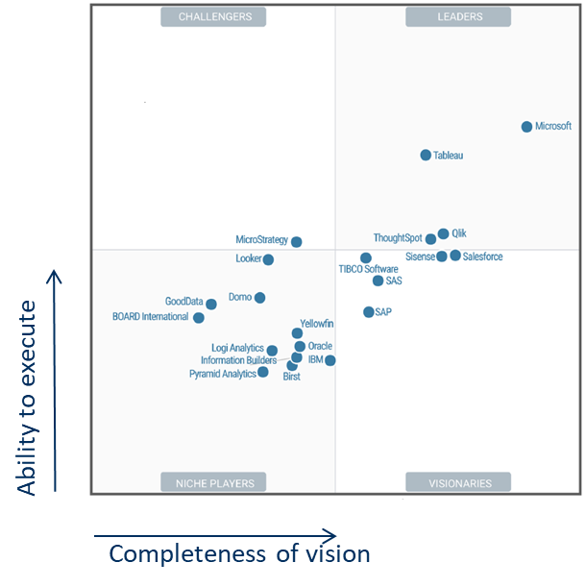
Magic Quadrant
Gartner’s Sources:
Survey of vendor’s reference customers, 1639 respondents
Vendors’ completed questionnairs, briefings and video demos of and BI products
Gartner’s testing of analytic and BI-platforms
Evaluation of use cases and critical capabilities
Ability to execute
Completeness of vision

Slide 12
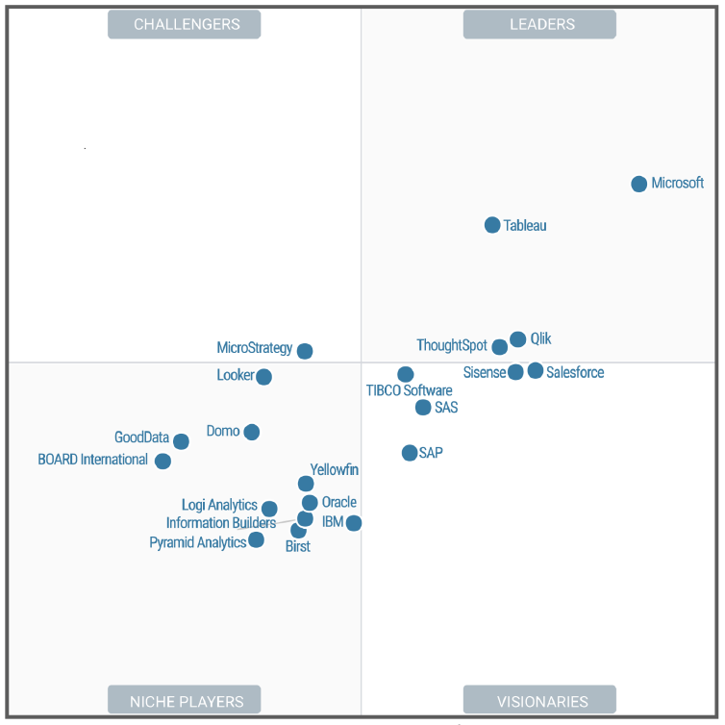
Magic Quadrant
Ability to execute – vendors ability to makes their vision a market reality, to provide products/services that customers are prepared to buy into, and to deliver a positive customer experience
The criteria used:
Product/Services – how well the vendors provide competitive and successful products given 15 specified product capabilities
Customer experience – how the vendors enable and support customers to use their products/services
Overall viability – financial health of vendors and their future investments
Market responsiveness – vendors’ momentum and success in the current market
Sales execution/pricing – vendors’ presale activities, deal management, pricing
Operations – trouble-free software for cusomers, how easy it is to migrate to new versions
Ability to execute
Completeness of vision

Slide 13
Magic Quadrant
Completeness of vision – vendors understanding of how market forces can be exploited to create value for customers, such as support key trends and meet the needs of current and future requirements
The criteria used:
Market understanding – how well the vendors understand buyers needs
Marketing strategy– how well the vendors communicate value and product/service differentiation to the market
Sales strategy – innovative partner strategy, attractive pricing and flexible product packaging
Offering(product) strategy – how well the vendors meet the needs of current and future requirements
Vertical/industry strategy– how well the vendors meet the needs of different type of industies
Innovation – how large investments in unique and in-demand capbilities
Geographic strategy – how the vendors meet the needs of locations outside native country, directly or via partners
Ability to execute
Completeness of vision

Slide 14
Magic Quadrant
Leaders – have a solid understanding of necessary product capabilities as-is and to-be, provide needed commitment to customers, and have a robust roadmap for keeping the position as market leaders
Visionaries – have a strong vision for delivering modern products/services, but have gaps to fulfilling broader functionality requirements or lower scores for customer experiences, operations and sales execution, etc
Ability to execute
Completeness of vision

Slide 15
Magic Quadrant
Challengers – are well-positioned to succeed in the market. However, they may be limited to specific technical environments, application domains or use cases (see next slide)
Nisch players – may focus on, and do well, in a specific domain or aspect of BI, but lack depth of functionality elsewhere
Ability to execute
Completeness of vision

Slide 16
15 capabilities using 5 use cases
Gartner assesses 15 product capabilities for BI producs using 5 use cases

Slide 17
Use cases
Agile, centralized BI provisioning – a use case where the analytic workflow is agile – and where the analytic content is centrally managed and delivered
Decentralized analytic – a use case where the analytic workflow supports self-service analytics for individual business units and users
Governed data discovery – a use case where the analytic workflow supports self-service analytics of user-generated content, certified and analytic content as well as other forms of content

Slide 18
Use cases
Embedded analytics – a use case where the analytic workflow support the embedding of content into processes and applications
Extranet deployment – a use case where the analytic workflow is similar to the agile, centralized BI provisioning – but for the external customer (or citizens in the public sector)

Slide 19
Capability of BI products
Infrastructure capabilities:
BI platform administration, security and achitecture – capabilities that provide administration of users, auditing of access and utilization, and disaster recovery
Cloud BI – capabilities of building, deploying and managing BI in the cloud
Data source connectivity and ingestion – capabilities to connect to both structured and un-structured data contained within different platforms

Slide 20
Capability of BI products
Data management capabilities:
Metadata management – capabilities that makes it possible to search, capture, store, reuse and publish metadata, such as dimensions, hierachies and measures/KPIs
Data storing and loading options – capabilites to load, access, integrating, transform, refresh store and load data

Slide 21
Capability of BI products
Data management capabilities:
Data preparation – capabilities to combine data from different sources and create analytical models, including defining measures, groups and hierarchies for analysis
Scalability and data model complexity – capabilities of in-memory engines or in-database architeture to handle high voiumes of data and complex data models

Slide 22
Capability of BI products
Analysis and content creation capabilities:
Advanced Analytics for Citizen Data Scientist – capabilities that provide users to easy access advanced analytics capabilities using menu driven options and/or through the import of externally developed models.
Analytic Dashboards – capabilities to develop interactive dashboards, with visual exploration and embedded advanced analytics to be consumed by others
Interactive Visual Exploration – capabilities to explore data via a number of visualization options that go beyond basic pie, bar and line charts, for example heat and tree maps, geographic maps, and scatter plots

Slide 23
Capability of BI products
Analysis and content creation capabilities:
Augmented Data Discovery – capabilities that automatically visualizes important findings such as correlations, links, predictions, and exceptions in data that are relevant to users without requiring the users to build models or write algorithms
Mobile Exploration and Authoring – capabilities for developing and delivering content to mobile devices

Slide 24
Capability of BI products
Sharing of findings:
Embedding Analytic Content – capabilities, such as software developer kit, for embedding analytic content into a business process and/or an application or portal
Publish, Share and Collaborate on Analytic Content – capabilities that allow users to publish, share and collaborate analytic content

Slide 25
Capability of BI products
Overall platform capabilities:
Ease of Use, Visual Appeal and Workflow Integration – capabilities that makes it easy to administer the BI platform, makes the content visually appealing, and support analytical workflow integration

Slide 26
Magic Quadrant 2017
Challengers
Leaders
Tableau
Qlik
Microsoft
Ability to execute>
Niche players
Visionaries
SAS
Salesforce
SAP
IBM
TIBCO Software
Completeness of vision>

Slide 27
Magic Quadrant 2019
Challengers
Leaders
Microsoft
Tableau
Qlik
Ability to execute>
Niche players
Visionaries
Salesforce
TIBCO Software
IBM
SAS
SAP
Completeness of vision>

Slide 28
Microsoft
Microsoft’s major BI product is Power BI
Power BI offers data preparation, visual based data discovery, interactive dashboards and augumented analytics
Power BI can be used for all analytics use cases (presented by Gartner)
Power BI is an easy-to-use product with high levels of customer satisfaction
Power BI is low priced and have a strong global adoption
A drawback is that the cloud version on Power BI cannot be used on any IaaS, it can only run in the Azure Cloud

Slide 29
Tableau
Tableau’s major BI product is named Tableau
The product Tableau enables the users to access, prepare, analyse and in data without technical skills or coding
The product is popular due to its easy-to-use visual exploration and data manipulation
Tableau has a large active user community that acts like fans
Some drawbacks are Tableau’s decline in customer support and that customers report about performance issues

Slide 30
Qlik
Qlik’s major product is QlikSense, built on Qlik Analytics Platform. However, Qlik’s original product, QlikView, still have a large customer base.
The products QlikSense and QlikView provide data discovery, agile analytics and BI
Qlik continue working on its augumented analytics roadmap, including an improved data preparation and a support for embedded analytics
The Qlik Analytics Platform also provide possibilties to build customized applications
Qlik have a large and active user community
Qlik BI-plattform support the use of multiple cloud data sources
A drawback is that both QlikSence and QlikView still require additional products for providing a full analytical workflow

Slide 31
Salesforce
Salesforce’s major products are Einstein Analytics Platform (formerly Wave), Einstein Discovery (augmented analytics), and Einstein Data Insights (AI-automated insights for Salesforce reports).
Salesforce’s Einstain products are strong in augumented analytics
Einstein Analytics Platform is integrated with Salesforce business applications
Salesforce also have a robust collaboration with different software vendors
Drawbacks are the high cost of the Einstein products and that a majority of the customers do not use Einstein as their enterprise analytics and BI platform

Slide 32
TIBCO Software
TIBCO Software Spotfire is a product that provide visual-based data discovery, analytics dashboards, interactive visualization and data preparation in a single design tool and workflow.
The latest release, Spotfire X, also adds automated insight generation.
Sportfire is a strong product for all use cases, and its customer experience score high
Drawbacks are high cost for the product, which is a barrier to wider deployment

Slide 33
SAP
SAP’s lead product for modern analytics and BI is SAP Analytics Cloud
A majority of users of SAP Analytics Cloud already use other SAP applications
SAP Analytics Cloud is one of the highest rated platforms for augumented data discovery capability
Drawbacks are lack of quality and poor performance for the product

Slide 34
SAS
SAS is a global vendors due to its different analytical applications used all over the world
SAS’s product for modern analytics and BI is Visual Analytics (on SAS Viya).
Visual Analytics combines reporting, data preparation, visual exploration and dashboards in a single product.
Visual Analytics is also a component in the companies data science product, SAS Visual Data Mining and Machine Learning
Drawbacks are that Visual Analytics is not assessed as a easy-to-use product, and that sales experience is low

Slide 35
IBM
IBM’s modern analytics and BI platform is Cognos Analytics
Cognos Analytics is newly enhanched with augumented analytics capabilities that previously only existed in IBM Watson Analytics (which was removed from IBM’s price list in 2018)
Drawbacks are that Cognos Analytics is an immature product with basic gaps across in the analytic workflow

