Slide 1
Machine learning – why such a big deal, and what is the role of data?
Erik Perjons
DSV, Stockholm University

Slide 2
Why is ML such a big deal?

Slide 3
Why is ML such a big deal?
According to Brynjolfsson and Mcafee (2017), machine learning (ML) is the most important general-purpose technology of our era, similar to previous general-purpose technologies such as steam power, electricity and the combustion engine
They argue that important general-purpose technologies, such as ML, have a transformational impact on the economy and business, both directly, but also indirectly by enabling complementary innovations and opportunities
(Brynjolfsson, E., & Mcafee, A. (2017). The business of artificial intelligence. Harvard Business Review, 1-20.)

Slide 4
Why is ML such a big deal?
There are two reasons why ML is such a big deal:
Humans cannot automate a number of tasks since they cannot explain how to carry out these tasks. In such cases, traditional software cannot be developed, since it requires the software developer to understand the tasks at hand in order to code the predefined sequence of instructions. Read Polanyi: Humans know more than they can tell
On the other hand, ML systems are excellent learners, so with ML we can automate these tasks even if human do not know the sequence of instructions. Why? Since ML can learn from data
(Brynjolfsson, E., & Mcafee, A. (2017). The business of artificial intelligence. Harvard Business Review, 1-20.)

Slide 5
Why is ML such a big deal?
There are two reasons why ML is such a big deal:
Humans cannot automate a number of tasks since they cannot explain how to carry out these tasks. In such cases, traditional software cannot be developed, since it requires the software developer to understand the tasks at hand in order to code the predefined sequence of instructions. Read Polanyi: Humans know more than they can tell
On the other hand, ML systems are excellent learners, so with ML we can automate these tasks even if human do not know the sequence of instructions. Why? Since ML can learn from data
(Brynjolfsson, E., & Mcafee, A. (2017). The business of artificial intelligence. Harvard Business Review, 1-20.)

Slide 6
What is ML?

Slide 7
What is ML?
Brynjolfsson and Mcafee (2017), define Machine Learning (ML) as “the machine’s ability to keep improving its performance without humans having to explain exactly how to accomplish all the task it’s given”
(Brynjolfsson, E., & Mcafee, A. (2017). The business of artificial intelligence. Harvard Business Review, 1-20.)

Slide 8
What is ML?
ML comes in two major categories:
supervised learning systems
unsupervised learning systems
(Brynjolfsson, E., & Mcafee, A. (2017). The business of artificial intelligence. Harvard Business Review, 1-20.)

Slide 9
Supervised learning system

Slide 10
Supervised learning system
Supervised learning system are systems that are trained using "labelled" training data in order to categorize new, unlabeled data, based on the training
More precisely, a supervised learning system use a large set of training data showing both the input (for example, pictures of dogs and cats) and the correct output (for example, correct labels for dogs and cats)
After the system has been trained with the training data, the system should be able to do the mapping between input and output itself. That is, given new input (new pictures of dogs and cats), the system should be able to predict the correct output (label of dog or label of cat)
(Brynjolfsson, E., & Mcafee, A. (2017). The business of artificial intelligence. Harvard Business Review, 1-20.)

Slide 11
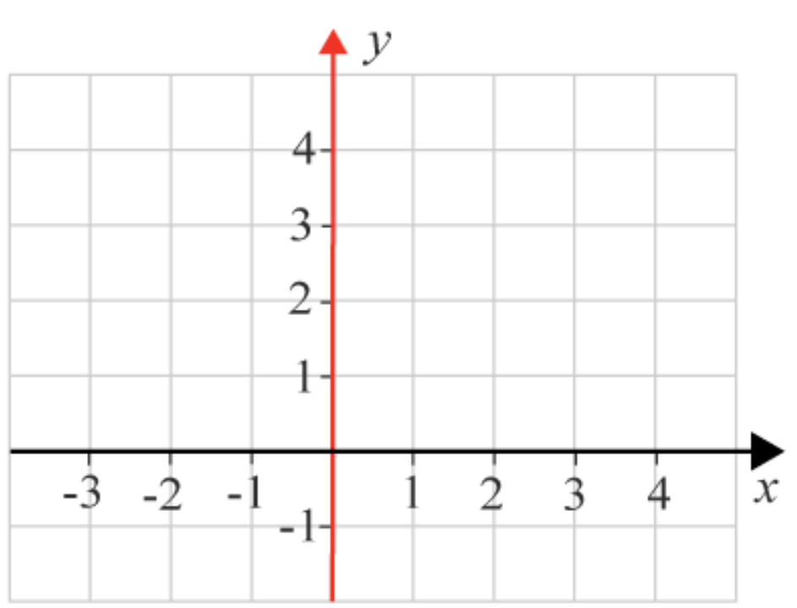
Supervised learning system
A somewhat simplified example of how a supervised learning system address a given problem:
First, a ML algorithm and set of training data need to be selected that are suitable for the problem to be addressed;
The selected ML algorithm could look like this: y= kx + l (but represented as code in order to be run in a computer). The algorithm in this case is called ”linear regression”
The training data could consist of one input (x) and one output (y) value, in the form of a value pair (x,y), for example, (1,3), (0,2), (-1,0), etc.
… (cont. next slide)
X | Y
1 | 3
0 | 2
-1 | 0

Slide 12
Supervised learning system
… (from previous slide)
Second, the ML algorithm needs to be applied on the training data:
By applying the ML algorithm (y= kx + l) on the training data, the values of the parameters k and l will emerge.
For each training data (value pair) used, the algorithm will somewhat adjust the values of the parameters k and l. This is called training the ML model.
When the ML algorithm has been applied on all training data, a ML model is created, in this case: y= 2x + 2, that is, we have received the final values of k and l (k=2 and l=2)
… (cont. next slide)
y=2x+2

Slide 13
Supervised learning system
… (from previous slide)
Second, the ML algorithm needs to be applied on the training data:
By applying the ML algorithm (y= kx + l) on the training data, the values of the parameters k and l will emerge.
For each training data (value pair) used, the algorithm will somewhat adjust the values of the parameters k and l. This is called training the ML model.
When the ML algorithm has been applied on all training data, a ML model is created, in this case: y= 2x + 2, that is, we have received the final values of k and l (k=2 and l=2)
… (cont. next slide)
y=2x+2

Slide 14
Supervised learning system
… (from previous slide)
Third, this ML model can now be used on new data items as input to predict output:
Each data item has a value for input (x).
By applyling the ML model, the value for output (y) will be calculated and predicted
y=2x+2
X | Y
3 | 8
2 | 6
1 | 4

Slide 15
Supervised learning system

Slide 16
Supervised learning system
Note, in ML, the use of the terms ”ML algorithm” and ”ML model” are sometimes confusing, since they are used in different ways by different authors.
Other terms used are ”learned function” and ”learning algorithm”

Slide 17
Supervised learning system
The selection of an ML algorithm is important since it decide the general approach to take. There are several guidelines published for selecting an appropriate ML algorithm to address a problem at hand
Note also:
The same ML algorithm can be applied on a different set of training data
A different ML algorithm can be applied on the same set of training data
(Alpaydin, E. (2021). Machine Learning, MIT Press Essential Knowledge Series, Chapter 1, s11-33)

Slide 18
Supervised learning systems
Brynjolfsson & Mcafee (2017) state, referring to Tom Mitchell and Michael I. Jordan, that there are many examples of recent supervised learning systems - which actually map input to output:
Application | Input X | Output Y
Speech recognition | Voice recording | Transcript
Face recognition | Faces | Name
Customer retension | Purchase histories | Future purchase behavior
Fraud detection | Transaction details | Fraudulent transactions
(Brynjolfsson, E., & Mcafee, A. (2017). The business of artificial intelligence. Harvard Business Review, 1-20.)

Slide 19
Supervised learning systems
Supervised learning systems can be applied when:
the user aims to predict the future and
the user have a lot of data based on the past (to use for training the system)
Examples of applications using supervised learning systems are: diagnosing skin cancer, reviewing loan applications or contracts, and optimizing supply-chains
(Brynjolfsson, E., & Mcafee, A. (2017). The business of artificial intelligence. Harvard Business Review, 1-20.)

Slide 20
Unsupervised learning system

Slide 21
Unsupervised learning systems
Unsupervised learning systems aims to learn on their own, without a set of training data. That is, unsupervised learning systems finds hidden pattern in unlabeled data
(Brynjolfsson, E., & Mcafee, A. (2017). The business of artificial intelligence. Harvard Business Review, 1-20.)

Slide 22
Unsupervised learning systems
Unsupervised learning systems can discover patterns that we are currently unaware of
However, unsupervised learning systems are difficult to build
Note, humans are excellent unsupervised learners. Humans are building up their knowledge based on a small amount of data, labeled or not
(Brynjolfsson, E., & Mcafee, A. (2017). The business of artificial intelligence. Harvard Business Review, 1-20.)

Slide 23
Cluster analysis
Cluster analysis is a type of unsupervised learning
“Cluster analysis or clustering is the task of grouping a set of objects in such a way that objects in the same group (called a cluster) are more similar (in some sense) to each other than to those in other groups (clusters)”.
Note, the characteristics of similarity are not known in advance - training data are not used
An example of cluster analysis is segmenting consumers into similar groups for targeted marketing
(https://en.wikipedia.org/wiki/Cluster_analysis.)

Slide 24
Artificial Neural Network (ANN)

Slide 25
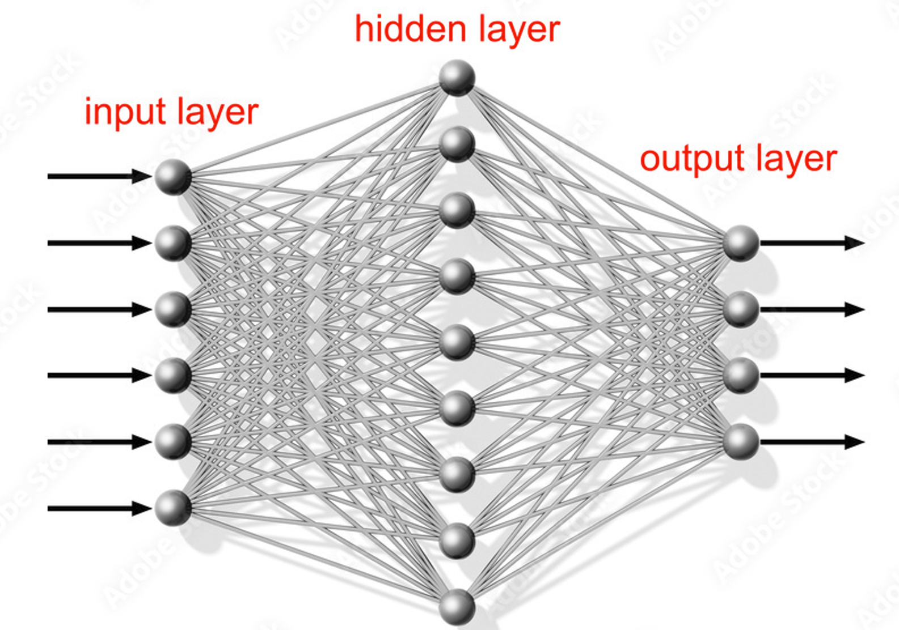
Artificial Neural Network (ANN)
A artificial neural network (ANN) is a machine learning approach that make use of a network of nodes that associate inputs with outputs – via a hidden layer of nodes – and make use of weights on these associations (that is, weights on the associations between the input layer nodes and the hidden layer nodes, and between the hidden layer nodes and the output layer nodes), in order to predict output from given input
Each node in an ANN performs some kind of a calculation, that is, calculation is performed on the receiving input, to be passed on to nodes in another layer

Slide 26
ANN - similar to the brain
The idea with ANN is to build algorithms that behave similar to the human brain
Nodes in a ANN were inspired by the neurons in the human brain. In the brain, these neurons work together in groups connected via synapses. These synapses are represented as associations in the ANN
(McCullum, N. (2020) Deep Learning Neural Networks Explained in Plain English, available at (2023-01-9)https://www.freecodecamp.org/news/deep-learning-neural-networks-explained-in-plain-english/)

Slide 27
ANN - weights and activation function
Each node in an ANN performs some kind of a calculation based on the weight on the association and an activation functions. Then, a new calculated output and sent to nodes in the next layer.
The data scientist select the weight and the types of activation function to be used
(McCullum, N. (2020) Deep Learning Neural Networks Explained in Plain English, available at (2023-01-9)https://www.freecodecamp.org/news/deep-learning-neural-networks-explained-in-plain-english/)

Slide 28
Training the ANN
When training the ANN - the weights are modified until the expected output is received (in this case, it is a form of supervised learning using a set of training data showing the correct output from given input)
A specific cost function is used to train the ANN, that is, to minimize the error of the ANN’s prediction. This is done by, as specified above, modifying the weights.
(McCullum, N. (2020) Deep Learning Neural Networks Explained in Plain English, available at (2023-01-9)https://www.freecodecamp.org/news/deep-learning-neural-networks-explained-in-plain-english/)

Slide 29
ANN – a simple example
x1
Area (m²)
Number of bedrooms
x2
Y
Price
Distance to city (km)
x3
Age of house
x4
Input layer
Hidden layer
Output layer
(McCullum, N. (2020) Deep Learning Neural Networks Explained in Plain English, available at (2023-01-9)https://www.freecodecamp.org/news/deep-learning-neural-networks-explained-in-plain-english/)

Slide 30
ANN – a simple example
x1
Area (m²)
Number of bedrooms
x2
Y
Price
Distance to city (km)
x3
Age of house
x4
Input layer
Hidden layer
Output layer
(McCullum, N. (2020) Deep Learning Neural Networks Explained in Plain English, available at (2023-01-9)https://www.freecodecamp.org/news/deep-learning-neural-networks-explained-in-plain-english/)

Slide 31
Deep Learning

Slide 32
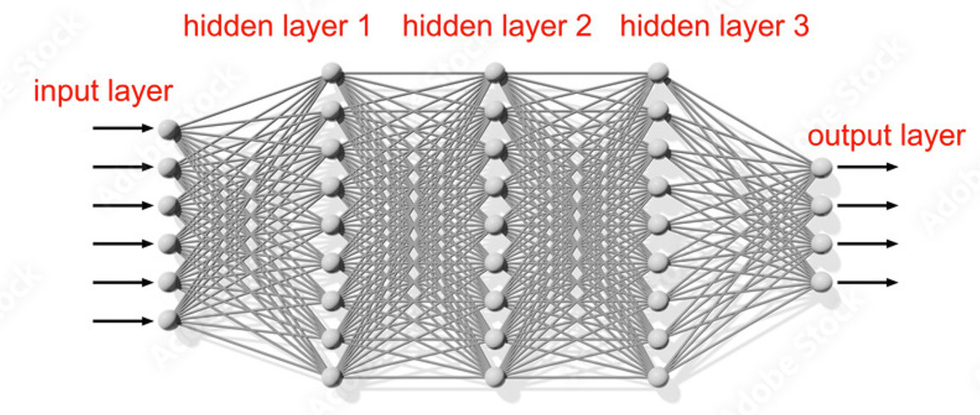
Deep learning
Deep learning is a machine learning approach that is using a “multiple layers neural network” – that is, an ANN with several hidden layers of nodes
That is, deep learning is using a so called “deep neural network”

Slide 33
Deep learning
The multiple layers of nodes in deep learning are often used to progressively extract higher-level features from the raw input
“For example, in image processing, lower layers may identify edges, while higher layers may identify the concepts relevant to a human such as digits or letters or faces”
(https://en.wikipedia.org/wiki/Deep_learning)

Slide 34
Deep learning
Deep learning has been very successful, expecially in the areas of automatic speech and image recognition
The success of deep learning has more or less transformed the whole AI industry Therefore, the term ”deep learning revolution” is often used when deep learning is discussed
Example of deep learning applications: image recognition, recommender system, financial fraud detection
(Brynjolfsson, E., & Mcafee, A. (2017). The business of artificial intelligence. Harvard Business Review, 1-20.)

Slide 35
Deep learning – benefits
Deep learning can make use of larger dataset than traditional ML can do.
More data leads to better predictions using deep learning, while for traditional ML, more data make better prediction only up to a certain amount of data
(Brynjolfsson, E., & Mcafee, A. (2017). The business of artificial intelligence. Harvard Business Review, 1-20.)

Slide 36
Deep learning - drawbacks
Deep neural networks may use hundreds of millions of associations between the nodes
Each of this association contribute to the decision suggested – but each association’s impact on the decision is limited.
Therefore, deep neural networks have problem to explain, in a simple way, why it ended up in a certain decision.
That is, deep neural networks knows more than they can tell us (Note, Polanyi’s paradox again)
(Brynjolfsson, E., & Mcafee, A. (2017). The business of artificial intelligence. Harvard Business Review, 1-20.)

Slide 37
Putting ML to work

Slide 38
Putting ML to work
According to Brynjolfsson & Mcafee (2017), there are three good news for organizations that want to make use of ML:
First, AI skills are spreading quickly. More and more data scientists are trained and educated
Second, algorithms and hardware for ML can be bought or rented, and powerful ML infrastructures are available via the cloud, all provided by a number of organizations
Third, to start making productive use of ML, you may not need that much data after all, if the user accept that significantly improving performance is good enough (and not require to be a dominant actor)
(Brynjolfsson, E., & Mcafee, A. (2017). The business of artificial intelligence. Harvard Business Review, 1-20.)

Slide 39
ML is driving changes at three levels
According to Brynjolfsson & Mcafee (2017), ML is driving changes at three levels:
Task and occupation: Example of a new task could be to identify potential cancer cells by analyzing radiology images based on ML, carried out by a skilled data scientist
Business processes: Business processes need to change in order to making use of ML, for example, a clinical process within the radiology department need to be changed when using ML for analyzing radiology images.
Business models: Business models may need to be reconsidered when introducing ML solutions, in order to take advantage of these solutions
(Brynjolfsson, E., & Mcafee, A. (2017). The business of artificial intelligence. Harvard Business Review, 1-20.)

Slide 40
Will ML replace jobs?

Slide 41
ML is not replacing the entire job
According to Brynjolfsson & Mcafee (2017), most often ML systems do not replace the entire task, process, or business model
Instead, ML systems often complement human activities, thereby, making the human’s work more efficient and effective
Designing solutions combining ML solutions with humans skills can be very rewarding, but require human understanding and planning
(Brynjolfsson, E., & Mcafee, A. (2017). The business of artificial intelligence. Harvard Business Review, 1-20.)

Slide 42
Risk and limitation with ML

Slide 43
Three risks with ML
According to Brynjolfsson & Mcafee (2017), there are three major risks with ML:
First, the ML system may have hidden biases, derived from the data used for training the system
Second, it is difficult to prove with complete certainty that the system will work in all cases when applying an ML model, since the ML systems are based on training data and, especially for neural network systems, statistical truth
Third, when the ML system does make errors, it is difficult to diagnose and correct exactly what was wrong, due to the complex structure behind the solution (especially regarding neural network systems)
(Brynjolfsson, E., & Mcafee, A. (2017). The business of artificial intelligence. Harvard Business Review, 1-20.)

Slide 44
ML limitations
According to Brynjolfsson & Mcafee (2017), ML has its limitations compared to humans:
ML systems do not provide general intelligence across diverse domains or different contexts. That is, ML systems are trained to do specific tasks, but can typically not be generalized and do related tasks or similar tasks in another domain
Compare ML to human beings: if a human preforms well in one task, she/he often have competence in related tasks. This not the case for ML
Moreover, ML systems are not good in posing questions, decide what problem to work on next, and decide what area to explore
(Brynjolfsson, E., & Mcafee, A. (2017). The business of artificial intelligence. Harvard Business Review, 1-20.)

Slide 45
Predicting behavior using ML

Slide 46
Using data to predict behavior
Companies want to predict human behavior, for example, predict what products the customers are likely to buy in the future
However, predicting customer behavior is tricky since customers change their behavior over time based on different factors, for example, the customers change behavior based on weather, trends and locations
Still we can predict customer behavior. Why?
(Alpaydin, E. (2021). Machine Learning, MIT Press Essential Knowledge Series, Chapter 1, s11-33)

Slide 47
Using data to predict behavior
Predicting customer behavior is possible because: human behavior is not totally random
Customer behavior follow certain patterns
Data, for example sales transactions data, can help us find these patterns, which then can be used for predicting future behavior
(Alpaydin, E. (2021). Machine Learning, MIT Press Essential Knowledge Series, Chapter 1, s11-33)

Slide 48
ML – to find patterns in data
To find the patterns in the data, an ML algorithm can be selected and used in order to create an ML model.
The ML model could be seen as a general template with parameters modified during the training of the ML model using the ML algorithm
(Alpaydin, E. (2021). Machine Learning, MIT Press Essential Knowledge Series, Chapter 1, s11-33)

Slide 49
The brain and ML

Slide 50
The brain – similar to computers
According to Marr (1982), an information processing system, like the brain and the computer, can be analyzed on three different levels:
Computational theory – defines goal of the system and the overall task to be carried out
Representation and algorithm – defines how input and output are represented and specify the algorithm for transforming input to output
Hardware implementation – defines the physical realization of the system
(Alpaydin, E. (2021). Machine Learning, MIT Press Essential Knowledge Series, Chapter 1, s11-33)

Slide 51
The brain – similar to computers
The human brain is – in some respect - similar to a computer – and in other not
For example, when human and computer are carrying out calculations:
the computational theory is the same,
the representation and algorithm are different
the hardware implementation is also different
(Alpaydin, E. (2021). Machine Learning, MIT Press Essential Knowledge Series, Chapter 1, s11-33)

Slide 52
The brain – can be of help in building software solutions
Still, the brain can help humans building better computer system
More precisely, human can learn from how the brain make use of the representation and the algorithm in order to design another representation and algorithm, adapted for computers, which is the case when developing artificial neural networks (ANN)
(Alpaydin, E. (2021). Machine Learning, MIT Press Essential Knowledge Series, Chapter 1, s11-33)

Slide 53
The brain – differs from computers
However, the brain and computer are also different in many ways:
The brain has a very large number of processing units, called neurons, while the computer only has a few
Each processing units in a brain is much simpler and slower than a processing units in a computer
The brain has a large connectivity that provides its processing power. A neuron have connections, called synapses, to ten of thousands other neurons.
In the brain, processing and memory are distributed together over the network of neurons and synapses. Processing is done by the neurons, but the memory occurs in the synapses between the neurons. In a computer, the processing units and memory are separated
(Alpaydin, E. (2021). Machine Learning, MIT Press Essential Knowledge Series, Chapter 1, s11-33)

