Slide 1
Classification II (continued) Model Evaluation

Slide 2
The perceptron
Input: each example x_{i} has a set of attributes x_{i} = {α₁, α₂, …, α_{m}} and is of class y_{i}
Estimated classification output: u_{i}
Task: express each sample x_{i} as a weighted combination (linear combination) of the attributes
<w,x>: the inner or dot product of w and x

Slide 3
The perceptron
-
-
The perceptron learning algorithm is guaranteed to find a separating hyperplane – if there is one.
+
-
+
-
-
+
+
-
-
-
+
-
+
+
-
+
+
+
-
+
+
+
+
+
-
+
separating hyperplane

Slide 4
Many possible separating hyperplanes
-
-
-
-
-
-
-
-
-
-
-
-
-
-
-
-
-
-
-
-
-
-
-
-
-
-
-
-
-
-
-
-
-
+
+
+
+
+
+
+
+
+
+
+
+
+
+
+
+
+
+
+
+
+
Which hyperplane to choose?

Slide 5
Choosing a separating hyperplane
-
-
-
-
-
-
-
-
-
-
-
-
-
-
-
-
-
-
-
-
-
-
-
-
-
-
-
-
-
-
-
-
-
+
+
+
+
+
+
+
+
+
+
+
+
+
+
+
+
+
+
+
+
+
margin: defined by the two points (one from the ‘+’ set
and the other from the ‘–’ set) with the minimum distance to the separating hyperplane

Slide 6
The maximum margin hyperplane
There are many hyperplanes that might classify the data
One reasonable choice:
The hyperplane that represents the largest separation, or margin, between the two classes
We choose the hyperplane so that the distance from it to the nearest data point on each side is maximized
If such a hyperplane exists, it is known as the maximum-margin hyperplane
It is desirable to design linear classifiers that maximize the margins of their decision boundaries
This ensures that their worst-case generalization errors are minimized
Risk of overfitting is reduced by finding the maximum margin hyperplane!

Slide 7
The maximum margin hyperplane
It is desirable to design linear classifiers that maximize the margins of their decision boundaries
This ensures that their worst-case generalization errors are minimized
One example of such classifiers:
Linear support vector machines:
Find the maximum-margin hyperplane
Express this hyperplane as a linear combination of the data points (x_{i}, y_{i}):
The two points (one from each side) with the smallest distance from the hyperplane are called support vectors

Slide 8
Linear SVM
-
-
-
-
-
-
-
-
-
-
-
-
-
-
-
-
-
-
-
-
-
-
-
-
-
-
-
-
x₁
-
-
-
-
-
x₂
+
maximum-margin hyperplane
+
+
+
+
+
+
+
+
+
+
+
+
+
+
+
+
+
+
+
+
x₁ and x₂ are the support vectors

Slide 9
What if the classes are not linearly separable?
-
-
-
-
-
-
-
-
-
-
-
-
-
-
-
-
-
-
-
-
-
-
-
+
+
-
-
-
-
+
+
-
-
-
-
-
+
+
+
+
+
+
+
-
-
-
+
+
-
+
+
-
-
+
+
-
+
+
-
-
-
-
+
+
+
+
-
+
+
+
-
-
-
+
+
-
+
+
+
+
-
-
-
+
-
+
+
+
-
+
-
-
+
+
+
-
-
-
-
-
Artificial Neural Networks
Support Vector Machines

Slide 10
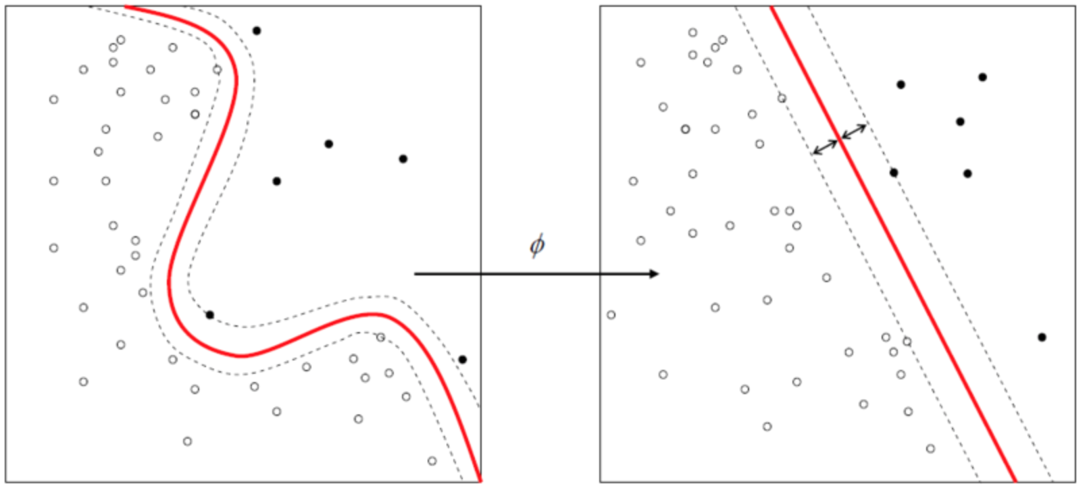
Support vector machines
Original attributes are mapped to a new space to obtain linear separability
Define a mapping φ(x) that maps each attribute of point x to a new space where points are linearly separable

Slide 11
Support vector machines
Original attributes are mapped to a new space to obtain linear separability
-
-
-
-
-
-
-
-
-
-
-
-
-
-
-
-
-
-
-
-
-
-
-
-
-
+
+
-
-
-
-
+
+
-
-
-
-
-
-
+
+
+
+
+
+
+
-
+
+
-
-
-
+
-
-
+
+
-
+
-
+
+
-
-
+
+
-
+
+
-
-
+
+
+
+
+
+
-
-
-
+
-
+
+
-
+
+
+
+
-
-
+
-
-
+
+
+
-
-
– the closest examples to the separating hyperplane
are called support vectors

Slide 12
Kernels
kernel function:
x₁ = (α₁, α₂) x₂ = (b₁, b₂)
Observation:
φ(x) can be quite complex, for example see above
Kernel trick:
Do not need to actually compute the vectors φ in the mapped space
Just need to identify a simple form of the dot product of the mapped values φ(x₁) and φ(x₂)

Slide 13
Kernels
kernel function:
polynomial kernels
Gaussian radial basis function
two-layer sigmoidal neural network
and many more including kernels for sequences, trees, …

Slide 14
Eager vs Lazy learners
Eager learners:
learn the model as soon as the training data becomes available
Lazy learners:
delay model-building until testing data needs to be classified

Slide 15
Rote Classifier
Memorizes the entire training data
When a test example comes and all its attribute values match those of a training example
it assigns it with the same class as that of the training sample
otherwise it cannot classify it

Slide 16
Rote Classifier
Drawbacks?
Needs to memorize the whole data
Cannot generalize!
Alternative: K-Nearest Neighbor Classifier

Slide 17
k-Nearest Neighbor Classification
Flexible version of the rote classifier:
find the k training examples with attributes relatively similar to the attributes of the test example
These examples are called the k-Nearest Neighbors
Justification:
“If it walks like a duck, quacks like a duck, and looks like a duck,
... then it’s probably a duck!”

Slide 18
k-Nearest Neighbor Classifiers
k-nearest neighbors of an example x are the data points that have the k smallest distances to x

Slide 19
k-Nearest Neighbor Classification
Given a data record x find its k closest points
Closeness: ?
An appropriate similarity measure should be defined
Determine the class of x based on the classes in the neighbor list
Majority vote
Weigh the vote according to distance d
e.g., weight factor, w = 1/d²

Slide 20
Characteristics of k-NN classifiers
No model building (lazy learners)
Lazy learners: computational time in classification
Eager learners: computational time in model building
Decision trees try to find global models, k-NN take into account local information
k-NN classifiers depend a lot on the choice of proximity measure

Slide 21
The Real World
Sec. 15.3.1
Gee, I’m building a classifier for real, now!
What should I do?
How much training data do you have?
None
Very little
Quite a lot
A huge amount and its growing

Slide 22
How many categories?
Sec. 15.3.2
A few (well separated ones)?
Easy!
A zillion closely related ones?
Think: Yahoo! Directory, Library of Congress classification, legal applications
Quickly gets difficult!
Classifier combination is always a useful technique
Voting, bagging, or boosting multiple classifiers
Much literature on hierarchical classification
E.g., Tie-Yan Liu et al. 2005
May need a hybrid automatic/manual solution

Slide 23
Model Evaluation

Slide 24
Model Evaluation
Metrics for Performance Evaluation
How to evaluate the performance of a model?
Methods for Model Comparison
How to compare the relative performance of different models?

Slide 25
Metrics for Performance Evaluation
Focus on the predictive capability of a model
rather than how fast it takes to classify or build models, scalability, etc.
Confusion Matrix:
 | PREDICTED CLASS
ACTUAL CLASS |  | Class=Yes | Class=No
 | Class=Yes | a: TP | b: FN
 | Class=No | c: FP | d: TN
a: TP (true positive)
b: FN (false negative)
c: FP (false positive)
d: TN (true negative)

Slide 26
Accuracy
Most widely-used metric:
 | PREDICTED CLASS
ACTUAL CLASS |  | Class=Yes | Class=No
 | Class=Yes | a (TP) | b (FN)
 | Class=No | c (FP) | d (TN)

Slide 27
Limitation of Accuracy
Consider a 2-class problem
Number of Class 0 examples = 9990
Number of Class 1 examples = 10
One solution:
A model that predicts everything to be Class 0
Accuracy: 9990/10000 = 99.9 % ☺
Anything went wrong?
Accuracy is misleading because model does not detect any class 1 example

Slide 28
Cost Matrix
 | PREDICTED CLASS
ACTUAL CLASS | C(i|j) | Class=Yes | Class=No
 | Class=Yes | C(Yes|Yes) | C(No|Yes)
 | Class=No | C(Yes|No) | C(No|No)
C(i|j): Cost of misclassifying class j example as class i

Slide 29
Computing Cost of Classification
Cost Matrix | PREDICTED CLASS
ACTUAL CLASS | C(i|j) | + | -
 | + | -1 | 100
 | - | 1 | 0
Confusion matrix: Model M₁ | PREDICTED CLASS
ACTUAL CLASS |  | + | -
 | + | 150 | 40
 | - | 60 | 250
Confusion matrix: Model M₂ | PREDICTED CLASS
ACTUAL CLASS |  | + | -
 | + | 250 | 45
 | - | 5 | 200
Accuracy = 80%
Accuracy = 90%
Cost = 150*(-1) +40*(100)+60*(1) + 250* (0) = 3910
Cost = 4255

Slide 30
Cost vs Accuracy
Confusion Matrix | PREDICTED CLASS
ACTUAL CLASS |  | Class=Yes | Class=No
 | Class=Yes | a | b
 | Class=No | c | d
Accuracy is proportional to cost if
C(Yes|No) = C(No|Yes) = q
C(Yes|Yes) = C(No|No) = p
Let N = a + b + c + d
Then,
Accuracy = (a + d) / N
Cost = p (a + d) + q (b + c)
= p (a + d) + q (N – a – d)
= q N – (q – p)(a + d)
= N q – N (q – p)(a + d)/N
= N [q – (q – p) (a + d)/N]
= N [q – (q – p) × Accuracy]
Cost Matrix | PREDICTED CLASS
ACTUAL CLASS |  | Class=Yes | Class=No
 | Class=Yes | p | q
 | Class=No | q | p

Slide 31
Cost-Sensitive Measures
What fraction of the positively classified samples is actually positive
What fraction of the total positive samples is classified correctly
Harmonic mean of precision and recall
 | PREDICTED CLASS
ACTUAL CLASS |  | Class=Yes | Class=No
 | Class=Yes | a: TP | b: FN
 | Class=No | c: FP | d: TN

Slide 32
Methods for Performance Evaluation
How to obtain a reliable estimate of performance?
Performance of a model may depend on other factors besides the learning algorithm:
Class distribution
Cost of misclassification
Size of training and test sets

Slide 33
Methods of Estimation
Holdout
Reserve 2/3 for training and 1/3 for testing
Random subsampling
Repeated holdout
Cross validation
Bootstrapping

Slide 34
Cross validation
Partition data into k disjoint subsets
k-fold:
train on k-1 partitions
test on the remaining one
Each subset is given a chance to be in the test set
Performance measure is averaged over the k iterations
Original Data
training set
test set
1
2
3
…
k-1
k

Slide 35
Cross validation
Partition data into k disjoint subsets
k-fold:
train on k-1 partitions
test on the remaining one
Leave-one-out Cross validation
Special case where k=n (n is the size of the dataset)
Original Data
training set
test set
1
2
3
…
k-1
k

Slide 36
Bootstrapping
Samples the given training examples uniformly with replacement
each time a example is selected, it is equally likely to be selected again and re-added to the training set
Several boostrap methods available in the literature
A common one is .632 bootstrap

Slide 37
.632 bootstrap
Data set: n examples
Sample data set n times with replacement
Result: training set of n examples
Test set: data examples that did not make it to the training set
63.2% of the original data will end up in the bootstrap and 36.8% will form the test set
Procedure is repeated k times

Slide 38
.632 bootstrap
Chance that an instance will not be picked for the training set:
Probability to be picked each time: 1 / n
Probability not to be picked: 1 – 1 / n
Probability NOT to be picked after n times:
(1 – 1/n)^{n} = e⁻¹ = 0.368

Slide 39
ROC (Receiver Operating Characteristic)
Developed in 1950s for signal detection theory to analyze noisy signals
Characterize the trade-off between positive hits and false alarms
ROC curve plots TPR (or sensitivity) (on the y-axis) against FPR (or 1-specificity) (on the x-axis)
 | PREDICTED CLASS
Actual Class |  | Yes | No
 | Yes | a (TP) | b (FN)
 | No | c (FP) | d (TN)

Slide 40
ROC (Receiver Operating Characteristic)
Performance of each classifier represented as a point on the ROC curve
changing the threshold of algorithm, sample distribution, or cost matrix => changes the location of the point

Slide 41
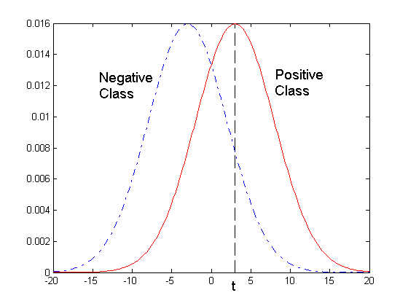
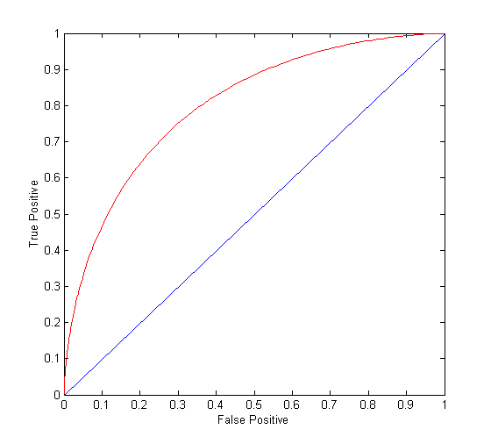
ROC Curve
- 1-dimensional data set containing 2 classes (positive and negative)
- any point located at x > t is classified as positive
At threshold t:
Rates TP=0.5, FN=0.5, FP=0.12, FN=0.88

Slide 42
ROC Curve
(TPR,FPR):
(0,0): declare everything to be negative class
(1,1): declare everything to be positive class
(1,0): ideal
Diagonal line:
Random guessing
Below diagonal line:
prediction is opposite of the true class
 | PREDICTED CLASS
Actual Class |  | Yes | No
 | Yes | a (TP) | b (FN)
 | No | c (FP) | d (TN)

Slide 43
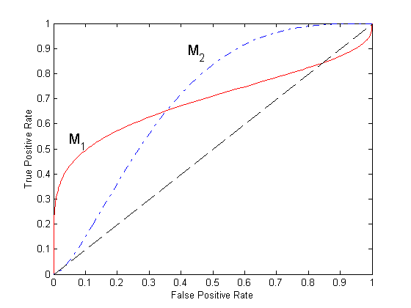
Using ROC for Model Comparison
No model consistently outperforms the other
M₁ is better for small FPR
M₂ is better for large FPR
Area Under the ROC Curve
Ideal:
Area = 1
Random guess:
Area = 0.5

Slide 44
How to Construct a ROC curve
Instance | P(+|A) | True Class
1 | 0.95 | +
2 | 0.93 | +
3 | 0.87 | -
4 | 0.85 | -
5 | 0.85 | -
6 | 0.85 | +
7 | 0.76 | -
8 | 0.53 | +
9 | 0.43 | -
10 | 0.25 | +
Use classifier that produces posterior probability for each test instance P(+|A)
Sort the instances according to P(+|A) in decreasing order
Apply threshold at each unique value of P(+|A)
Count the number of TP, FP, TN, FN at each threshold
TPR = TP/(TP+FN)
FPR = FP/(FP+TN)

Slide 45
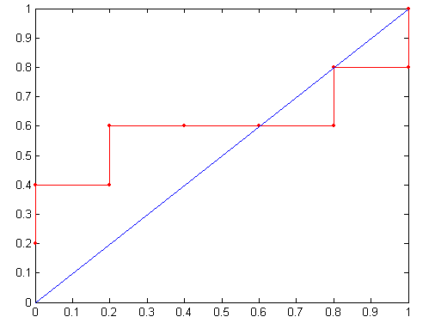
How to construct a ROC curve
Threshold >=
ROC Curve:

