Slide 1

An overview of projects Øystein Nytrø is working on
Notes:
Problemer i domenet. Et helsessytem er et informasjonssystem.
Problemer i forskningsfeltet.
NSEP som en kanal til teknologiske miljø. NSEP som en møteplass og arena.

Slide 2

Evidence- and knowledge based practice with decision support systems by Hans Moen, Laura Slaughter & Øystein Nytrø
with SI HF, OUS HF, Ahus HF,
DIPS ASA, HØKH, Sykehuspartner AS, Datakvalitet AS,
IDI@NTNU, Norw. Knowl. Ctr. For health, Natl. Health library

Slide 4
Real care
Pathways, Guidelines
Operational procedures
The patient plan
Documented practice

Slide 5
Objectives of Evicare
0. develop methods and technology for providing “Evidence-Based Medicine” (EBM) at the point of care, integrated with an electronic health record (EHR) or other health infor­mation systems directly involved in the clinical process, resulting in higher quality of care and a more detailed, transparent documentation of care processes.
Practical guidelines at point of care (ie. in CPR)
Insight into care practice, for clinician and patient
Practice-driven guideline review and grounding
Structural models (GL – Process – Patient trajectory)
National and local maintenance and administration of guidelines

Slide 6
Towards usability…
Difficult:
Authoring
Representation
Reasoning
Presentation
Uptake
Effect

Slide 7
So:
A lean infrastructure for clinical decision support in-the-large

Slide 8
Lean
Minimal, non-invasive, stepwise:
Relying on text data in
  record content
  recommendations
Search-like interface
Ranked list of opportunities
Avoid hard medical /organizational challenges
Small, mundane, important, but low-risk!
A Lean
Infrastructure for
Clinical
Decision support
in-the-large

Slide 9
In-the-… outside the lab
In a narrow domain, or two,
infection-susceptible patients (central venous catheterization)
prevention of deep venous thrombosis
take it all the way with real actors, in real systems, services, and… hopefully, in future projects, do research, improve, evaluate, innovate.
A Lean
Infrastructure for
Clinical
Decision support
in-the-large

Slide 10
Problems with formalized knowledge:
Maintaining
Evolving semantics
Localization
Fit to concrete case
From intention to action
Data quality and availability
Text is efficient and immediately available

Slide 11
What we do:
Structured guideline authoring with semantic tagging
Extraction of patient state from health record
Development of ontologies for bridging care act documents and care guidelines.
User interfaces recommendations.
Matching guidelines to computerized order sets.
Multi-tier architecture for guideline/plan/recommendations.
IE, IR, NLP, KR, ML, MMI, Eval, CDSS

Slide 13
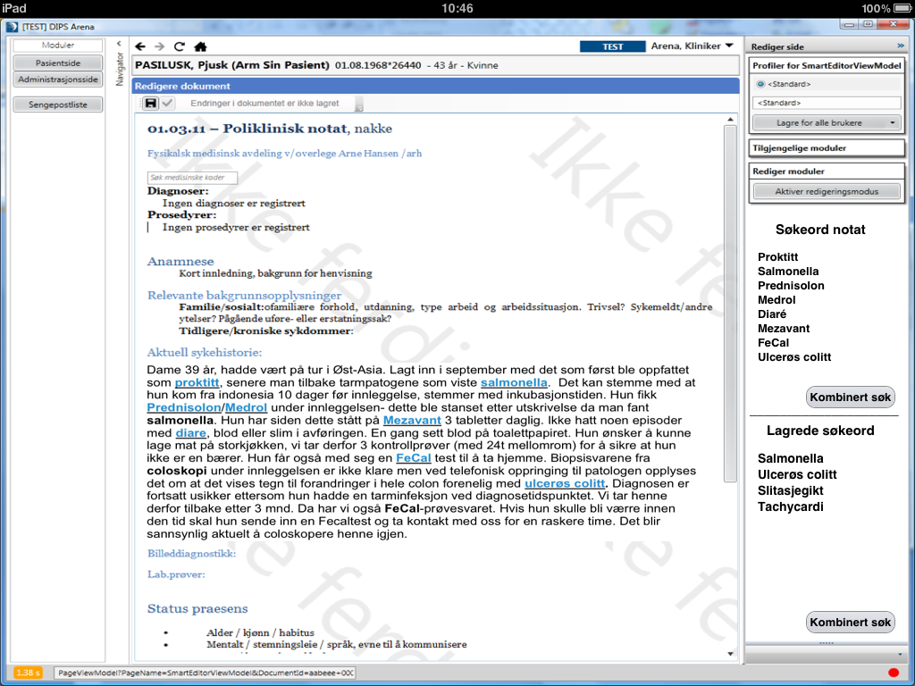

Slide 14
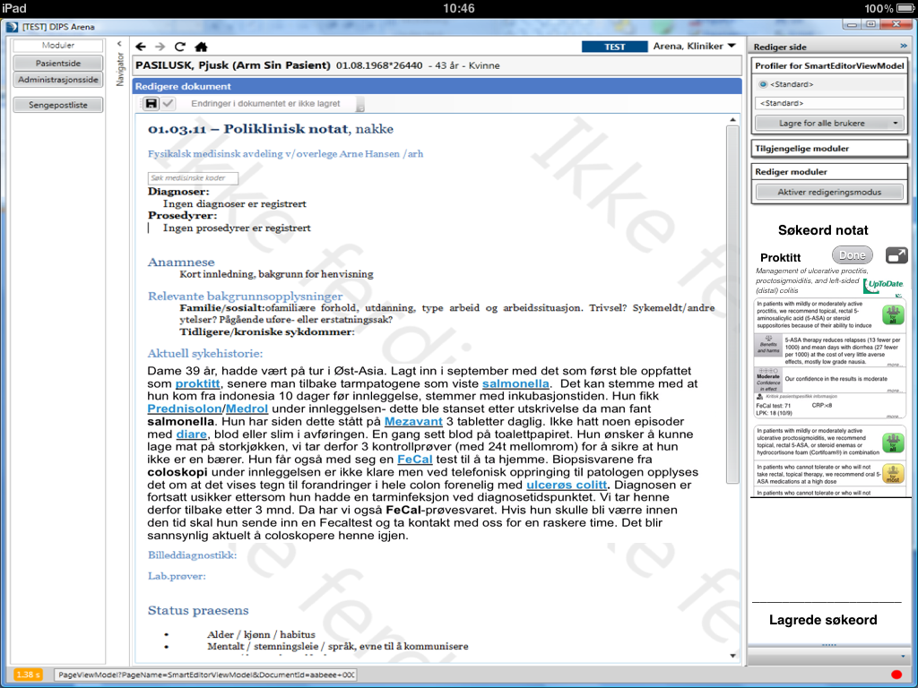
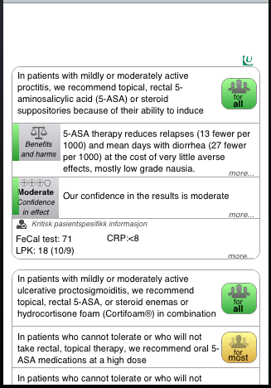

Slide 15
EviCare & NLP
Investigate the use of methods from NLP in applications aimed at supporting clinical work
Intended as possible extensions to EHR system
– DIPS ASA, participant in EviCare

Slide 16
Summarize health records
Goal:
Assist clinicians in getting an overview of the content in a health record (at the “point-of-care”)
How:
Present a subset of the text by using methods from the field of automatic text summarization
  Textual extracts
  Represents a possible interface for further search/navigation in the clinical notes by the user

Slide 17
Summarize health records (cont.)
Methods:
Mainly statistical based methods: VSM
Supplied with some domain knowledge:
  Now: Medical/clinical dictionaries, linked to a.o.t. ICD-10
  Later: C2PO

Slide 18
Automatically rank recommendations from clinical practice guidelines
Goal:
Present one or more (ranked) recommendations based on the content in a health record
How:
Use the “summaries” as search query, or context for the search query, to the guideline repositories

Slide 19
Automatically rank recommendations in clinical practice guidelines (cont.)
Methods:
Regexp based search mixed with statistical based methods for doing information retrieval
Attempting to rank the various sections in the guidelines according to:
  the content selected by the summary, or
  free-text search by the user, applying the summary as context

