Slide 1
Evicare: Guideline Representation
Goal:
Create a knowledge base that contains guideline content (recommendations) on one topic, CVC infections
Create some interesting search/browse tools for connecting guideline content with record content
Ontologies
C2PO, D-acts are used to annotate the guideline documents in the knowledge base + specific terminologies
CVK ontology used for annotations of records

Slide 2
Evicare Approach: Guideline Representation
Different approach from past methods
Specifying what should be done step-by-step
Guideline representation languages, e.g. GLIF
Instead, provide tools for exploring, searching the documents
Testing use of ontologies, capturing domain knowledge
Providing better search, browsing tools

Slide 3
Construction of C2PO
Purpose of C2PO
provides an ontological representation (a set of classes and axioms) allowing for reasoning about content of guidelines
http://code.google.com/p/c2po/
Purpose of D-acts
relies on the notion of document acts, a theory that describes what actions are based documents
provides an ontological representation of document acts to be used on information systems integration
http://code.google.com/p/d-acts/

Slide 4
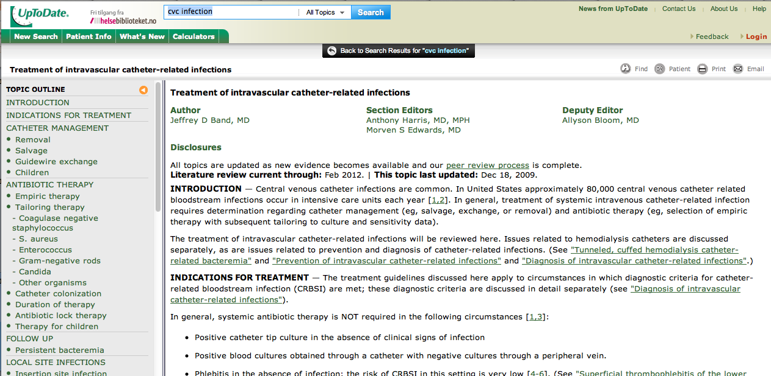
Instance-of
document
Following diagnosis of catheter-related infection, catheter removal is appropriate in the setting of severe sepsis, hemodynamic instability, suppurative thrombophlebitis, endocarditis, or persistent bacteremia after 72 hours of antimicrobial therapy to which the organism is susceptible.
Instance-of
document proposition

Slide 5
document proposition
(child class relation)
recommendation statement
is_about
is_about
patient state (situation)
suggested behavioral reaction
These statements are about concrete things in reality….
Patient state (situation) concerns: symptoms, on-going treatment, specific diagnoses, etc.
Suggested behavioral reaction concerns: monitoring patients, prescribing drugs, administering drugs, taking patient for further tests, etc.

Slide 6
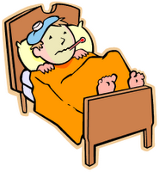
Current patient situation (state):
patients with a first VTE that is an unprovoked proximal DVT of the leg, and
who have a high risk of bleeding
(first) VTE (Venous thromboembolism) [disorder]
(unprovoked proximal) DVT = [disorder]
(of the) leg = [site]
(high risk of) bleeding = [sign/finding]
Document
[person] (in role as patient)
Real Life
experiences
[disorder]
at_location
[site]
at_risk_for
[sign/finding]

Slide 7
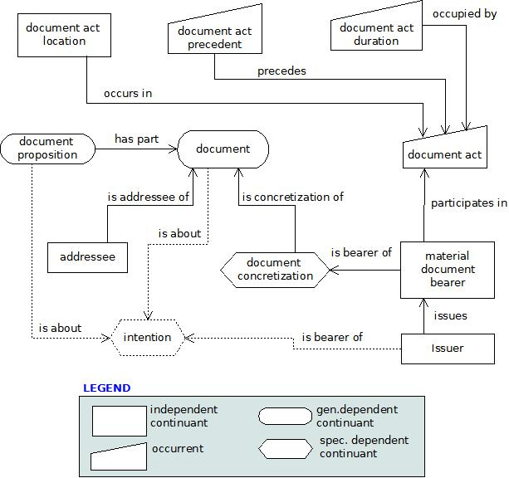
Figure 1. Classes created in d-act and their relations

Slide 8
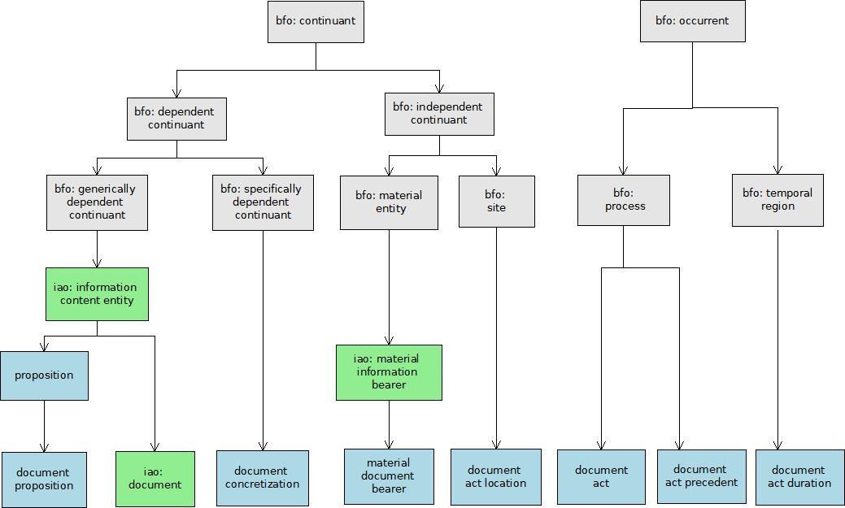
Figure 2. Building d-act based on BFO and IAO (Arrows representing is superclass relations)

