Slide 1
Danielle Mowery MS
Review of Preliminary Thesis Work for Problem List Generation and Interlock Project
Visiting PhD student| University of California San Diego
Primary Appointment PhD student| University of Pittsburgh
Biomedical Informatics
Thesis advisor: Wendy Chapman PhD

Slide 2
What is a problem list?
Dr. Lawrence Weed:
Problem-oriented medical record: def. confirmed diagnoses and unexplained problems with all relevant information for medical decision making.
Center for Medicare & Medicaid Services:
Meaningful Use Stage 1 Core Objective: def. current and active diagnoses…or an indication that no problems are known for the patient..
Joint Commission:
Elements of Performance for IM.6.40: def. significant diagnoses, drug allergies, procedures, and medications.
HL7:
Function PH.2.5.1 (Manage Problem Lists): def. chronic conditions, diagnoses, allergies, or symptoms, both past and present, as well as functional status, including date of onset, changes, and resolution…entire problem history for any problem
Simple
Complex

Slide 3
Why is keeping track of problems a problem?
Implications of patient and problem list mismatch:
 | Patient: Problem + | Patient: Problem -
Problem list: Problem + |  | Redundant & unnecessary treatment Increased cost of care Adverse medical events
Problem list: Problem - | Missed treatment opportunity Missed clinical trial inclusion Underestimate patient risk

Slide 4
How can natural language processing (NLP) help?
Enrich the completeness of the problem list by suggesting problems
Meystre and Haug. 2008. Randomized controlled trial of an automated problem list with improved sensitivity. International Journal of Medical Informatics. 77. 602–612.
Check the accuracy of the existing problem list in conjunction with medication lists prior to sign off or transfer
Carpenter et al. 2002. Using medication list – problem list mismatches as markers of potential error. AMIA Annual Symposium Proceedings. 106-110.
Provide a richer, more-detailed account of the problem over time and space
Bui et al. 2004. Automated medical problem list generation: towards a patient timeline. Stud Health Technol Inform. 107(Pt 1):587-91.
Bashyam et al. 2009. Problem-centric organization and visualization of patient imaging and clinical data. Radiographics. 29:331–343.

Slide 5
What are common steps using NLP to generate the problem list?
Who?
What?
When?
Where?
How?
If?
Step 1) Identifying problems
Step 2) Identifying context
of problem mentions
Active
Active
Active
Inactive
Step 3) Reconciling same mentions and episodes of problems
Step 4) Organizing and filtering

Slide 6
What are common steps using NLP to generate the problem list?
Who?
What?
When?
Where?
How?
If?
Step 1) Identifying problems
Step 2) Identifying context
of problem mentions
Active
Active
Active
Inactive
Step 3) Reconciling same mentions and episodes of problems
Step 4) Organizing and filtering

Slide 7
What contextual information could be used to classify problems in a problem list?
Active, Inactive, Resolved, Proposed, Historical
Experiencer - who is experiencing the problem: patient or other
Existence – did the problem ever occur: yes or no
Certainty – what certainty level of existence: high, moderate, low, unmarked
Mental State – any mental postulation about problem: yes or no
Generalized or Conditional – is problem stated with modality: yes or no
Change – what (if any) state associated: unmarked, improving, worsening, etc.
Intermittency – is the problem intermittent: yes, no, or unmarked
Relation to Current Visit – interval relative to encounter: before, after, etc.
Start Relative to Current Visit – magnitude & units of start before encounter
Department of Biomedical Informatics

Slide 8
What contextual information could be used to classify problems in a problem list?
Active, Inactive, Resolved, Proposed, Historical
Who?
Experiencer - who is experiencing the problem: patient or other
If?
Existence – did the problem ever occur: yes or no
Certainty – what certainty level of existence: high, moderate, low, unmarked
Mental State – any mental postulation about problem: yes or no
Generalized or Conditional – is problem stated with modality: yes or no
How?
Change – what (if any) state associated: unmarked, improving, worsening, etc.
Intermittency – is the problem intermittent: yes, no, or unmarked
When?
Relation to Current Visit – interval relative to encounter: before, after, etc.
Start Relative to Current Visit – magnitude & units of start before encounter
Department of Biomedical Informatics

Slide 9
“I think its highly likely the patient had flu.”
Proposed
Who?
Experiencer - who is experiencing the problem: patient
If?
Existence – did the problem ever occur: yes
Certainty – what certainty level of existence: high
Mental State – any mental postulation about problem: yes
Generalized or Conditional – is problem stated with modality: no
How?
Change – what (if any) state associated: unmarked
Intermittency – is the problem intermittent: unmarked
When?
Relation to Current Visit – interval relative to encounter: before
Start Relative to Current Visit – magnitude & units: not clear
Department of Biomedical Informatics

Slide 10
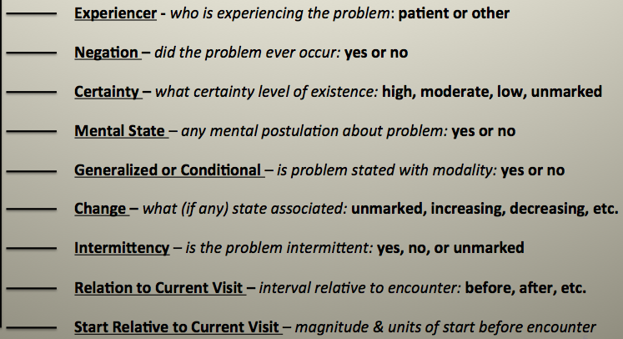
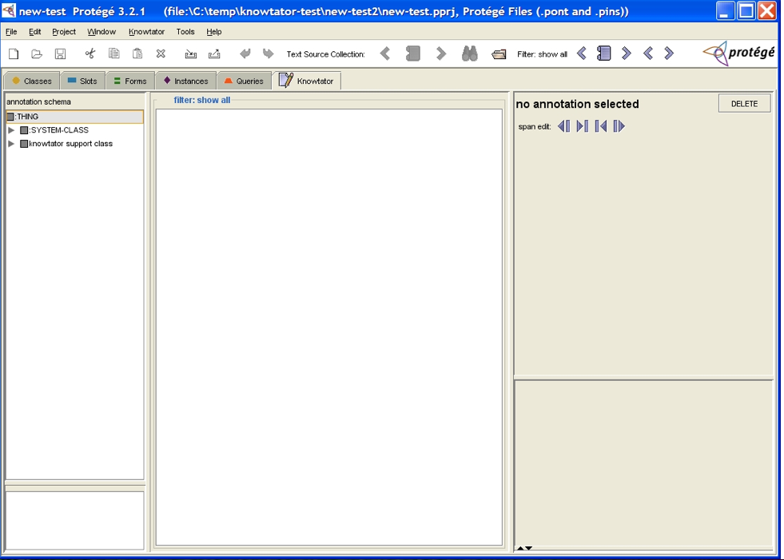
Experiment workflow
1) Recruitment phase
recruit annotators
+
Annotate?
n=6 medical students
n=4 non-medical students
2) Training phase
train problem schema
train annotation tool
+
3) Annotation phase
annotate problems using schema & tool
n=30 de-identified ED reports with 283 problems

Slide 11
Annotation performance metrics
1) How well do annotators annotate contextual information about problems?
Cohen’s kappa: def. percent agreement taking into account chance agreement
A_{O}-A_{E}
1-A_{E}
2) How many annotators do we need to reliably annotate contextual information about problems?
Generalizability coefficient: def. inference based on the computed between-subject variance used to predict the number of annotators needed to reliably annotate an observation.
Kappa and coefficient threshold = 0.7

Slide 12
How well did annotators annotate contextual information about problems?
Average IAA with Range
12

Slide 13
How well did annotators annotate contextual information about problems?
Average IAA with Range
13

Slide 14
How well did annotators annotate contextual information about problems?
Average IAA with Range
14

Slide 15
How many annotators do we need to reliably annotate contextual information about problems?

Slide 16
How many annotators do we need to reliably annotate contextual information about problems?
experiencer
existence

Slide 17
How many annotators do we need to reliably annotate contextual information about problems?
experiencer
existence
certainty
mental state
relation to current visit change

Slide 18
How many annotators do we need to reliably annotate contextual information about problems?
experiencer
existence
certainty
mental state
relation to current visit change
intermittency

Slide 19
How many annotators do we need to reliably annotate contextual information about problems?
experiencer
existence
certainty
mental state
relation to current visit change
generalized or conditional
intermittency

Slide 20
Lessons learnt from our study
Well understood and studied problem attributes like experiencer and existence can be annotated accurately and reliably
Other attributes like certainty and temporality require more study and resources
These attributes may prove more difficult to automate
Department of Biomedical Informatics

Slide 21
Future work: Investigating how to integrate Steps 1, 2, and 3 to accurately generate Step 4?
Who?
What?
When?
Where?
How?
If?
Step 1) Identifying problems
Step 2) Identifying context
of problem mentions
Active
Active
Active
Inactive
Step 3) Reconciling same mentions and episodes of problems
Step 4) Organizing and filtering
Department of Biomedical Informatics

Slide 22
Stockholm University Academic Initiative: Interlock Project
Aim 1) characterizing negation and uncertainty expressions and the underlying intention in English and Swedish (BioNLP 2012)
Aim 2) porting and adapting an existing negation and uncertainty tagging application, pyConText, to Swedish

Slide 23
Stockholm University Academic Initiative: Interlock Project
Aim 1) characterizing negation and uncertainty expressions and the underlying intention in English and Swedish (BioNLP 2012)
Aim 2) porting and adapting an existing negation and uncertainty tagging application, pyConText, to Swedish

Slide 24
Expressions for negation and uncertainty
 | Certainly |  | Probably |  | Possibly
 | English | Swedish | English | Swedish | English | Swedish
Positive | <default> | <default> | likely suspect thought it was felt appears to have there was apparently most likely | förmodligen, troligen(probably) troligtvis, troligen (probably/likely) [mest] sannolikt ([most] probable) tecken på (signs of) oklar (unclear) | this is not unlikely rule out differential includes possible could possible be indicative of possible I think this is probably probable | möjlig[en|tvis], (possibly) eventuell, ev, möjlig (possible) misstanke [på] (suspicion [for]) skulle kunna vara (could be) kan [ej|inte] uteslutas (cannot be ruled out)
Negative | denies; denies any recent no; not has never had; has not had no further episodes of no prior episode stopped resolution of has abated resolved; resolves; had resolved clear; free unremarkable for evidence of | misstanke [om|för] (no suspicion for) ing[en|a] (no) inga hållpunkter för (no indication of) utesluter (rule out) | no suspicion for | ingen stark [klinisk]misstanke [om] (no strong clinical suspicion for) ej visar tecken på (does not show signs for) | am not convinced‡
Notes:
Table contains some lexical cues (not all) with relative position to problem mention. Lexical similarities between English and Swedish in red. Differences in black.

Slide 25
Negation and Uncertainty Taxonomy
Position of lexical cue
Opinion source
Evidence evaluation
pre-disorder
dictating physician
limits of evidence
intra-disorder
dictating physician with consultation
one diagnosis
post-disorder
evidence contradicts
other clinical care providers
evidence needed
evidence not convincing, but diagnosis asserted
patient
unknown
more than one diagnosis
differential diagnoses enumerated
limits in source
of evidence
non-clinical source
clinical source
test source
limitless possibilities
other
asserting dx or disorder as affirmed

Slide 26
“Likely upper GI bleed with elevated bun, but normal h and h.”
Position of lexical cue
Opinion source
Evidence evaluation
pre-disorder
dictating physician
limits of evidence
intra-disorder
dictating physician with consultation
one diagnosis
post-disorder
evidence contradicts
other clinical care providers
evidence needed
evidence not convincing, but diagnosis asserted
patient
unknown
more than one diagnosis
differential diagnoses enumerated
limits in source
of evidence
non-clinical source
clinical source
test source
limitless possibilities
other
asserting dx or disorder as affirmed

Slide 27
Stockholm University Academic Initiative: Interlock Project
Aim 1) characterizing negation and uncertainty expressions and the underlying intention in English and Swedish (BioNLP 2012)
Aim 2) porting and adapting an existing negation and uncertainty labeling application, pyConText, to Swedish

Slide 28
Questions?
Department of Biomedical Informatics

