Slide 1
EviCare (NLP)
Aid clinical work in hospitals using NLP:
“Summarize” health records
Select and rank recommendations from clinical practice guidelines
(Semi-)automatically
Intended as possible extensions to EHR systems
DIPS ASA, partner in EviCare

Slide 2
“Summarize” health records
Goal:
Assist clinicians in getting an quick overview of the content in a health record (at the “point-of-care”)
How:
Present a subset of the text by using methods from the field of automatic text summarization
Textual extracts with central information from one or more clinical notes
User-guided
Represents a possible interface for further search/navigation in the clinical notes by the user
Visualization (e.g. timeline)

Slide 3
“Summarize” health records (cont.)
Mainly statistical based methods
Supplied with domain knowledge:
Now: Medical/clinical dictionaries
(linked to MeSH, SNOMED-CT)
Later: Task specific annotations & C2PO
Knowledge-poor → knowledge-rich

Slide 4
Select and rank recommendations from clinical practice guidelines
Goal:
Present one or more (ranked) recommendations based on the content in a health record
How:
Use the “summaries” as search query, or context for the search query, to the guideline repositories

Slide 5
Select and rank recommendations from clinical practice guidelines (cont.)
Regexp based search mixed with statistical based methods for doing information retrieval/extraction
Attempt to rank the various sections in the guidelines according to:
only the content selected by the summary (i.e. previous medical history), or
free-text search by the user, applying the summary content as context
Mono-/cross-lingual
Cross-domain (?)

Slide 6
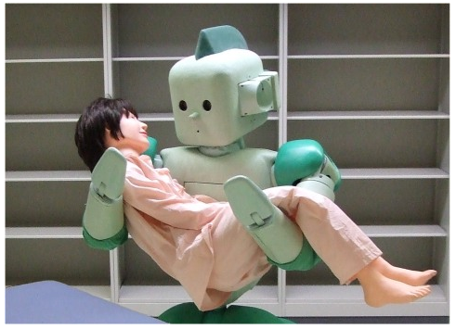
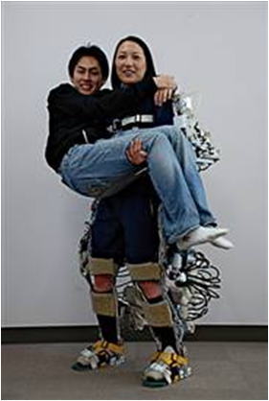
EviCare?
http://images.gizmag.com/gallery_lrg/riba-robot-nurse-0.png
http://1.bp.blogspot.com/_xA2nBrEVAhA/S7ImwBk0kQI/
AAAAAAAAAC4/zuxZngx5ong/s1600/powerassist.png

Slide 7
Questions?

